Slide 1
Graphics
Part IV

Slide 2
Background Images
If used carefully, they can enhance the look of the page.
But, they take extra time to load (while using just a background color does not).
Make sure the download hit is worth it.
Busy backgrounds are rarely a good thing; is that where we really want to direct the visitor’s focus?

Slide 3

Background Images
If you use background images, they should be
  Low contrast, like a watermark effect.
Text shows up well on a low-contrast background.

Slide 4
Background Images
  High contrast images have both light and dark areas, which makes light text hard to read in some areas and dark text hard to read in others.
  Can transform a high-contrast image into a low-contrast image by…
    Overlaying with a semi-transparent white, black, or color.
    Playing with levels and color saturation controls.

Slide 5
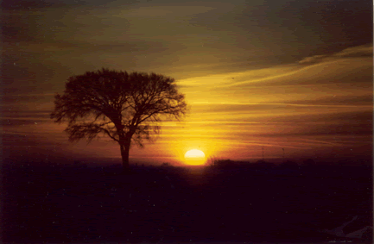
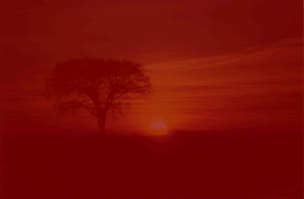

Background Images
Hard to read because of dark on dark
Hard to read because of light on light or…
Can read easily
Can read easily
overlaid with semi-transparent red
levels adjusted to lower contrast

Slide 6

Background Images
Text on high contrast images is problematic:

Slide 7
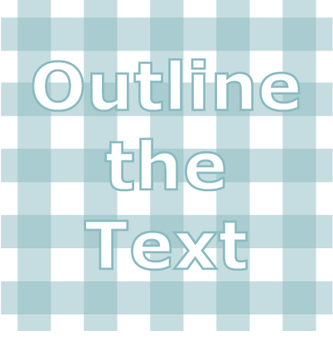
Background Images
If you must insist upon using a high contrast background, outline text or edge it with a shadow or glow:

Slide 8
Background Images
Remember, the outline technique works only on images, though, not HTML text.

Slide 9
Background Images
Three types of background images:
  Tiled
  Full-screen
  Partial

Slide 10
Background Images: Tiled
Tiled background image: using a small background image that tiles repeatedly to fill the entire background.
  Good: smaller images usually download faster than a full-screen background image.
  Still, don’t make the graphic very tiny, say 4 pixels high by one pixel wide –it takes forever for the browser to fill the screen.
    Instead, perhaps 100 x 100 pixels.
Notes:
WPTS p.81 – directions for Photoshop.

Slide 11
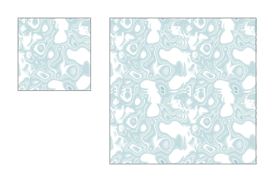
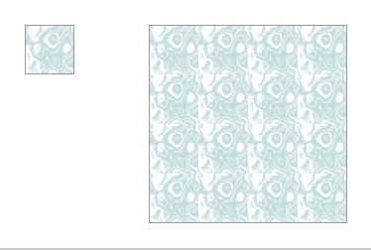
Background Images: Tiled
Textured tiles are popular, and easy to create in Fireworks and Photoshop.
  In Fireworks, most textures tile seamlessly at 100 x 100 pixels.
100x100 pixels – no seams
25x25 pixels – seams show
Notes:
WPTS p.81 – directions for Photoshop.

Slide 12

Background Images: Tiled
Gradients are another background option (one direction only, not diagonally):
Notes:
WPTS p.81 – directions for Photoshop.

Slide 13

Background Images: Tiled
Subtle horizontal stripes, maybe 2-5 pixels high:
Notes:
WPTS p.81 – directions for Photoshop.

Slide 14
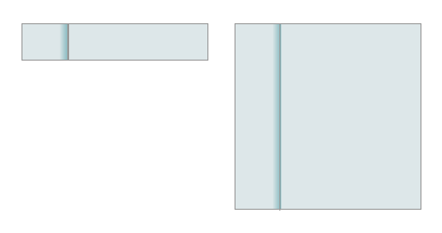
Background Images: Tiled
A background that seems to section off the page:
Notes:
WPTS p.81 – directions for Photoshop.

Slide 15
Background Images: Tiled
  To make your own freehand seamless tile…
Notes:
WPTS p.81 – directions for Photoshop.

Slide 16


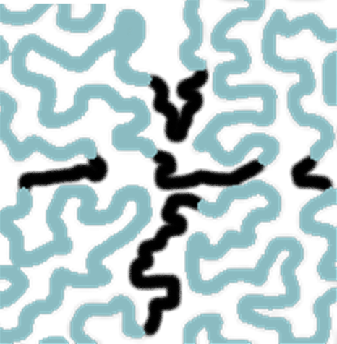

Background Images: Tiled
Create a single image, in this case 100 by 100 pixels, then cut into quarters.
Switch the four quadrants diagonally.
Fill the center gaps manually (black just for reference).

Slide 17

Background Images: Tiled
Final version of tile.
When tiled (black lines for reference).

Slide 18
Background Images: Full Screen
A full-screen image can be huge and delivers the worst download hit.
Also, you don’t know just how big a visitor’s screen might be -- very hard to make an image that doesn’t tile in an ugly way on a big screen while not looking truncated on a small screen.

Slide 19
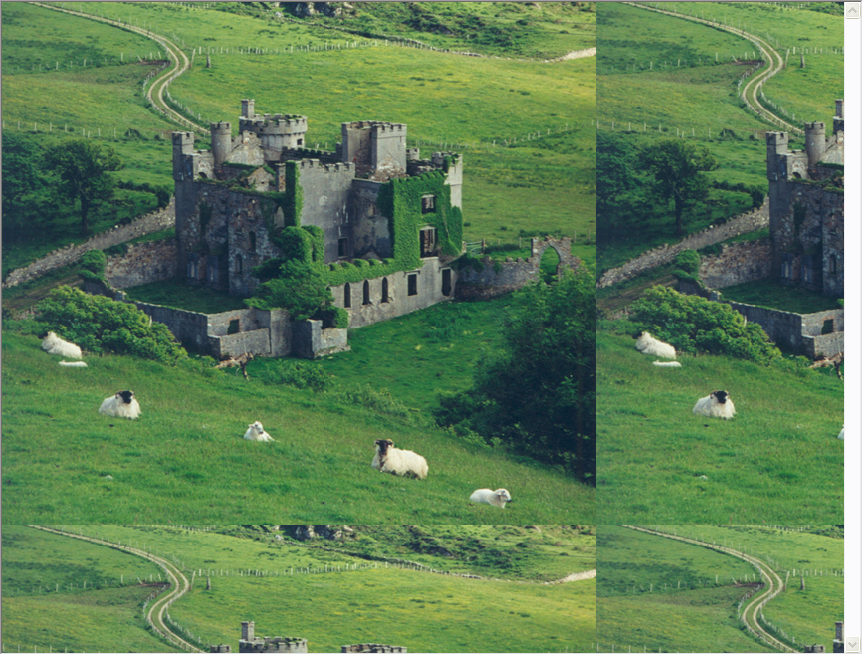
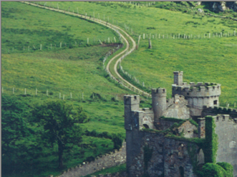
Background Images: Full Screen
image too small
image too big

Slide 20
Background Images: Full Screen
Make the image at least 1600 pixels wide – that will fill most display windows.
Also make sure the image still looks good when truncated at 640 pixels, the size of low-res monitors (easier said than done).
  Best if an abstract design, not a photo?

Slide 21
Background Images: Full Screen
To turn off background image scrolling with CSS:
  body {background-image(someImage.gif);
  background-attachment:fixed;}
  Downside: text scrolls over a fixed background and may scroll over an area where it blends in.

Slide 22
Background Images: Full Screen
Again, one way to minimize the size of a large background image: use a watermark type of GIF – only a couple of colors, with few lines and shapes so that it is still a small file.

Slide 23
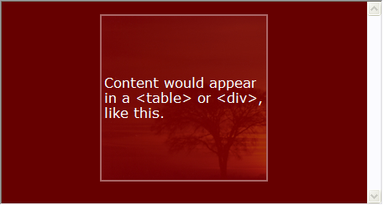
Background Images:
Partial Background Images
Use a table or div to specify the exact width (say, 750 pixels) of the content.
  Put the background image only in the table/div, with a background color around it.

Slide 24
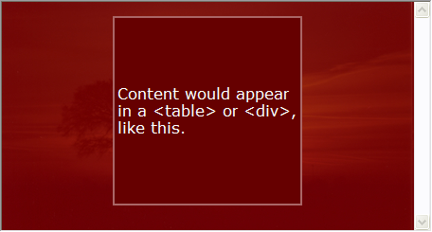
Background Images:
Partial Background Images
Or,
  Put the image only in the background, with a background color under the content (preferred for legibility).

Slide 25
Background Images:
Partial Background Images
Can position a single copy of the image in the background, without using tables or divs:
  body {background-image(someImage.gif); background-repeat: no-repeat;
  background-position: center 20px;}
  This centers the image horizontally and drops it down 20 px from the top.

Slide 26
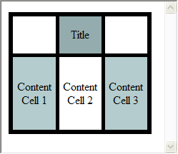
Background Images:
Partial Background Images
An alternative to a background image, using borders and background colors for table cells or divs:

Slide 27

Graphics Odds and Ends
Think in pixels, not inches.
Employ visual echoes:
  Repeat an element from the logo elsewhere on the page. Example:
Use the dingbat on the “i”s as bullets elsewhere.

Slide 28
Graphics Odds and Ends
  Choose a color from the logo or other image on the page to repeat elsewhere, such as on bullets, headers, links, borders, or backgrounds.
  Use a consistent mood:
    Not cartoony in some areas, realistic in others.
    Not spiky and sharp in some places, smooth and curvy in others.

Slide 29
Graphics Odds and Ends
Avoid www cliches, like spinning globes.
  Works for an airline or NASA, but not for most other sites.
  Also avoid spiders, webs, and folding envelopes for email links.

Slide 30
Graphics Odds and Ends
Borders on images:
  Early days on the web: thick, clunky, default border colors.
  Later, image borders were considered dated and eliminated entirely.
  Back in style again, but this time very tiny (1px) and graceful. Often black, but can be other colors as well.
  Borders use the HTML default text and link colors unless you change with CSS.

Slide 31
Graphics Odds and Ends
Use Dreamweaver to create remote mouseovers (changing a remote image):
  Insert > Image Objects > Rollover images.
  Answer all of the questions, including URLs for the two images and “#” for the “go to URL.”
  Move the <img /> tag from within the resulting <a> tag to the area on the page where the rollover image should actually render.
  Replace the removed image in the <a> tag with the text or image serving as the rollover trigger.

Slide 32
Graphics Odds and Ends
Make sure to use the alt parameter of the <img> tag, so that text can display when an image link is broken or when a browser won’t display graphics. Also:
  Displays on mouseover.
  Is read by screen readers.
  Is indexed by search engines.

Slide 33
Graphics Odds and Ends
Careful with cutesy; for instance, smiley faces are appropriate only if you are creating a web site for kindergarteners.

Slide 34
Graphics Odds and Ends
Don’t use graphics as dividers when a plain rule <hr> will do.
  Save the bandwidth for killer graphics – don’t waste it on a shaded bar.

Slide 35
Graphics Odds and Ends
Choose image file names by function, not visual attributes, because visual attributes may change in the future:
  Bad: blueButton.gif
  Good: goButton.gif

Slide 36
Graphics Odds and Ends
Alternatives to graphics:
  Text links, with specifications for active and hover links (can do hover in CSS, not in HTML).
  Javascript to change the cell background color on mouseover.
  Use CSS instead of JavaScript to make a rollover button (other ways, too):
    http://www.elated.com/articles/css-rollover-buttons/

Slide 37
Graphics Odds and Ends
Alternatives to graphics:
  Separating areas of the page with different colored backgrounds using table cells.
  <hr>
  HTML bullets.

Slide 38
Graphics Resources
www.istockphoto.com and www.veer.com Really good, cheap images ($1-15 each, generally)
www.photodisc.comG Really good but expensive images.
www.photorogue.com/ You request a photo, and volunteers may (or may not) offer you a photo to use for free. Worth a shot.

Slide 39
Graphics Resources
http://www.sxc.hu/ free images.
http://www.pexels.com free images, but as of August 2014, not very many to choose from.

Slide 40
Animation

Slide 41
Animation
Pros: It’s great fun and adds pizzazz to the site.
Cons:
  Greatly increases download times.
  Some animation formats require installation of a free player.
    Flash is included in all modern browsers, however.
    Always offer the option to skip the download.

Slide 42
Animation
Use with restraint; if you have more than one animation on a page, you probably have too many.
Frame: a single drawing within an animation (called a cell in traditional animation).
Keyframe: the beginning or ending of a path of motion.
  A bouncing ball would have a keyframe at the top of the bounce and another one at the bottom of the bounce.

Slide 43
Animation
Tweening: the process of creating the “in between” frames between two keyframes.
  Most animation-editing programs can tween automatically, interpolating the charactaristics between two keyframes.
  Tell the program, “I want 10 tweens between the top of the bounce and the bottom.”
  Tweening for motion, color, size, or shape.
  The more tweens, the smoother the animation.
    Jerky animation (fewer tweens) is popular these days, e.g. South Park

Slide 44
Animation
Onion skinning: showing all the frames and objects at once, rather than just the current frame.
Looping: specifying the number of times to replay the animation.
  Generally, endless looping is endlessly annoying.

Slide 45
Animation Formats
Three common animation formats…
JavaScript effects: beyond the scope of this book.
  Free animation scripts at www.javascriptsource.com.

Slide 46
Animated GIF
Animated GIFs: multiple GIF images stacked on top of each other, played in sequence to approximate movement.
  Bitmapped format, so every pixel in every frame must be specified and rendered, leading to larger file sizes.
  Files can be very small or very big, depending upon how many GIF cells are used and how big each one is.

Slide 47
Animated GIF
  Create in any good graphics program, like Fireworks.
  Embed with a standard <img> tag – animation and looping specifications are embedded in the animation itself upon save, so nothing special in the HTML.

Slide 48
Flash
Vector-based, so shapes defined, not pixels.
Smaller files sizes than the equivalent animated GIF.
Resizes beautifully, like all vector graphics.
Flash player was embedded on virtually all browsers for years, until the recent fight with Apple. Now, all bets are off.
  Good article about exporting Flash animation to an animated gif: http://www.trifoxdesigns.com/news/?p=47

Slide 49
Flash
Flash player is free, but Flash image editors (the Flash program from Adobe, for instance) are not.
  Download a free 30-day Flash trial from www.adobe.com, to get you through the Flash assignment.
  Fireworks has a “save as” option to save as a Flash animation.
  Anyone had experience with a free Flash editor?
Native format in Flash editors is .fla, but must export to an .swf (Small Web Format) file before embedding on an HTML page.

Slide 50
Flash
Provide a “skip animation” option, especially for splash pages (entrance pages just for “fun”).
Can specify that the animation starts to play before the entire file is downloaded, with remaining download happening in the background.
  Downside: animation might stop briefly to allow the download to catch up.

Slide 51
Flash
To embed Flash in HTML, use Dreamweavers’ Insert > Media > Flash.
Or, copy this (don’t ask)…

Slide 52
  <script type="text/javascript">
  AC_FL_RunContent( 'codebase','http://download.macromedia.com/pub/shockwave/cabs/flash/swflash.cab#version=9,0,28,0','width','32','height','32','title','abc','src','../images/arrow.png','quality','high','pluginspage','http://www.adobe.com/shockwave/download/download.cgi?P1_Prod_Version=ShockwaveFlash','movie','../images/arrow.png' ); //end AC code
  </script><noscript>
  <object classid="clsid:D27CDB6E-AE6D-11cf-96B8-444553540000" codebase="http://download.macromedia.com/pub/shockwave/cabs/flash/swflash.cab#version=9,0,28,0" width="32" height="32" title="abc">
  <param name="movie" value="url for your flash file" />
  <param name="quality" value="high" />
  <embed src=" url for your flash file " quality="high" pluginspage="http://www.adobe.com/shockwave/download/download.cgi?P1_Prod_Version=ShockwaveFlash" type="application/x-shockwave-flash" width="32" height="32"></embed>
  </object></noscript>
Wrap these sections without line breaks. Change widths and heights, etc., too.

Slide 53
Flash
Or, this much simpler code (what Dreamweaver used years ago) seems to still work, too:
<object width="fill in" height="fill in">
<embed src="assign.swf" width="fill in" height="fill in">
</object>

Slide 54
Flash
Flash can be used for the entire site, replacing HTML content, not just for animation.
  Advantages
    More efficient graphics than equivalent JPGs or GIFs.
    Impressive.
    Can access server-side data and programs through Adobe ActionScript and Air technology.
  Disadvantages
    The entire site is graphical – download issues.
    Can be annoying to visitors.
    Back and forward buttons are disabled.
    Not good for screen readers, because pictures, not words.

Slide 55
Animated png
There are two animated png formats:
  .apng, not supported by the group that manages the png specification, not supported by IE but degrades gracefully by showing the first fram.
  .mng, managed by the png group, works only in Opera and Firefox but with a plug-in. Does not degrade gracefully.
  End of story for now, until one of these formats becomes universal.

Slide 56
Animation Tips
Other animation technologies as well, like Shockwave, but they either use huge files that devour bandwidth, or they aren’t yet widely used.
Worth repeating: one animation per page, tops.
Animation that loops endlessly is annoying.
Calls attention to itself – is that what you really want?
  Good for a button that you want the visitor to click.
  Bad if it detracts from the item you are trying to sell.

Slide 57
Animation Resources
Information and inspiration about Flash
  www.adobe.com free 30-day download, plus tutorials.
  http://www.kongregate.com/pages/kongregate-labs Tutorial on Flash, walks you through creating a Flash game
  http://www.papervision3d.org/ Interesting Flash site (see what it does when you move the cursor)
  http://www.jacquielawson.com/ Exquisite Flash animations by Jacquie Lawson

Slide 58
Animation Resources
  http://fc01.deviantart.com/fs13/f/2007/077/2/e/Animator_vs__Animation_by_alanbecker.swf An absolutely delightful and creative piece of flash animation.

