Slide 1
Color

Slide 2
Introduction
Why is color so important?
Because color, more than any other single factor, dictates the mood and ambiance of a site.
Color schemes evoke moods: playful or sophisticated, chic or dingy, cold or warm, elegant or childish, gloomy or sparkling.

Slide 3
Introduction
We aren’t going into heavy theory (how the eye works, optical theory, etc.), just enough that you can understand the mechanics of web color, color mixing, and color schemes.
Note that the display system in this room does not display color as well as even a lousy monitor can.

Slide 4
Traditional Color Theory
The color wheel from traditional media like painted surfaces or print…

Slide 5
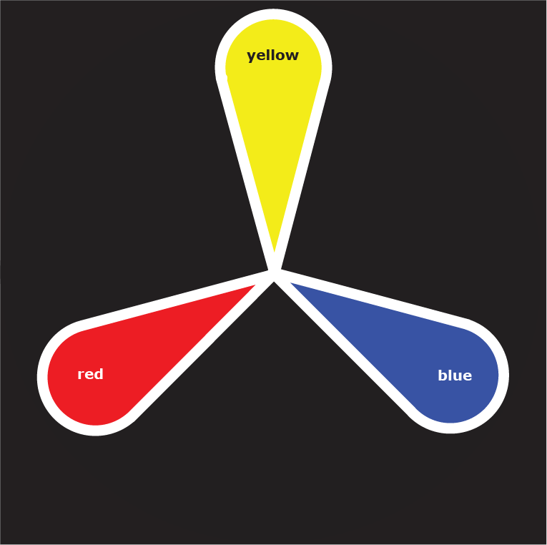
The three primary colors: all other colors can be created from mixing the primary colors.
yellow
blue
red

Slide 6
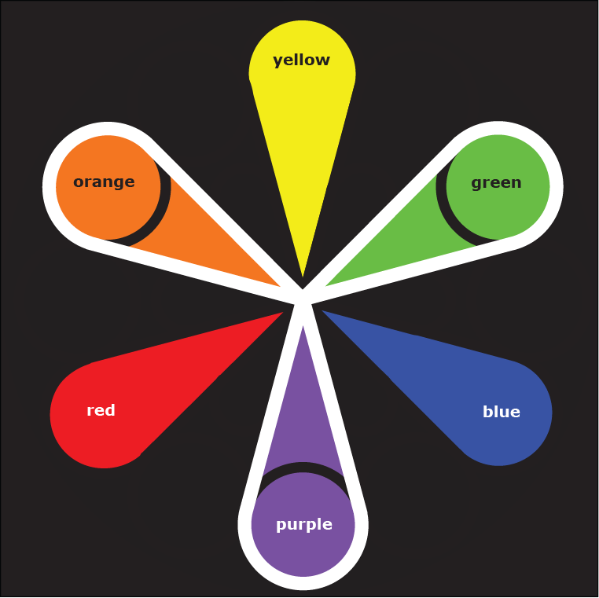
The three secondary colors: mixed from adjacent primary colors.

Slide 7
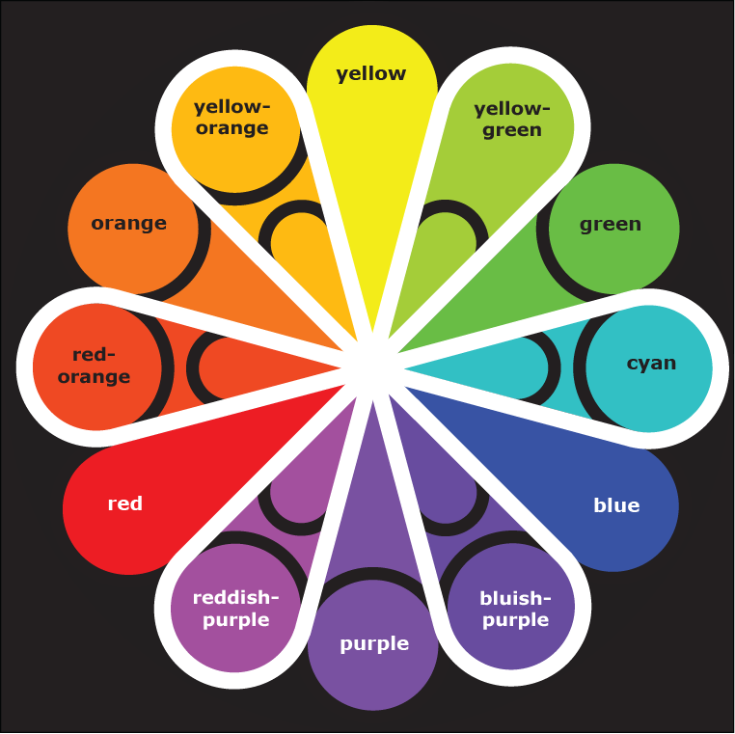
The six tertiary colors: mixed from a primary color and an adjacent secondary color.

Slide 8
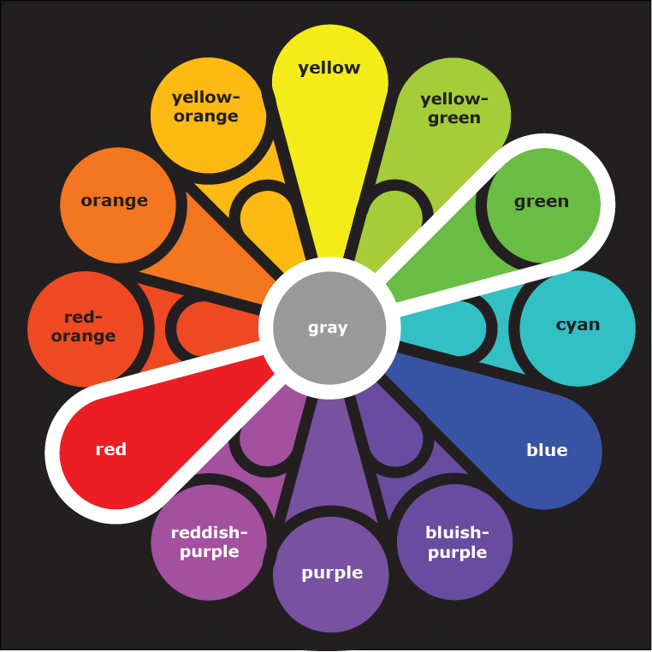
Mixing two complementary (opposite) colors on the wheel results in gray.

Slide 9
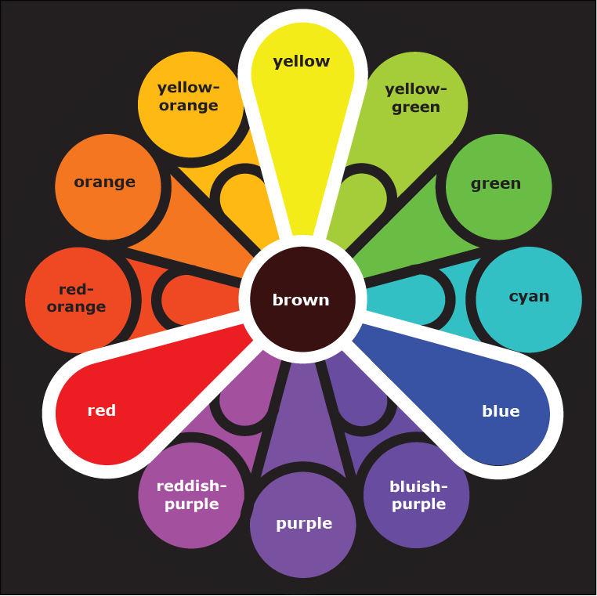
Mixing all colors together results in a blackish-brown.

Slide 10
Traditional Color Theory
Color has four attributes:
  Hue
  Value
  Saturation
  Temperature
Hue or chroma: the true color, like “red” or “blue.”

Slide 11
Traditional Color Theory
Value: the lightness or darkness of a color.
  Pink and dark red are different values of red.
  Value is the single most important attribute in determining the readability of a site.
    Think pink on black (good) versus burgundy on black (bad).

Slide 12
Traditional Color Theory
  Tint: a hue mixed with white, so-called high-key.
    Pink is a tint of red.
    A tint is a color that is approaching white.
+
=
color + white = tint

Slide 13
Traditional Color Theory
  Shade: a hue mixed with black, so-called low-key.
    Dark red is a shade of red.
    A shade is a color approaching black.
+
=
color + black = shade
Notes:
Tint/shade = Luminosity on Powerpoint

Slide 14
Traditional Color Theory
  Saturation: the intensity of pure color.
    Tints and shades have reduced saturation because they are mixed with white or black.
    Colors of low saturation are often viewed as muted, subtle, or sophisticated.
high saturation
low saturation

Slide 15
Traditional Color Theory
    A tone (a hue mixed with gray) also has reduced saturation.
    This is harder to describe, but it gives a less vivid, well, toned down, version of the color.
    A tone is a color approaching some version of gray.
+
=

Slide 16
Traditional Color Theory
  Can also create a tone by mixing with the color’s complementary color (opposite on the color wheel) instead of gray.
+
=
Notes:
Tone = saturation on PowerPoint

Slide 17
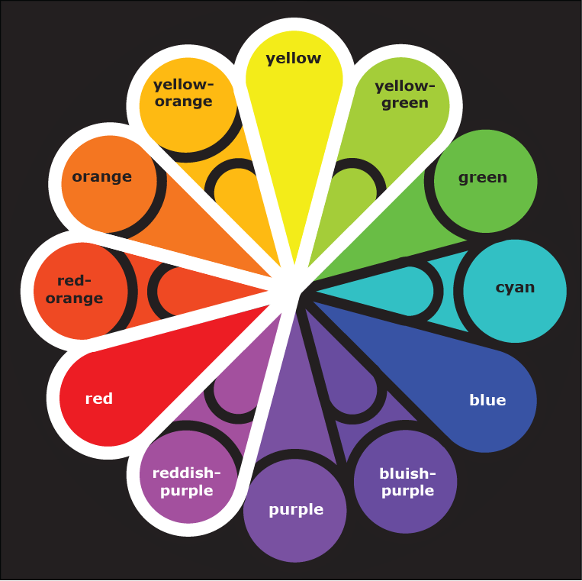
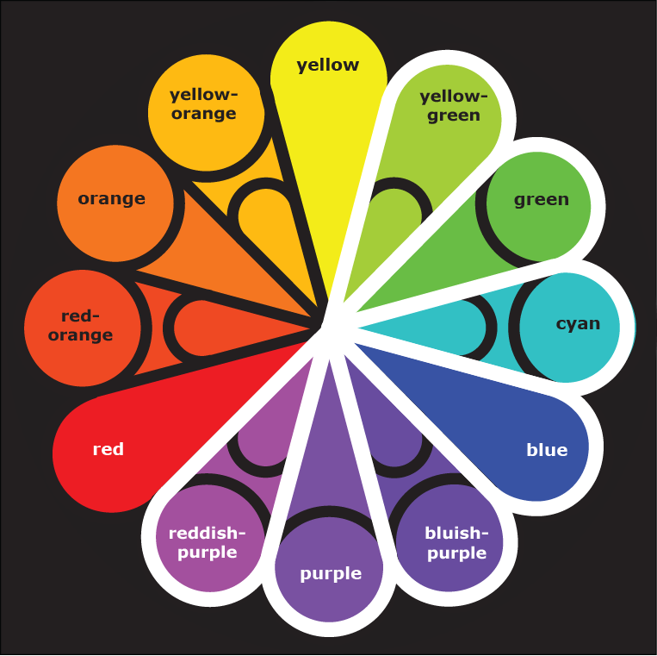
Traditional Color Theory
Color temperature: whether the color is
warm (reds, oranges, and yellows)
cool (blues, purples, and greens)
or
Notes:
Tone = saturation on PowerPoint

Slide 18
Traditional Color Theory
Note that borderline colors – yellow-green and reddish-purple – can swing either way.
Notes:
Tone = saturation on PowerPoint

Slide 19
Contrast
Contrast: The separation between the values of a color attribute.
  Used to emphasize some items while de-emphasizing others.

Slide 20
Contrast
  Color attributes that can be contrasted:
    Hue – complementary colors have the greatest contrast.
    Saturation – highly saturated colors versus colors of low saturation.
    Value – light versus dark.
    Warm (yellow, orange, red) versus cool (purple, blue, green) colors.
  Both extremely high contrast (red on green) and extremely low contrast (navy blue on black) can be hard to read.

Slide 21
Color Schemes
Certain predictable combinations of colors work well.
We are looking for harmony: the juxtaposition of variety and sameness.
  Too much variety and the chaos makes us uncomfortable.
  Too much sameness and we are bored.
  So we are actually looking for NIU’s “unity in diversity.”

Slide 22
Color Schemes:
Monochromatic
Monochromatic color scheme: tints and shades of a single hue.
  The mood is unified and harmonious, or dull.

Slide 23
Color Schemes:
Complementary
Complementary color scheme: two colors opposing each other on the color wheel.
  Vibrant, jarring, creates tension and the illusion of movement – often used for team colors.

Slide 24
Color Schemes:
Split Complementary
Split complementary color scheme: one of two complementary colors is replaced by its two adjacent colors.
  More variety available than complementary, but less vibrant.

Slide 25
Color Schemes:
Triad
Triad color scheme: three evenly spaced colors around the color wheel.
  Bold and vibrant (especially when used with the three primary colors), or jarring.

Slide 26
Color Schemes:
Analogous
Analogous color scheme: two or three colors (sometimes more) next to each other on the color wheel.
  Usually harmonious and stylish – one of the safest color schemes to use.

Slide 27
Color Schemes:
Warm
Warm color scheme: said to have a warm “temperature”, based on yellow, orange, and red.
  Cozy, inviting, and advancing.

Slide 28
Color Schemes:
Cool
Cool color scheme: cool temperature, based on purple, blue, and green.
Note that the borderline colors of yellow-green and reddish-purple can be either warm or cool.
  Cool colors are slick, professional, and receding.

Slide 29
Choosing a Color Scheme
The single most important thing you can do to give your site a theme and create appeal is to choose a good color scheme.
Often, you don’t have a choice about the color scheme, because the organization already has proscribed colors:
  NIU uses red and black; IBM uses blue; Ireland uses green; the Bears use…

Slide 30
Choosing a Color Scheme
Look at the purpose of a site in choosing colors.
  A site for kids might use primaries.
  A rock group site might use a funky combination of neon colors, or a dark and murky scheme.
  A corporate site might use a more staid and stable color scheme, like IBM’s monochromatic blue.

Slide 31
Choosing a Color Scheme
  Colors that can be described by a single, commonly accepted word are considered to be less complex and sophisticated than those that would require multiple words, or that defy description.
    Contrast “red”, “orange”, and “purple”, with “a greyed-down mauve” or “gray with a greenish cast.”
    Shades and tones are usually more complex.
  High-end, sophisticated sites seem to be using more black, white, and gray.

Slide 32
Choosing a Color Scheme
One way of choosing a color scheme is to repeat colors from the logo or a photo that you’re using in the banner.

Slide 33
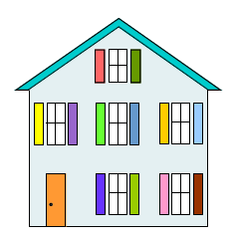
Choosing a Color Scheme
What’s wrong with this picture?

Slide 34
Choosing a Color Scheme
Don’t fall into the trap that every element on a page needs to be a different color – chaotic.
Instead, repeat colors throughout the site; usually not good to choose a color for one element (say a header) and never use it again elsewhere.

Slide 35
Choosing a Color Scheme
Most of us should limit our colors to two or three, plus neutrals – pulling off a color scheme with more colors than that takes a master hand.
Color proportions, like a man’s suit:
  60% one color, like the suit itself.
  Perhaps 30% another color, the shirt.
  Perhaps 10% the brightest, the tie.

Slide 36
Choosing a Color Scheme
Usually, all pages on a site should use identical colors.
  Exception: when sections of a site are color-coded, say if Amazon made book pages blue, music green, etc.
  Even so, the colors should have a similar feel – not bright primaries on one page, dull tones on another.

Slide 37
Choosing a Color Scheme
Keep in mind that colors “read” differently, depending upon adjacent colors.

Slide 38
Choosing a Color Scheme
Background color
  Many experts say to avoid black as a background color because it is the mark of an amateur, and it’s hard to read text on a back background. (???)
  Most of the problem is that black backgrounds have not been used wisely.

Slide 39
Choosing a Color Scheme
Always use sufficient contrast between foreground elements like text and background.
For a dark background, change the default colors on elements like links.
  The defaults are designed for light-colored backgrounds and won’t show up on dark backgrounds.
  But then, I would never think of using the defaults!

Slide 40
Choosing a Color Scheme
To find appealing color schemes, look around you...
  Your favorite sweater
  Ads in magazines or on TV
  Opening credits of movies
  Decorating magazines and catalogs
  In other words, STEAL!
    In Fireworks, holding shift allows you to take the “eyedropper” color selector off the Fireworks window to other windows, like web sites.

Slide 41
Choosing a Color Scheme
Go to the art section of a big bookstore for books with pages and pages of color schemes.
  Best if you can get one that gives RGB colors, like Color Harmony for the Web, by Cailin Boyle.

Slide 42
Choosing a Color Scheme
Keep in mind that the colors you choose may have to be used on collateral printed materials like brochures and business cards.
The print color space is CMYK (Cyan, Magenta, Yellow, and blacK) and, no matter what you do, the translation from RGB to CMYK will not be a perfect match – you’ll have to tweak it.

Slide 43
Color Blindness
10% of the male population is color-blind.
  Try using red on a green background if you really want to mess with them.

Slide 44
Color Blindness
Anyone in the class admit to being RG color blind?
See this?
(same value)
See this?
(value
contrast)
See this?
(on neutral
ground)

Slide 45
Color Blindness
Design your site so that it makes sense even if the colors are illegible; make sure that all important foreground elements contrast in value with background elements.
AIS toolbar shows your page in grayscale to check value contrast.
  http://www.visionaustralia.org/digital-access-wat

Slide 46
Color Blindness
  Photoshop and Illustrator can simulate color-blindness in the View > Proof Setup > Color Blindness menu.
  In Fireworks, the best you can do is convert to grayscale, then undo (don’t do a “round trip”).

Slide 47
Reflected Light:
Subtractive Color Mode
Color is produced by light waves – a beam of white light is composed of all of the colors of the visible color spectrum.
When white light lands on an object, the object absorbs some of the colors while reflecting others.
The colors that are reflected are the colors we see.

Slide 48
Reflected Light:
Subtractive Color Mode
A yellow sunflower reflects yellow and absorbs (subtracts) all the other colors of the spectrum.
The physics of this are referred to as the subtractive color mode – color based on reflected light.

Slide 49
Reflected Light:
Subtractive Color Mode
To reiterate: when you mix pigments, you are subtracting the absorbed colors, thereby decreasing the number of colors reflected, hence the “subtractive.”

Slide 50
Projected Light:
Additive Color Mixing
Projected light (light bulb, computer monitor, TV screen, etc.) is different from reflected light.
There is no surface reflection—you see just the light itself.
For instance, if white light shines through a prism, it breaks into the rainbow of its color components.

Slide 51
Projected Light:
Additive Color Mixing
In the same way, raindrops in the sky break the sun’s white light into a rainbow.
Pure light, with no worries about what a surface might absorb – there is no surface.
This projected light shows additive color mixing: adding light waves without subtracting any absorbed colors – thus additive color mixing.

Slide 52
Projected Light:
Additive Color Mixing
The primary colors in additive color mixing are not those of traditional color theory – they are now Red, Green, and Blue; i.e., RGB.
Each pixel is an additive mix of all three colors, in varying proportions.
An RGB color wheel looks different…

Slide 53
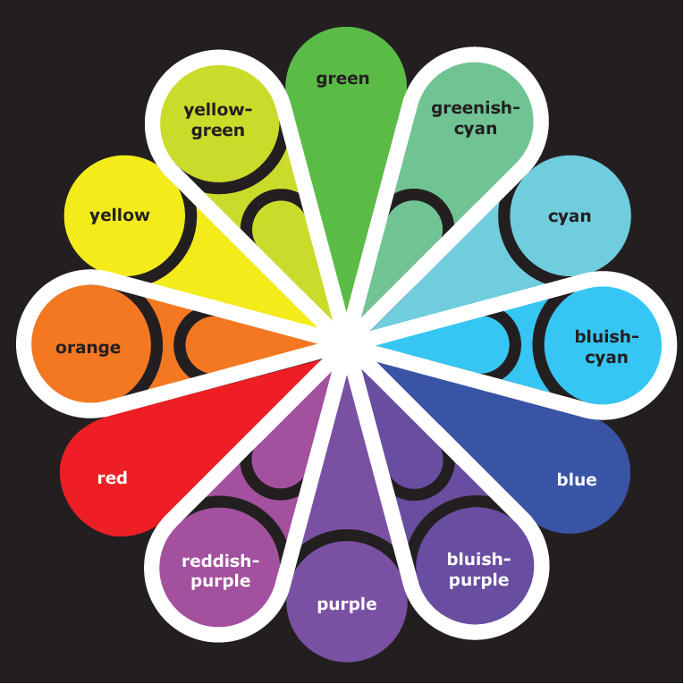
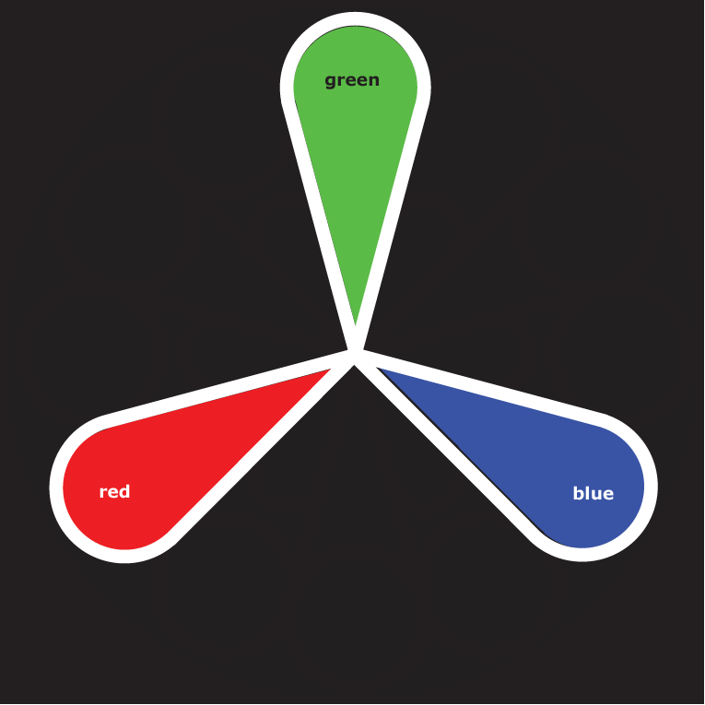
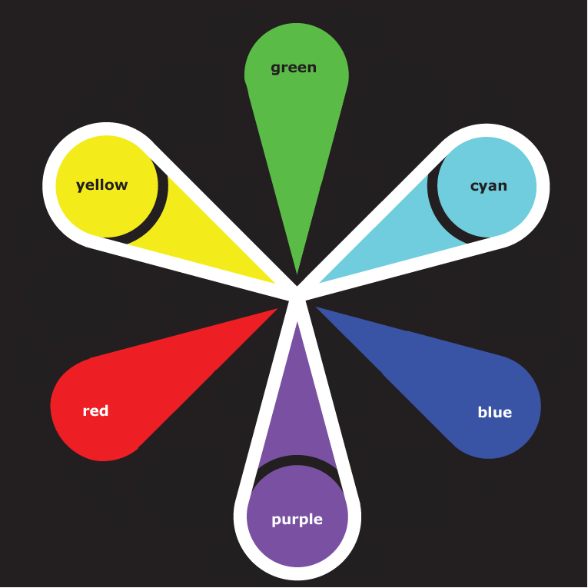
Projected Light:
Additive Color Mixing
RGB primary colors: red, green, blue
RGB secondary colors: yellow, purple, cyan
RGB tertiary colors: yellow-green, greenish cyan, bluish-cyan, bluish-purple, reddish-purple, and orange.

Slide 54
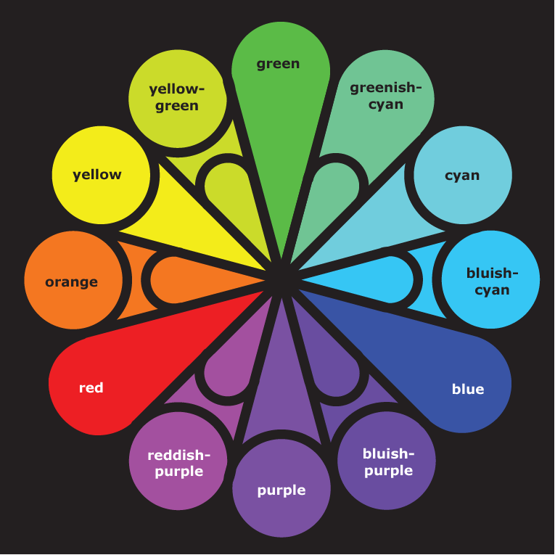
Projected Light:
Additive Color Mixing
This palette has fewer warm colors and more cool colors than the traditional color wheel.
warm
colors

Slide 55
Web Color
The new wheel doesn’t mean that you need to learn all new theories to make RGB color work on the web; we still have the same ideas about which colors and color schemes are pleasing.
But you do need to understand that the colors projected on a web page are mixed in a different way than you would mix paints.

Slide 56
Web Color
RGB colors are referred to by a hexadecimal number: #FF99CC
  The first hex pair refers to the amount of red, the second hex pair the amount of green, and the third hex pair the amount of blue.
  FF is maximum saturation, 00 is none of that color at all.

Slide 57
Web Color
Examples:
White is maximum color.
#FFFFFF
#FF0000
#0000FF
#9966FF
Black is no color.
#00FF00
#FFFF00
#CC00CC
#000000

Slide 58
Web Color
A six-digit hex color code can describe 16.8 million colors.
Newer monitors can use all 16.8 million colors: termed true color.
Very old monitors and graphics cards may have a more limited palette (set of allowed colors) of only 256 colors, but that limitation is usually found only on older phones and such these days.

Slide 59
Web Color
We need to understand the implications of limited colors, especially now that web surfers use phones.
A definition first…

Slide 60
Web Color
Dithering: Simulating more colors and shades than the current palette actually permits.
Not dithered
Dithered
6 x 6 pixels
Appears on screen >
< Appears on screen

Slide 61
Web Color
Now on to the implications…
Web-safe colors (“Safety Palette”): 216 colors that can be displayed by all browsers without dithering.
  Why not all 256 colors of even a limited display? Because 40 colors are reserved for the operating system and browser.
  Web-safe colors were chosen mathematically, not because they were aesthetically pleasing.

Slide 62
Web Color
  The 216 colors web-safe colors use the following pairs of hex code numbers, all multiples of 51₁₀:
  Decimal Hex
    00 00
    51 33
    102 66
    153 99
    204 CC
    255 FF
All numbers a zero or a multiple of 3, and all pairs.
00 is the weakest a color can get, FF the strongest.

Slide 63
Web Color
#FFFFFF
#FF0000
#0000FF
#9966FF
All web-safe colors:
All pairs, each number a zero or multiple of three.
#00FF00
#FFFF00
#CC00CC
#000000

Slide 64
Web Color
Note that yellow is an equal mixture of red and green:
#FFFF00
Now just how strange is that?

Slide 65
Web Color
#F7F7F7
#A86958
#2E55D2
#8CC6DA
Not web-safe colors: not all pairs, numbers not always a zero or multiple of three.
#757575
#D9E818
#795279
#004900

Slide 66
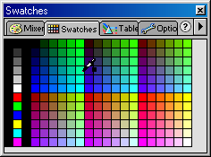
Web Color

Slide 67
Web Color
Should we stick to web-safe colors for all of our sites?
NO! It would be a shame to waste 16.7999 million colors just because of cell phones, tablet computers, and ancient computer systems.

Slide 68
Web Color
So, what happens when a 256-color-device is told to display a non-web-safe color?
  The color shifts to the nearest web-safe color, or it dithers.
  Either one is acceptable these days, on the less-powerful devices.

Slide 69
Palettes
Most graphics editors and web IDEs default to a web safe palette.
All contain the same 216 colors, just arranged differently.
First, let’s look at Adobe’s web safe palettes.
After looking at the palettes, we’ll explore how to get to all the other colors 16.7999 million colors.

Slide 70
Adobe’s Color Cubes Palette
Not good – all the related colors are separated from each other: blues in three places, etc.

Slide 71
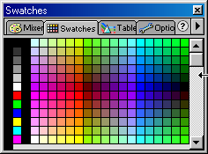
Adobe’s “Continuous Tone” Palette
Better. Like a cylinder split lengthwise, so some related colors still separated.

Slide 72
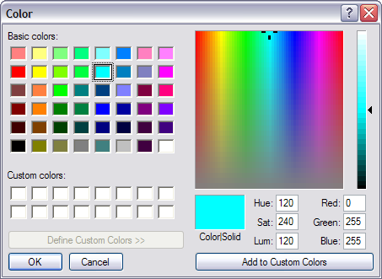
Adobe’s True Continuous Tone Palette
Even better, but:
Trying to pick a single pixel that is what you want is tough.
If you enter the numbers manually, you must translate hex to decimal – easier just to think in hex.

Slide 73
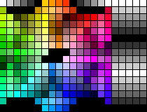
The Visibone Palette,
free from www.visibone.com
The best palette that can be installed in the browser.

Slide 74

Penny’s Palette
six major axes for the primary and secondary colors.
color that “rules” each axis
black
saturated colors
tints
shades
tones
white

Slide 75
Palettes
This palette works both mathematically and creatively.
Download it and use it as a graphic in the background, for color selection.

Slide 76
Web Color Mixing
Palettes are a great start, but they give you only 216 colors.
How do you get to the remaining 16.7999 million codes?

Slide 77
Web Color Mixing
Three methods to mix your own:
  Mix the math.
  Use a gradient (blend of one color to another).
  Use a semi-transparent color overlay.
We’ll go through how to use these three methods with neutrals, tints, shades, and tones.

Slide 78
Web Color Mixing:
Neutrals
First, let’s look at neutrals (gray, black, and white) are simply all three colors in equal amounts:
#ffffff
#cccccc
#999999
#666666
#333333
#000000
Mix the math: the larger the color codes, the closer to white (FFFFFF), and the lighter the gray.

Slide 79

Web Color Mixing:
Neutrals
Mixing with a gradient: set up a gradient between white and black, then use Adobe’s color picker to get the color code:

Slide 80
Web Color Mixing:
Neutrals
Mixing with a transparent overlay, then use Adobe’s color picker to get the color code:

Slide 81
Web Color Mixing:
Tints
Mix the math: (using red): make the color code approach white (#FFFFFF) by adding progressively larger, equal amounts of the other two colors:
#ff0000
#ff3333
#ff6666
#ff9999
#ffcccc
#ffffff

Slide 82
Web Color Mixing:
Tints
Mix with a gradient: create a gradient using the color and white, then sample with the color picker:

Slide 83
Web Color Mixing:
Tints
Mix with a semi-transparent white overlay, then sample with the color picker:

Slide 84
Web Color Mixing:
Shades
Mix the math: make the color code approach black (#000000) by progressively reducing the hex code for the color itself:
#ff0000
#cc0000
#990000
#660000
#330000
#000000

Slide 85
Web Color Mixing:
Shades
Use a gradient: create a gradient from the color to black, then sample with the color picker:

Slide 86
Web Color Mixing:
Shades
Use a semi-transparent black overlay, then sample with the color picker:

Slide 87
Web Color Mixing:
Tones
Mix the math #1: progressively reduce the hex code for the color itself and progressively add its complement (in this case, cyan, which is green and blue in equal amounts) so that the color approaches gray (equal RGB pairs):
#ff0000
#cc3333
#cc6666
#cc9999
#996666
#993333

Slide 88
Web Color Mixing:
Tones
Mixing the math #2: start with gray as a base and emphasize one of the colors by increasing it a bit:
#ffcccc
#cc9999
#996666
#663333
#cccccc
#999999
#666666
#333333
#ccccff
#9999cc
#666699
#333366

Slide 89
Web Color Mixing:
Tones
Either way, make sure the base color code still remains larger than the complementary color code, or you cross over to another color entirely.
Red is still larger
#ff0000
#996666
OK
#ff0000
#99cccc
Now blue has become larger
not OK

Slide 90
Web Color Mixing:
Tones
Use a gradient #1: create a gradient using the color and the RGB complementary color (which may be different than a traditional complementary color)…

Slide 91
Web Color Mixing:
Tones
Using cyan, the RGB complement
Careful not to use the complementary color from the traditional color wheel – it skews the color a different direction, rather than toning down…

Slide 92
Web Color Mixing:
Tones
Use a gradient #2: create a gradient using the color and gray, then sample with the color picker…

Slide 93
Web Color Mixing:
Tones
Using grays (from light to dark) to create a tone

Slide 94
Web Color Mixing:
Tones
Use a use a semi-transparent overlay with gray or the complementary color, then sample with the color picker:
using gray
using the complement

Slide 95
Web Color Mixing:
Creating New Colors
Mixing the math: start with the base color, then skew it by adding other color(s) in unequal proportions:
#ff0000
#ff6600
#ff9900
#ff0099
#cc0033
#cc3399

Slide 96
Web Color Mixing:
Creating New Colors
Using a gradient: create a gradient with the base color and some other color:

Slide 97
Web Color Mixing:
Creating Entire Palettes
Use the same techniques not just to create a single color, but to create an entire palette of related colors…

Slide 98
Web Color Mixing:
Creating Entire Palettes
An analogous palette shading from one color to another using a gradient:

Slide 99
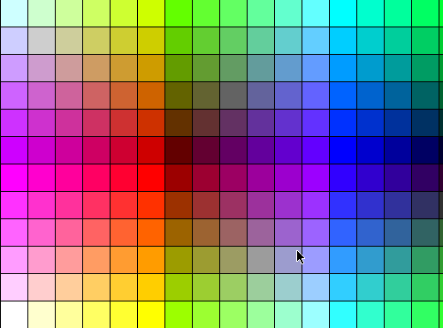
A palette of tones using a semi-transparent overlay:
Standard palette of colors,
Overlayed with medium gray at 50% transparency

Slide 100
Standard palette of colors,
Overlayed with yellow at 50% transparency

Slide 101
Gamma
Be aware of gamma fluctuations.
  Gamma refers to the lightness or darkness of a system’s display.
  Macs (not iPhones) have a lighter gamma (1.8) than Windows systems (2.2-2.8).
  Older versions of Photoshop had a built-in utility so that you can adjust the gamma of your system so that it mimics either the Mac or the PC precisely.
  That doesn’t help your visitors, however.

Slide 102
Gamma
Even if the gamma is tuned the same, colors won’t look the same on different systems.
  Try looking at a row of TVs in Best Buy – they don’t look the same either.
  A barn red that a friend put on her web site looks barn red on my computer at home and magenta on my computer at work.

Slide 103
Color Resources
Awesome articles on color, with lots of web site screen prints for inspiration.
  http://www.smashingmagazine.com/2010/01/28/color-theory-for-designers-part-1-the-meaning-of-color/
  http://www.smashingmagazine.com/2010/02/02/color-theory-for-designers-part-2-understanding-concepts-and-terminology/
  http://www.smashingmagazine.com/2010/02/08/color-theory-for-designer-part-3-creating-your-own-color-palettes/
http://kuler.adobe.com/#themes/rating?time=30 Helps you create color schemes.
http://www.colourlovers.com/ Palettes, patterns and blogs, all about color.

Slide 104
Color Resources
Http://lightsphere.com/colors/ Web Engineer’s Toolbox, a clickable 216-color palette.
http://world.std.com/~wij/color/index.html Color Theory
https://chrome.google.com/webstore/detail/colorpicker-09/jegimleidpfmpepbfajjlielaheedkdo Chrome plug-in, changes colors on the fly.

Slide 105
Color Resources
http://www.beverlyashgilbert.com/colorinspiration.html and http://www.colorqueens.com/ Color inspiration sites – be sure to follow links on the page. Same artist contributes to both sites.
Paint store color palettes.

Slide 106
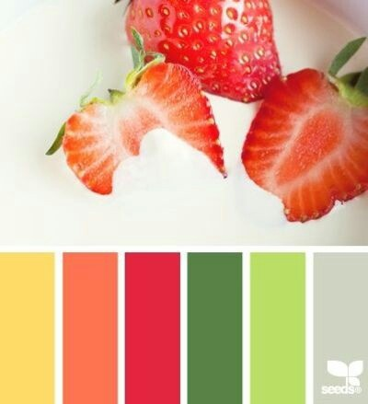
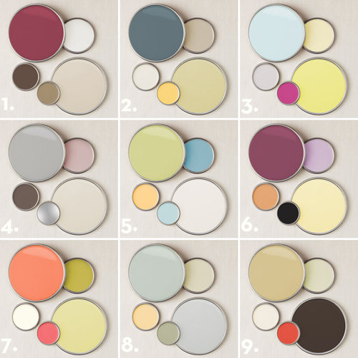
Color Resources
Pinterest – search "color palette"

Slide 107
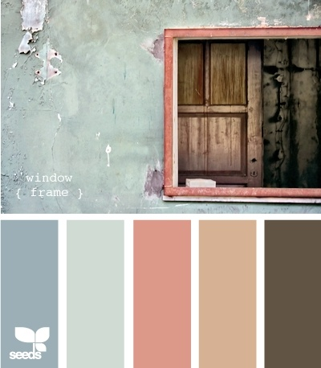
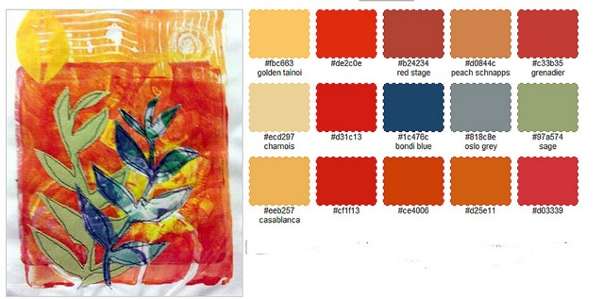
Color Resources

Slide 108
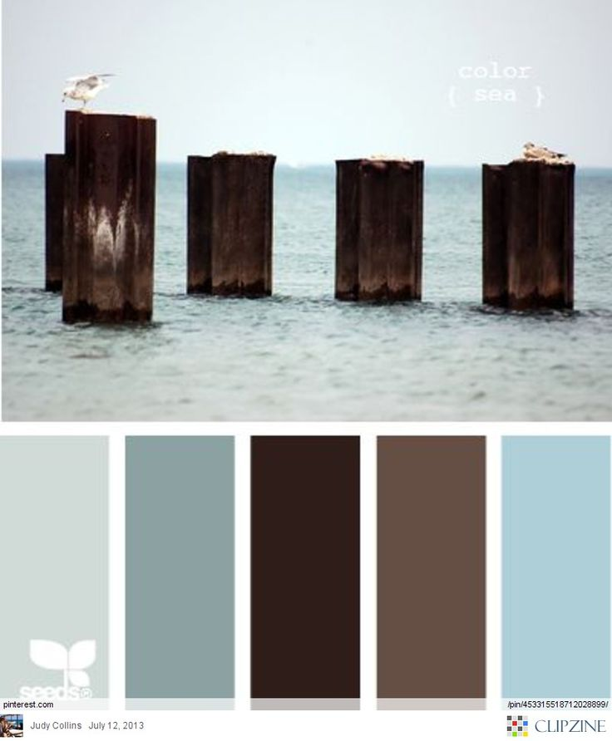

Color Resources

