Slide 1
Forms

Slide 2
Forms
Forms capture information from your visitor.
They must be so obvious and unambiguous that there’s no doubt about how to use them.
Bad form design = bad input.

Slide 3
Principles of Form Design:
1. Reduce Physical Effort
Minimize clicks, keystrokes, mouse movements, and scrolling.

Slide 4
Principles of Form Design:
2. Reduce Cognitive Effort
The form should be simple and easy to understand.
Avoid visual chaos.

Slide 5
Principles of Form Design:
3. Avoid Unnecessary Entries
Don’t ask for the same piece of information more than once.
  E.g., if permanent address and shipping address are the same, let them check a “same as” button instead of typing twice.
  If the information might be used on future visits, store it in the database or in a cookie.

Slide 6
Principles of Form Design:
3. Avoid Unnecessary Entries
Avoid requiring any information perceived to be unnecessary or not benefiting the visitor. Examples:
  Marketing questions.
  Forcing visitors to log in before getting into the site.

Slide 7
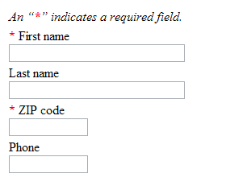
Principles of Form Design:
3. Avoid Unnecessary Entries
Indicate required fields with an asterisk, a color, etc.

Slide 8
Input Controls/Widgets
Two general categories:
  Predefined choice controls like radio buttons, checkboxes, list boxes.
  Text controls that allow the visitor to enter free-form text data.

Slide 9
Input Controls/Widgets:
Predefined Choice Controls
They minimize visitor keystrokes and ensure accuracy.
  No typos, etc.
  Use whenever there are a limited number of choices, like states, countries, etc.

Slide 10
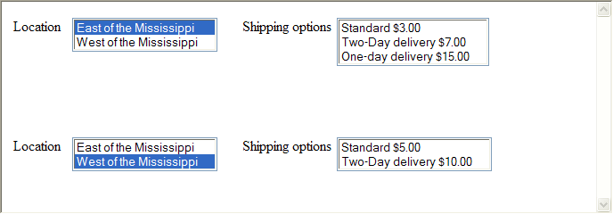
Input Controls/Widgets:
Predefined Choice Controls
Dependent choices / filtered choices: when an early choice may determine which later choices are available…

Slide 11
Predefined Choice Controls:
Radio Buttons
When only one option can be chosen; i.e., mutually exclusive options.
Called “option buttons” by Microsoft.
Easiest to line them all up if the radio button is to the left of the text that describes it.
Must make clear which buttons belong together, with white space, the <fieldset> tag, a header, borders, background color, etc…

Slide 12
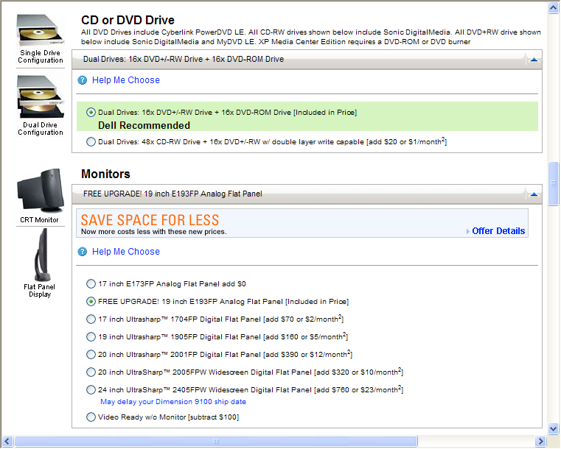
Note borders and headers, separating topics.

Slide 13
Predefined Choice Controls:
Checkboxes
When multiple options can be chosen.
Again, it’s easiest to align the checkboxes when they’re on the left.
Again, they should be visually grouped somehow.

Slide 14
Predefined Choice Controls:
List Boxes
When listing all options would take up too much space on the screen.
Yes, many of us would rather type “IL” than deal with a list box of 50 states, but the list box has a better chance of capturing accurate input (i.e., no typos).
Decide the order of the items:
  Strictly alphabetical?
  Most common choice first, as the default?

Slide 15

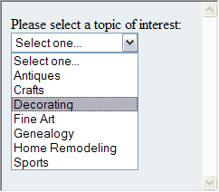
Predefined Choice Controls:
List Boxes
Drop-down list versus scrollable list:
Drop-down
List Box

Slide 16
Predefined Choice Controls:
List Boxes
<select size=“1”…>, the default, displays a single entry and a dropdown, like we just saw.
  The single displayed entry is usually a statement like “Select one…”

Slide 17
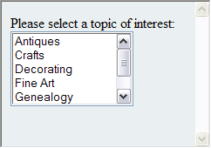
Predefined Choice Controls:
List Boxes
Scrollable list:
Scrollable
List Box

Slide 18
Predefined Choice Controls:
List Boxes
<select size=“n”…> displays a scrollable box with n entries displayed at once.

Slide 19

Predefined Choice Controls:
List Boxes
Use the attribute multiple in the select statement for choosing multiple items with CTRL-click.
A gotcha: multiple plus size=“1” provides a scrollable box with only one entry displayed at a time, which is claustrophobic:

Slide 20
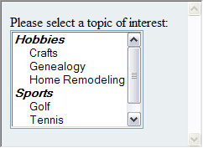
Predefined Choice Controls:
List Boxes
Non-clickable headers in a list box, to group items:

Slide 21
Predefined Choice Controls:
List Boxes
<select …>
<optgroup label="Hobbies">
<option …>…</option>
<option …>…</option>
<option …>…</option>
</optgroup>
<optgroup label="Sports">
...
</optgroup>

Slide 22
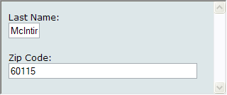
Text Controls:
Single Line Text Input
size attribute and maxlength should roughly correspond, although maxlength might be somewhat longer, allowing for scrolling on rare longer items.
Bad:

Slide 23
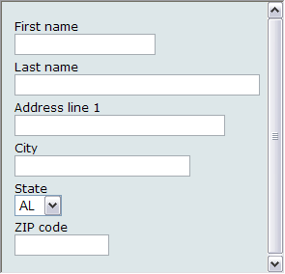
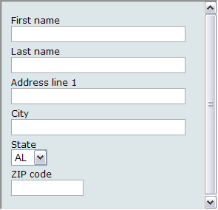
Text Controls:
Single Line Text Input
However, making all fields different lengths can lead to visual chaos:
somewhat chaotic
visually pleasing

Slide 24
Text Controls:
Single Line Text Input
Therefore, there must be a compromise between indicating field lengths accurately and making the form aesthetically appealing.

Slide 25
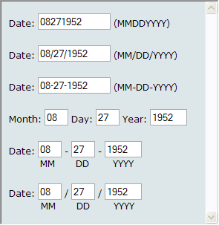
Text Controls:
Single Line Text Input
Punctuation and formatting:
  Various ways of guiding visitors to use correct input formatting…
The first one conserves keystrokes, but makes it harder for a visitor to notice input errors, because it all runs together.

Slide 26
Text Controls:
Single Line Text Input
Alternative: allow visitors to enter data any way they want. Phone numbers, for instance:
  8155551212
  815-555-1212
  815.555.1212
  (815) 555-1212
Advocated by many experts, but visitors might pause, looking for direction.

Slide 27
Text Controls:
Single Line Text Input
Displaying default value in the field:
  Advantage – Saves keystrokes when the default is used.
  Disadvantage – the default must be erased when the default is not used.
  Use only when perhaps 90% of the visitors will use the default?

Slide 28
Text Controls:
Single Line Text Input
For critical fields (e.g., new password), force user to type twice, preferably on a new screen so the visitor can’t copy and paste.

Slide 29
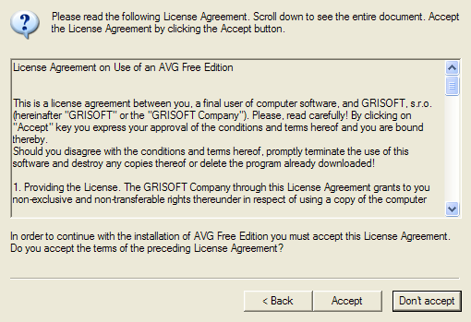
Text Controls:
<textarea> tag
Used for multiple line text inputs.
Also used for informational text that scrolls, using readonly attribute…

Slide 30
Submit Buttons
Standard submit buttons use
  <input type="submit" …>
Can use your own image instead:
  <a href="#" onClick="formName.submit();" >
  <img src=“myOwnButton.gif" … />
  </a>

Slide 31
Submit Buttons
After submit, send back a response page, so the visitor knows the action was accepted.
To avoid multiple submissions (visitor clicks multiple times):
  Reassure visitor with feedback, like a small animation.
  Better: disable the button by adding to the <form> tag…
    onsubmit="this.formName.disabled=true"
    The page would need to be reloaded to re-enable the button.

Slide 32
Reset Buttons
Can use a custom image, just like with a submit button.
Some experts argue that reset buttons should never be used; rarely does a visitor clear an entire form.
If you do put a reset button on the page, use JavaScript to pop-up a window asking, “Are you sure?”

Slide 33
Submit and Reset Buttons
Safer/more positive of the two on the left so focus lands there first.
Verify all ejector seat functions (i.e., non-reversible actions) with a pop-up.

Slide 34
Transaction Structure:
Wizards
Wizard: a linear, step-by-step interaction that loads one page per step, in a defined order…

Slide 35
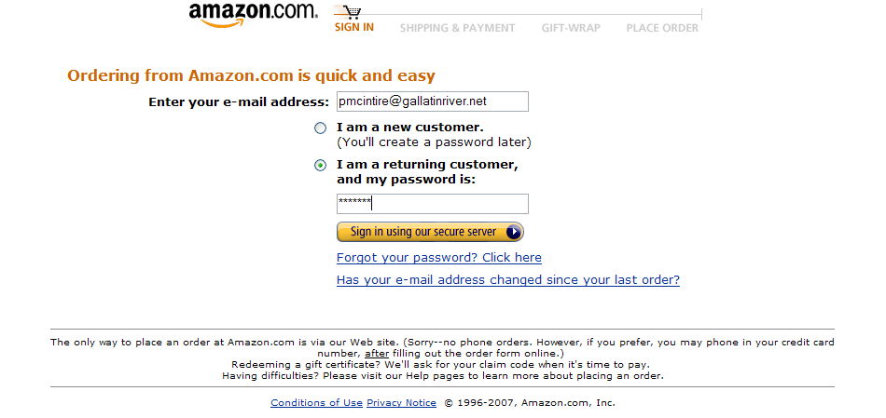
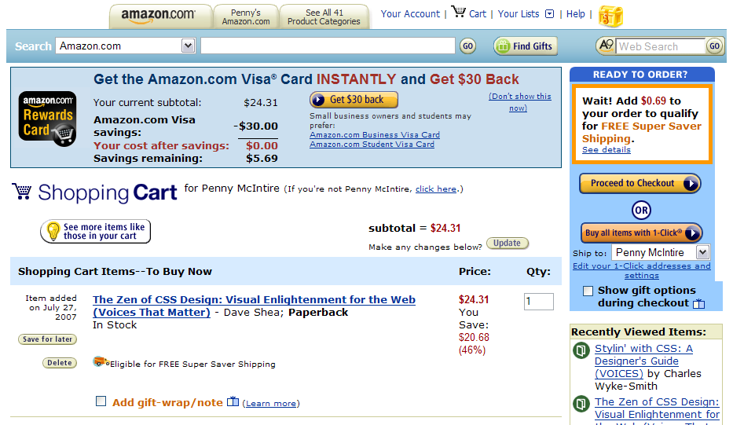
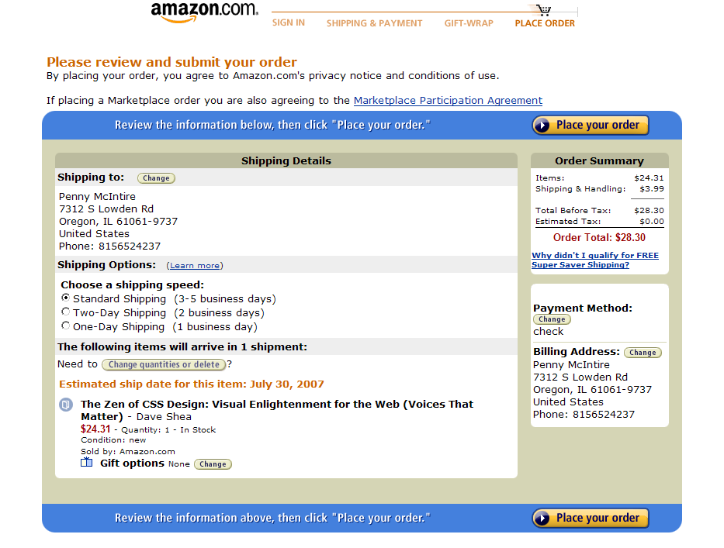
Login
Shopping Cart
Shipping

Slide 36
Transaction Structure:
Control Panels
Control panel: The entire transaction is presented on one (often) long page…

Slide 37
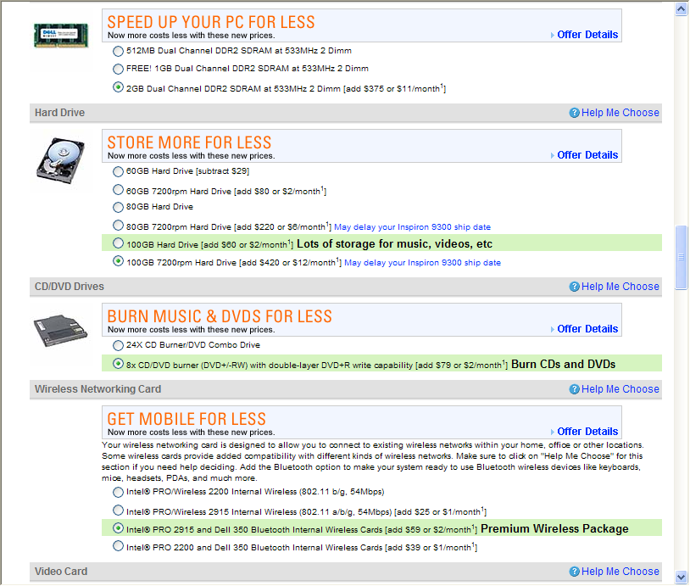

Slide 38
Transaction Structure:
Wizards versus Control Panels
Wizard advantages:
  Ideal for visitors who are not tech savvy or who perform the task only occasionally, because it’s less intimidating.
  Dependent choices (discussed earlier) are much easier to program on separate pages.
Control panel advantages:
  Only one page load for the whole thing.
  Less tedious, cumbersome, and condescending to visitors who are familiar with the process.

Slide 39
Input Form Page Layout:
Controlling Tab Order
A form control is said to have focus if the cursor is resting on it.
Form controls naturally acquire focus following the sequence of their location in the HTML source code; left to right, top to bottom on the display.
Sometimes the natural order doesn’t make sense, as in the following default tabbing order…

Slide 40
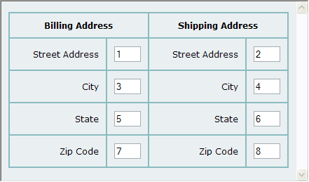
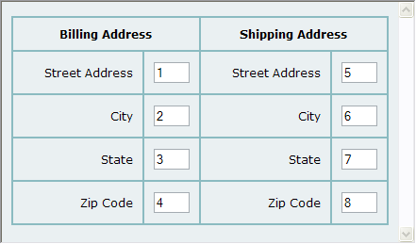
Input Form Page Layout:
Controlling Tab Order
HTML order, but not usual human order…
Instead, we
would prefer…

Slide 41
Input Form Page Layout:
Controlling Tab Order
To control tab order, add tabindex="n" to the control.
  Values starting at 1.
  If no tabbing order on a control, it is picked up (in source code order) after all tabindex items are done.
  I have had problems getting tabindex to work consistently, especially in IE.

Slide 42
Input Form Page Layout:
Controlling Focus
You can set focus to a specific control.
For instance, you can set focus to the first control on the page when it loads.
  Add to the body tag…
      onLoad=document.formName.fieldName.focus();
Or you can set focus to a field in error, when the error is discovered.
  More about this when we discuss JavaScript.

Slide 43
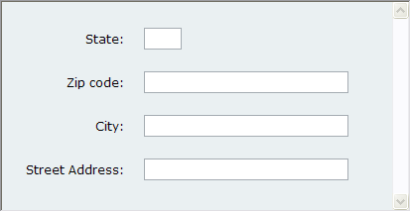
Input Form Hints
Present input controls in the expected order.
  Bad example:

Slide 44
Input Form Hints
  Another bad example: Asking for a credit card number before displaying the items in the cart and showing total cost of the sale, including tax and shipping.

Slide 45
Input Form Hints
Chunk input controls by category, like on the Dell control panel…

Slide 46
Form Validation
Validate as much as possible on the client, using JavaScript, to avoid wasting bandwidth with invalid entries.
Client-side validation is generally limited to completeness (all required fields are entered) and format (numeric, etc.).

Slide 47
Form Validation
Can validate upon submit, as well as when each field is entered and then loses focus.
The latter is rarely done these days, although often done on non-web applications.
Free validation scripts (dates, states, email addresses, valid zip codes, etc.) at www.javascriptsource.com .

Slide 48
Visitor Support:
Instructions, Help, & Error Handling
Also under the categories of user-centric design, human factors, and usability.
“Don’t explain unless you have to, and consider all explanations as bad design, unless you can’t find a better way.” John Cato, User-Centered Web Design.

Slide 49
Visitor Support:
Instructions, Help, & Error Handling
Principles of visitor support:
  Practice defensive design – make it hard for the visitor to make a mistake.
  Cope gracefully with errors (more in a bit).
  Less is more – be brief and salient, and make sure that critical information is highlighted.

Slide 50
Visitor Support:
Instructions, Help, & Error Handling
  Provide obvious documentation for probabilities, and less “in your face” documentation for rarer possibilities, to avoid overwhelming the visitor with too much information.

Slide 51
Visitor Support:
Instructions
Accurately label each form control, including any formatting requirements (e.g., date).
Instructions should be close to the applicable control.
Be unobstrusive – e.g., don’t pop up a separate window with instructions unless the visitor requests it.

Slide 52
Visitor Support:
Instructions
Use a consistent vocabulary (e.g., don’t use “participant” in one place, “member” in another.
Be concise; avoid TMI.
Include the title attribute on form controls if you need to provide further instructions on rollover.

Slide 53
Visitor Support:
Help
Should rarely need on web sites; only for the most complicated tasks.
If a visitor consults “help,” it’s because he or she is at a crisis point and already frustrated.
Which means we need to be particularly, well, helpful.

Slide 54
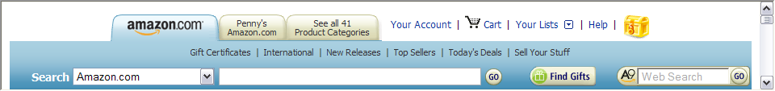
Visitor Support:
Help
Two types:
  Action-based help, like a tutorial.
  Reference-based, with just an explanation.
Links to help can be in two places:
  On the main navigation, always available…

Slide 55
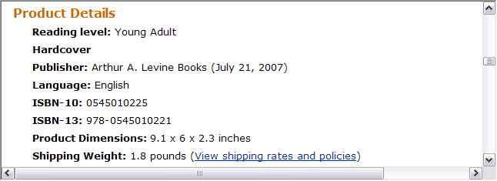
Visitor Support:
Help
  Contextual help / smart help, right where needed…

Slide 56
Visitor Support:
Feedback
Example of appropriate feedback: if visitors enter shipping info on one page and credit card info on another, redisplay all order information on a summary page before asking for order confirmation.

Slide 57
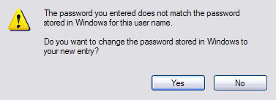
Visitor Support:
Feedback
Two types of feedback:
  Modal: requires a response before the activity can proceed, usually in the form of a dialog box…

Slide 58
Visitor Support:
Feedback
  Modeless: feedback that’s informational but doesn’t require an action from the visitor.
    Examples:
      Active link formatting indicates that a click on a text link was recognized.
      An animation to indicate that an activity is progressing.

Slide 59
Visitor Support:
Feedback
Avoid modal feedback whenever possible because it delays the visitor.
  Use only for critical errors or double-checking before executing an irreversible (so called “ejector seat”) action.

Slide 60
Visitor Support:
Error Handling/Contingency Design
Be helpful: state the error, it’s implications, and what to do.
  Some of my favorite error messages…
Be clear and non-technical:
  “Our UNIX server doesn’t recognize URLs with embedded spaces,” versus
  “Please don’t use spaces in the address.”
Be concise; extraneous information merely obscures critical information.

Slide 61
Visitor Support:
Error Handling/Contingency Design
Be polite, non-technical, non-accusatory, and apologetic.
Avoid humor; a visitor at a crisis point rarely has much of a sense of humor.
Focus the cursor on the field in error, so the visitor doesn’t need to hunt for it.
Make sure the error stands out on the page, with color coding, asterisks, or an obvious error icon.

Slide 62
Visitor Support:
Error Handling/Contingency Design
If the error is discovered after hitting the server, don’t make the visitor re-enter the entire form again!
Two polite options:
  Present the entire form again, with fields populated as the visitor entered them and errors highlighted.
  Present an abbreviated form, with only the fields in error.

Slide 63
Visitor Support:
Error Handling/Contingency Design
Surprising finding: successful resolution of a problem builds customer loyalty faster than delivering a product that performs flawlessly!

Slide 64
Visual Design of Form Controls
All of the design guidelines we’ve already examined – layout, color, typography, etc.– apply to form pages.
But we can do styling on individual form controls, too, using CSS…

Slide 65
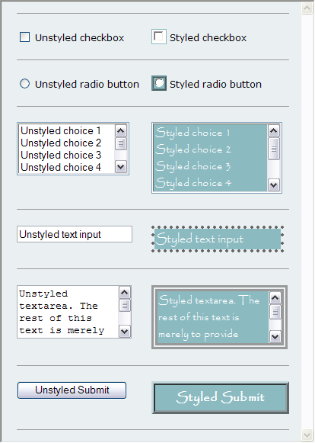

Slide 66
Visual Design of Form Controls
These examples use background colors, borders (including ridge, dotted, double, etc.), fonts (including size, typefaces, styles, and color).
Just because we can do this much styling doesn’t mean we should; some of these controls are almost unrecognizable.

Slide 67
Visual Design of Form Controls
Sometimes, the styling around a control can help to increase accuracy, like this color coding…

Slide 68
Input Forms and Accessibility
Ideally, the label should be to the left of the input control itself, so that the screen reader reads the label first.
  Unfortunately, that makes it hard to line things up on the screen visually.
  An alternate is to use the following to associate the label with the control…
    <label for="controlName">
    label goes here
    </label>

Slide 69
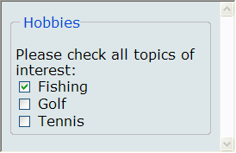
Input Forms and Accessibility
To make chunking more explicit, surround related form elements in a <fieldset> tag, complete with a <legend>.

Slide 70
Input Forms and Accessibility
Don’t use instructions as the default value in a field, because once data entry has started, the instructions can’t be revisited.
Avoid using long list boxes with the multiple attribute; whenever possible use checkboxes instead.

Slide 71
Input Forms and Accessibility
Don’t set the default value for a single yes/no checkbox to “yes.”
Use the title attribute to provide tooltips on rollover.

Slide 72
Resources
http://www.creativepro.com/article/view-source-building-better-forms-dreamweaver-cs3 Auto form validation in Dreamweaver CS3 and newer

