Slide 1
CSCI 330
UNIX and Network Programming
Unit XX: Linux Administration

Slide 2

Plan for today’s lecture
Install new release of Linux
  while we wait …
  after the wait …
Customize new system
  install some software
  add a new disk
User Management
  sudo
Software Management
  apt-get, synaptic
File system Management
  fdisk, mkfs, mount, fsck

Slide 3
Linux Installation
Select from:
  Debian 7.2
  Ubuntu 13.10
  Linux Mint 16

Slide 4
User Configuration
user info is stored in file /etc/passwd
  userid, user name, group, home directory, shell
  passwords are stored in separate file: /etc/shadow
group info is stored in file /etc/group
  groupid, group name
  additional group members
to find out group info, use: groups user-id
Example:
  % groups student
  student adm cdrom sudo dip plugdev lpadmin sambashare

Slide 5
Steps to create a new user
add info to /etc/passwd
add info to /etc/shadow
add info to /etc/group
create home directory
add default content to home directory
set password
common Debian utilities:
adduser, deluser
addgroup, delgroup

Slide 6
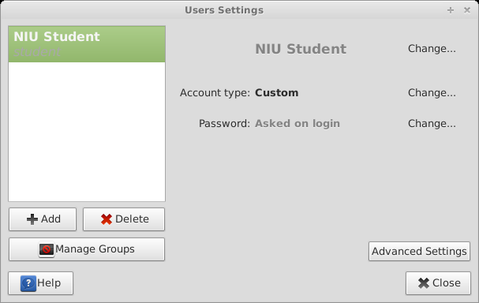
Linux “Users and Groups” utility
to create and manage users and groups

Slide 7
sudo
execute commands as super user “root”
  will be prompted for password
/etc/sudoers
  lists designated users/groups
    group “sudo”
    user “student” belongs to “sudo” group
  lists allowed commands
    root can do anything
Example:
% sudo chown user:group file
% sudo -i

Slide 8
Software Management
applications are bundled into package file:
  tar
    original (tape) archive format
  rpm
    Redhat package manager format
    download & install via: yum
  deb
    Debian package format
    download & install via: apt-get
“tarball”
know dependencies
among applications

Slide 9
deb Package Management
Basic utilities:
  dpkg – package manager
  apt-get – package handling utility
User friendly interfaces
  aptitude – command line frontend
  synaptic – GUI frontend
Software Manager
  unified web-based application store

Slide 10
apt-get configuration
/etc/apt/sources.list
contains locations of package files
for different categories

Slide 11
apt-get sub-commands
update
  re-synchronize package listing
install
  installs new package(s)
upgrade
  install newest version of installed packages
remove, purge
  un-installs package(s) (deletes config files)
dist-upgrade
  installs latest version of system
clean
  empties local cache of downloaded packages

Slide 12
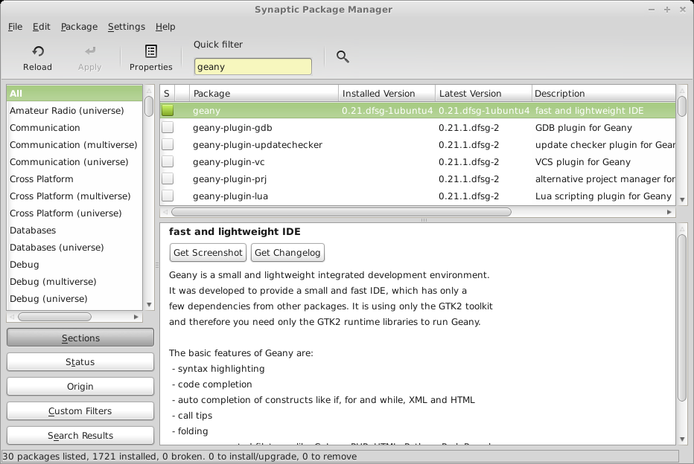
Synaptic

Slide 13
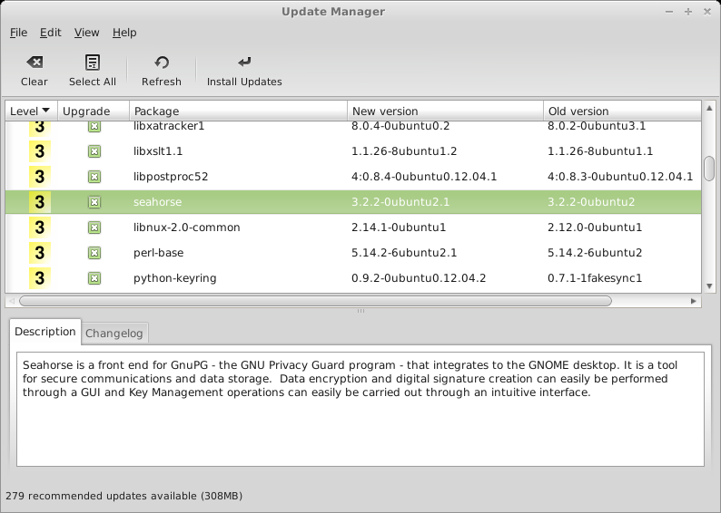
Update Manager

Slide 14
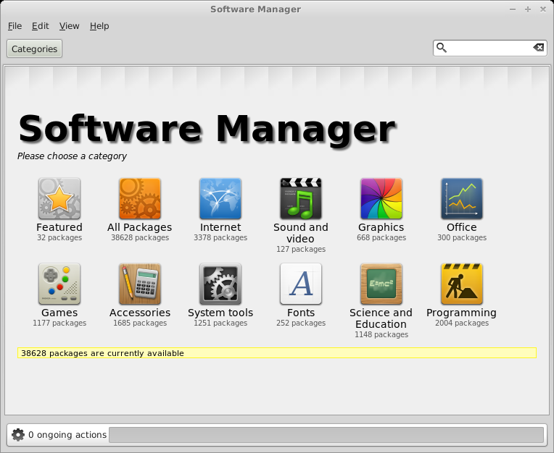
Software Manager

Slide 15
File System Management
logical file system top: root “/”
constructed from one or more physical file systems that reside on physical devices
potential devices:
  hard drive
  removable drive
  main memory
  remote device

Slide 16
File System commands
df
  displays make up of logical file system
  fdisk
    prepare partitions on physical medium
mkfs
  create file system on physical device
  select file system type, ex.: ext4
mount
  add additional physical into logical file system
  undone via: umount
  made permanent with entry into /etc/fstab

Slide 17
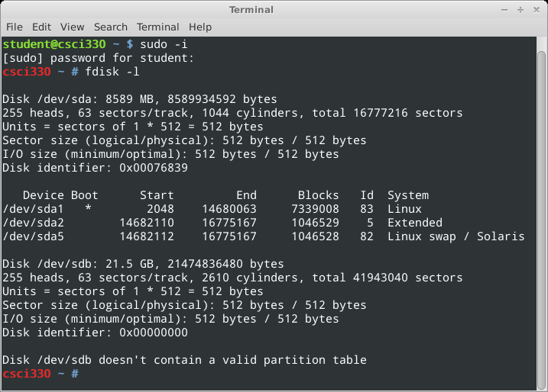
  fdisk: prepare partitions

Slide 18
Steps to enable new hard drive
find device name: fdisk -l
edit partition table: fdisk /dev/sdb
  create partition /dev/sdb1
create file system: mkfs -t ext4 /dev/sdb1
mount file system:
  mkdir /mnt/extra
  mount /dev/sdb1 /mnt/extra
see file systems: df

Slide 19
Summary
User Management
  sudo
Software Management
  apt-get, synaptic
File system Management
  fdisk, mkfs, mount, df

