Slide 1
CSCI 330
UNIX and Network Programming
Unit IIX: awk, Part I

Slide 2
What is awk?
created by: Aho, Weinberger and Kernighan
scripting language used for manipulating data and generating reports
versions of awk:
  awk, nawk, mawk, pgawk, …
GNU awk: gawk

Slide 3
What can you do with awk?
awk operation:
  reads a file line by line
  splits each input line into fields
  compares input line/fields to pattern
  performs action(s) on matched lines
Useful for:
  transform data files
  produce formatted reports
Programming constructs:
  format output lines
  arithmetic and string operations
  conditionals and loops

Slide 4
Basic awk invocation
awk 'script' file(s)
awk –f scriptfile file(s)
common option: -F
  to change field separator

Slide 5
Basic awk script
consists of patterns & actions:
pattern {action}
  if pattern is missing, action is applied to all lines
  if action is missing, the matched line is printed
  must have either pattern or action
Example:
  awk '/for/ { print }' testfile
  prints all lines containing string “for” in testfile

Slide 6
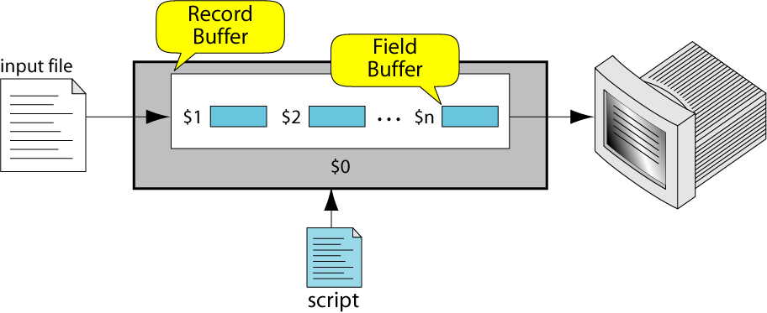
awk variables
awk reads input line into buffers:
record and fields
field buffer:
  one for each field in the current record
  variable names: $1, $2, …
record buffer:
  $0 holds the entire record

Slide 7
More awk variables
NR Number of the current record
NF Number of fields in current record
also:
FS Field separator (default=whitespace)

Slide 8
Example: Records and Fields
% cat emps
Tom Jones 4424 5/12/66 543354
Mary Adams 5346 11/4/63 28765
Sally Chang 1654 7/22/54 650000
Billy Black 1683 9/23/44 336500
% awk '/Tom/ { print }' emps
Tom Jones 4424 5/12/66 543354

Slide 9
Example: Records and Fields
% cat emps
Tom Jones 4424 5/12/66 543354
Mary Adams 5346 11/4/63 28765
Sally Chang 1654 7/22/54 650000
Billy Black 1683 9/23/44 336500
% awk '{print NR, $0}' emps
1 Tom Jones 4424 5/12/66 543354
2 Mary Adams 5346 11/4/63 28765
3 Sally Chang 1654 7/22/54 650000
4 Billy Black 1683 9/23/44 336500

Slide 10
Example: Space as Field Separator
% cat emps
Tom Jones 4424 5/12/66 543354
Mary Adams 5346 11/4/63 28765
Sally Chang 1654 7/22/54 650000
Billy Black 1683 9/23/44 336500
% awk '{print NR, $1, $2, $5}' emps
1 Tom Jones 543354
2 Mary Adams 28765
3 Sally Chang 650000
4 Billy Black 336500

Slide 11
Example: Colon as Field Separator
% cat emps2
Tom Jones:4424:5/12/66:543354
Mary Adams:5346:11/4/63:28765
Sally Chang:1654:7/22/54:650000
Billy Black:1683:9/23/44:336500
% awk -F: '/Jones/{print $1, $2}' emps2
Tom Jones 4424

Slide 12
Special Patterns
BEGIN
  matches before the first line of input
  used to create header for report
END
  matches after the last line of input
  used to create footer for report

Slide 13
example input file
Jan 13 25 15 115
Feb 15 32 24 22
Mar 15 24 34 228
Apr 31 52 63 420
May 16 34 29 208
Jun 31 42 75 492
Jul 24 34 67 436
Aug 15 34 47 316
Sep 13 55 37 277
Oct 29 54 68 525
Nov 20 87 82 577
Dec 17 35 61 401
Jan 21 36 64 620
Feb 26 58 80 652
Mar 24 75 70 495
Apr 21 70 74 514

Slide 14
awk example runs
awk '{print $1}' input
awk '$1 ~ /Feb/ {print $1}' input
awk '{print $1, $2+$3+$4, $5}' input
awk 'NF == 5 {print $1, $2+$3+$4, $5}' input

Slide 15
awk example script
BEGIN {
print "January Sales Revenue"
}
$1 ~ /Jan/ {
print $1, $2+$3+$4, $5
}
END {
print NR, " records processed"
}

Slide 16
Categories of Patterns
simple patterns
  BEGIN, END
  expression patterns: whole line vs. explicit field match
    whole line /regExp/
    field match $2 ~ /regExp
range patterns
  specified as from and to:
    example: /regExp/,/regExp/

Slide 17
awk actions
basic expressions
output: print, printf
decisions: if
loops: for, while

Slide 18
awk Expression
consists of: operands and operators
operands:
  numeric and string constants
  variables
  functions and regular expression
operators:
  assignment: = ++ -- += -= *= /=
  arithmetic: + - * / % ^
  logical: && || !
  relational: > < >= <= == !=
  match: ~ !~
  string concatenation: space

Slide 19
awk Variables
created via assignment:
var = expression
types: number (not limited to integer)
string, array
variables come into existence when first used
type of variable depends on its use
variables are initialized to either 0 or “”

Slide 20
awk variables example
BEGIN {
print "January Sales Revenue"
count = 0
sum = 0
}
$1 ~ /Jan/ && NF == 5 {
print $1, $2+$3+$4, $5
count++
sum += $5
}
END {
print count, " records produce: ", sum
}

Slide 21
awk output: print
Writes to standard output
Output is terminated by newline
If called with no parameter, it will print $0
Printed parameters are separated by blank
Print control characters are allowed:
  \n \f \a \t \b \\ …

Slide 22
print examples
% awk '{print $1, $2}' grades
john 85
andrea 89
jasper 84
% awk '{print $1 "," $2}' grades
john,85
andrea,89
jasper,84

Slide 23
printf: Formatting output
Syntax:
  printf(format-string, var1, var2, …)
each format specifier within “format-string” requires additional argument of matching type
    %d, %i decimal integer
    %c single character
    %s string of characters
    %f floating point number

Slide 24
Format specifier modifiers
between “%” and letter
%10s
%7d
%10.4f
%-20s
meaning:
  width of field, field is printed right justified (“-” will left justify)
  precision: number of digits after decimal point

Slide 25
awk Example: list of products
101:propeller:104.99
102:trailer hitch:97.95
103:sway bar:49.99
104:fishing line:0.99
105:mirror:4.99
106:cup holder:2.49
107:cooler:14.89
108:wheel:49.99
109:transom:199.00
110:pulley:9.88
111:lock:31.00
112:boat cover:120.00
113:premium fish bait:1.00

Slide 26
awk Example: output
Marine Parts R Us
Main catalog
Part-id name price
======================================
101 propeller 104.99
102 trailer hitch 97.95
103 sway bar 49.99
104 fishing line 0.99
105 mirror 4.99
106 cup holder 2.49
107 cooler 14.89
108 wheel 49.99
109 transom 199.00
110 pulley 9.88
111 lock 31.00
112 boat cover 120.00
113 premium fish bait 1.00
======================================
Catalog has 13 parts

Slide 27
awk Example: complete
BEGIN {
FS= ":"
print "Marine Parts R Us"
print "Main catalog"
print "Part-id\tname\t\t\t price"
print "=================================="
}
{
printf("%3d\t%-20s\t%6.2f\n", $1, $2, $3)
}
END {
print "=================================="
print "Catalog has", NR, "parts"
}

Slide 28
Summary
next: more awk
  arrays
  control structures

