Slide 1
CSCI 330
UNIX and Network Programming
Unit XVI: TCP Server Programming

Slide 2
Unit Overview
TCP client & server programming
  add DNS lookup: basicClient
server fork to process client request
example TCP server
  list files in directory specified

Slide 3
TCP programming
provides multiple endpoints on a single node: port
common abstraction: socket
socket is end-point of communication link
  identified as IP address + port number
  can receive data
  can send data

Slide 4
Socket system calls
server
Primitive | Meaning
socket | Create a new communication endpoint
bind | Attach a local address to a socket
listen | Announce willingness to accept connections
accept | Block caller until a connection request arrives
connect | Actively attempt to establish a connection
write | Send(write) some data over the connection
read | Receive(read) some data over the connection
close | Release the connection
client

Slide 5
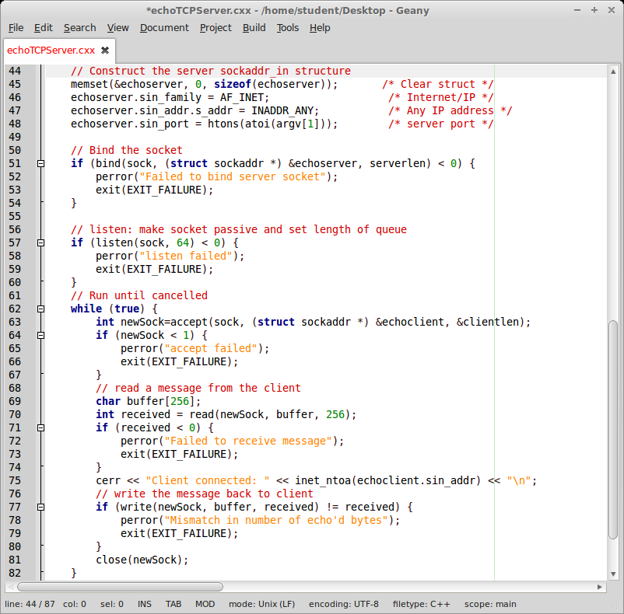
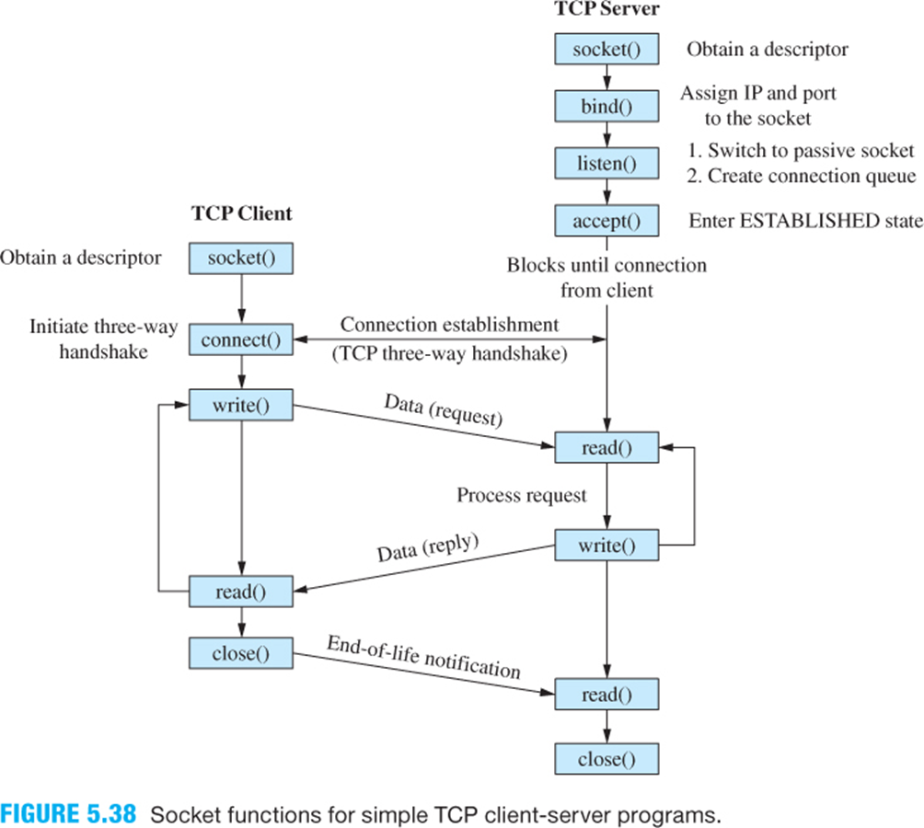
TCP server illustration

Slide 6
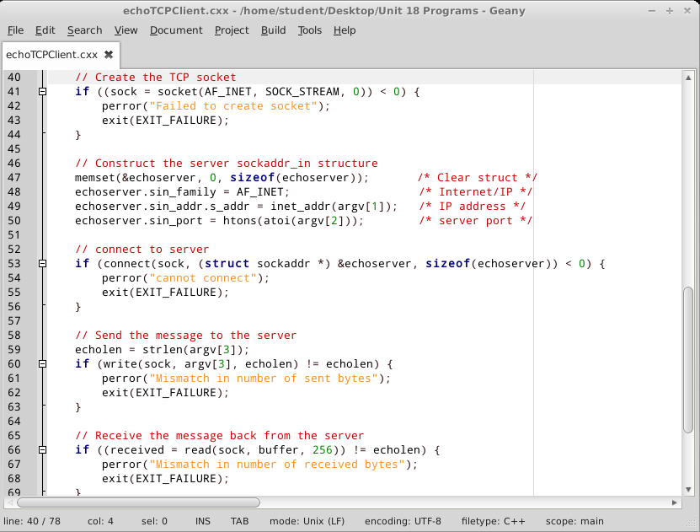
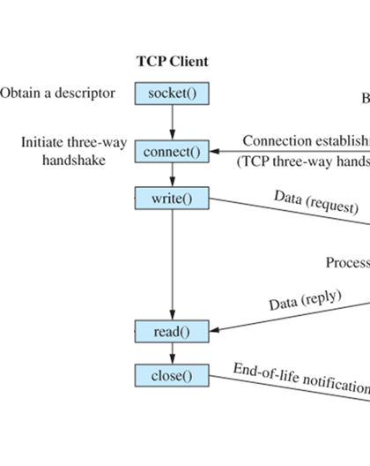
TCP client illustration

Slide 7
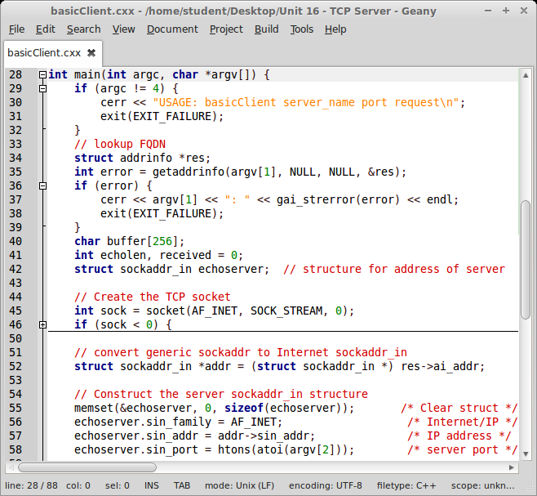
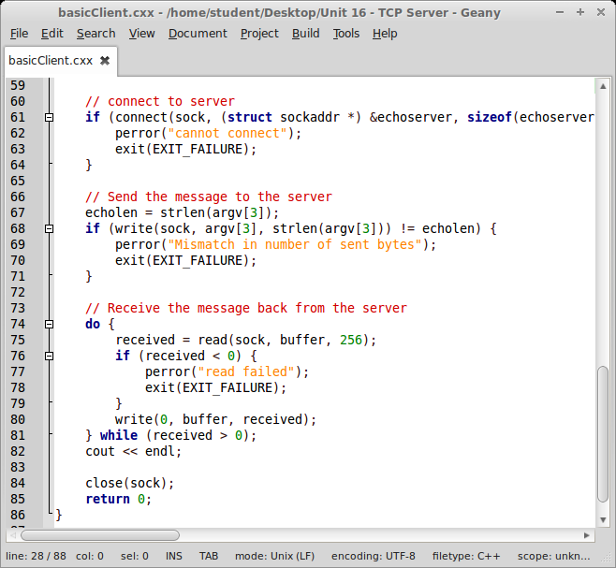
Illustration: Basic TCP request client

Slide 8
Review: TCP Server basic logic
    while (true) {
    connSock = accept(sock, ...);
    // process client’s request
    // via connSock
    close(connSock);
    }

Slide 9
TCP Server fork
server starts loop
  blocks on accept for connection from client
after accept:
  accept returns dedicated connection socket
  server forks to service client request
parent process
  closes dedicated connection socket
  continues to block for next accept
child process
  serves client request
  communicates with client via dedicated connection socket

Slide 10
TCP Server fork: logic
    while (true) {
    connSock = accept(sock, ...);
    if (fork()) { // parent process
    close(connSock);
    } else { // child process
    // process client’s request via connSock
    ...
    }
    }

Slide 11
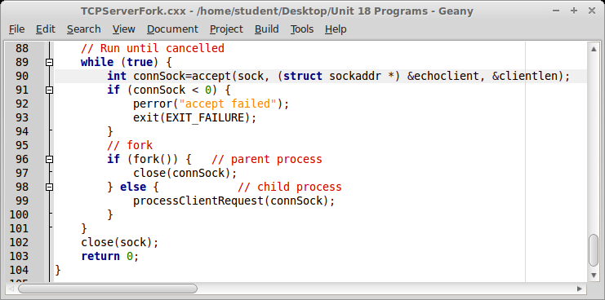
TCP server/fork illustration

Slide 12
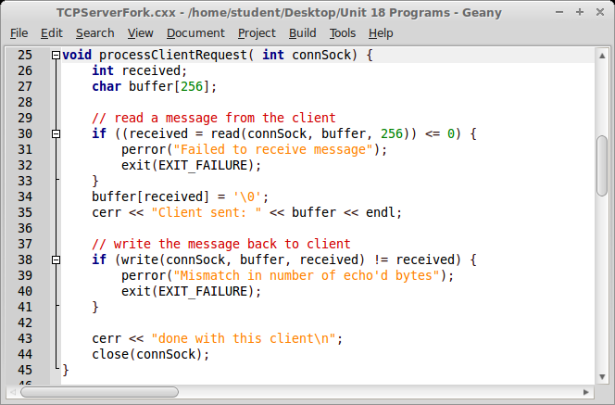
TCP server/fork illustration

Slide 13
Server example: list directory
after accept, server forks to service client request
  parent process will continue to block on new accept
child process serves client request
  open directory
  read directory entries

Slide 14
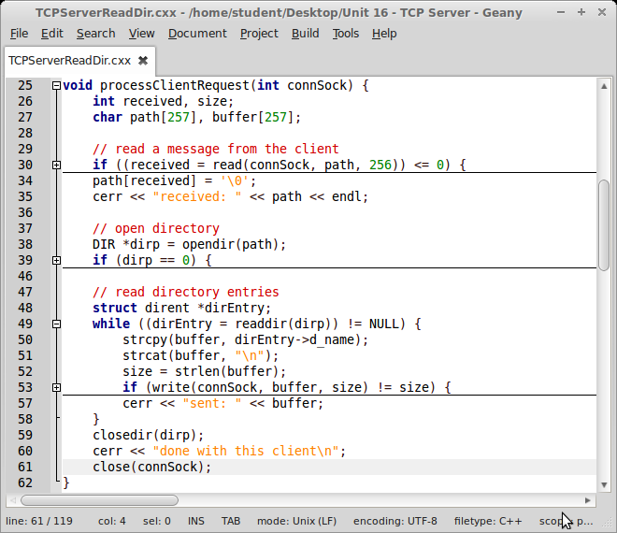
Server child: processClientRequest

Slide 15
TCP server: opendir detail
// open directory
DIR *dirp = opendir(path);
if (dirp == 0) {
// duplicate socket descriptor into error output
close(2);
dup(connSock);
perror(path);
exit(EXIT_FAILURE);
}

Slide 16
TCP server: readdir detail
while ((dirEntry = readdir(dirp)) != NULL) {
strcpy(buffer, dirEntry->d_name);
strcat(buffer, "\n");
size = strlen(buffer);
if (write(connSock, buffer, size) != size) {
perror("Mismatch in number of bytes");
exit(EXIT_FAILURE);
}
cerr << "sent: " << buffer;
}

Slide 17
Summary
TCP server programming
server fork to process client request

