Slide 1
CSCI 330
UNIX and Network Programming
Unit XV: Transmission Control Protocol

Slide 2
Unit Overview
Transport layer
Transmission control protocol
TCP programming

Slide 3
Transport Layer
provides end-to-end communication services for applications
provides multiple endpoints on a single node
  Address: IP address + port number
TCP: transmission control protocol
  connection oriented, guaranteed delivery
  stream oriented: basis for: http, ftp, smtp, ssh
UDP: user datagram protocol
  best effort
  datagram oriented: basis for: dns, rtp

Slide 4
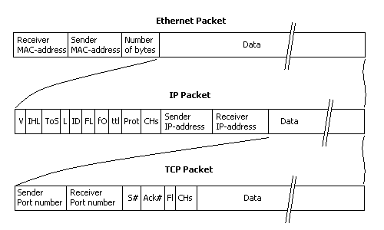
TCP/IP protocol packet

Slide 5

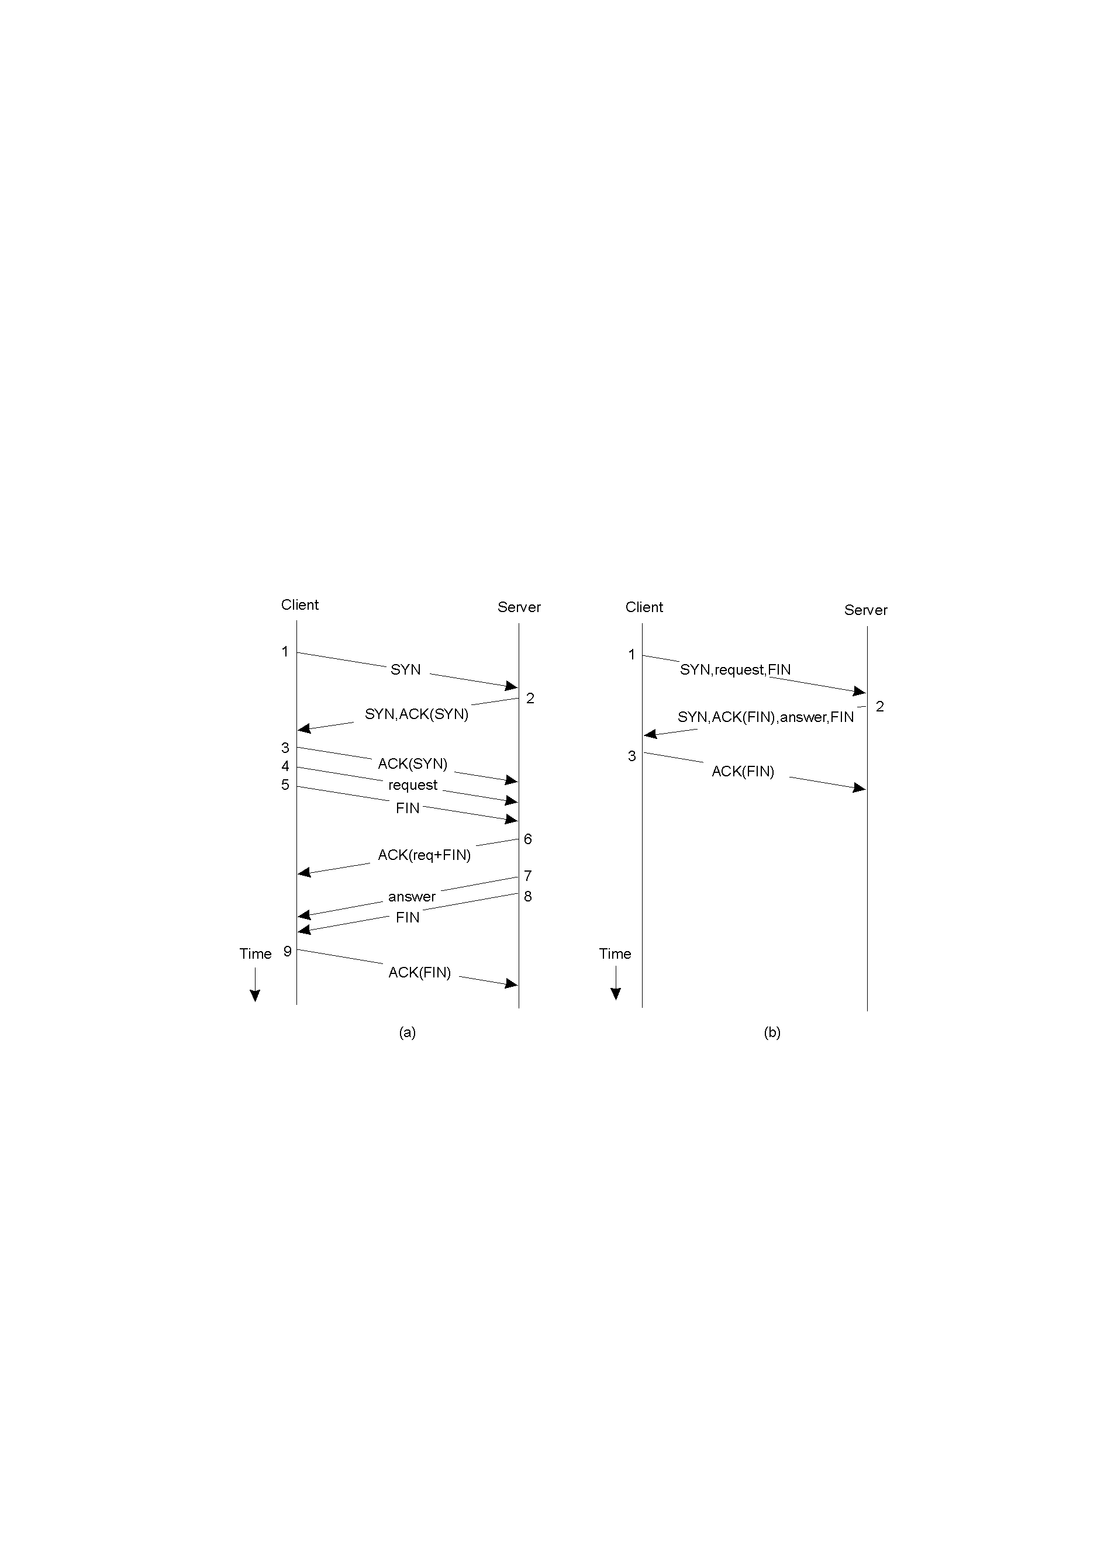
TCP communication
TCP 3-way handshake
TCP 3-way handshake

Slide 6
TCP programming
common abstraction: socket
first introduced in BSD Unix in 1981
socket is end-point of communication link
  identified as IP address + port number
  can receive data
  can send data

Slide 7
Socket system calls
server
Primitive | Meaning
socket | Create a new communication endpoint
bind | Attach a local address to a socket
listen | Announce willingness to accept connections
accept | Block caller until a connection request arrives
connect | Actively attempt to establish a connection
write | Send(write) some data over the connection
read | Receive(read) some data over the connection
close | Release the connection
client

Slide 8
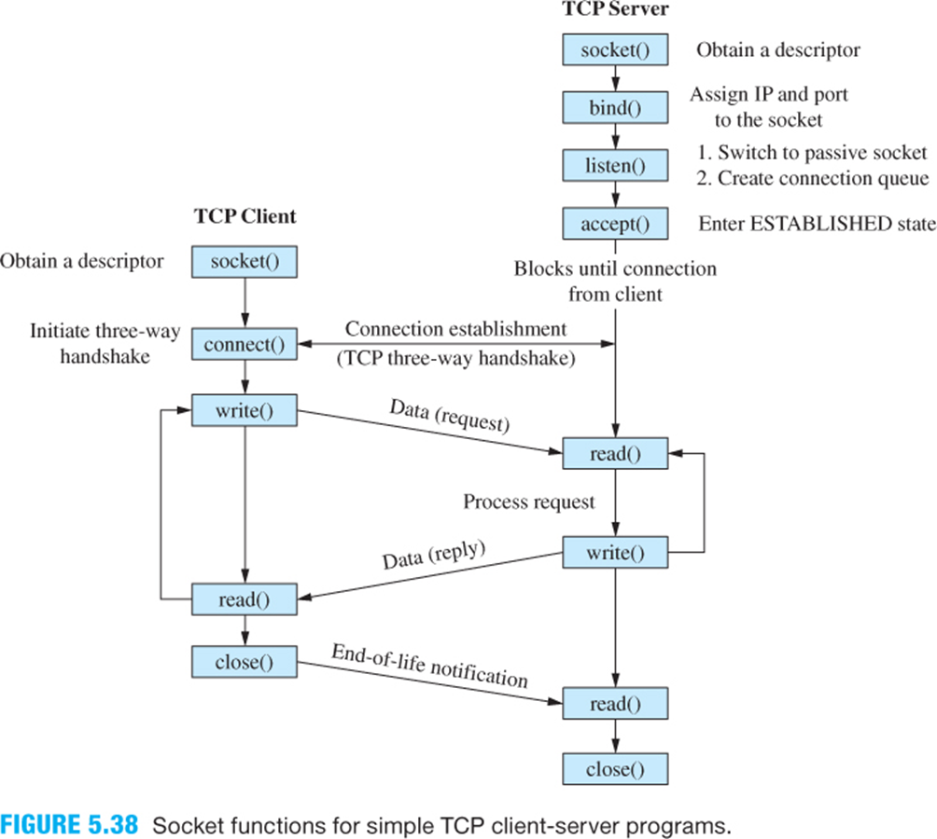
TCP communications pattern

Slide 9
System call: socket
int socket(int domain, int type, int protocol)
creates a new socket, as end point to a communications link
domain is set to AF_INET
type is set to SOCK_STREAM for stream communication
protocol is set to 0, i.e. default TCP
returns socket descriptor:
  used in bind, listen, accept, connect, write, read, close

Slide 10
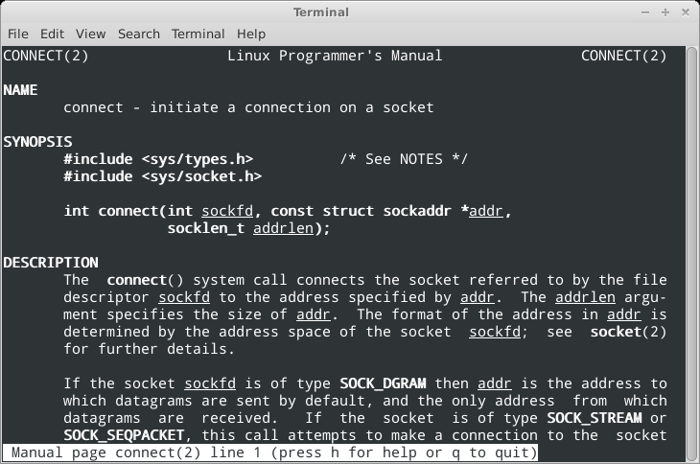
Client system call: connect

Slide 11
Client system call: connect
int connect(int sockfd,
const struct sockaddr *addr,
socklen_t addrlen)
connects socket to remote IP number and port
struct sockaddr holds address information
  will accept struct sockaddr_in pointer
addrlen specifies length of addr structure
returns 0 on success, -1 otherwise

Slide 12
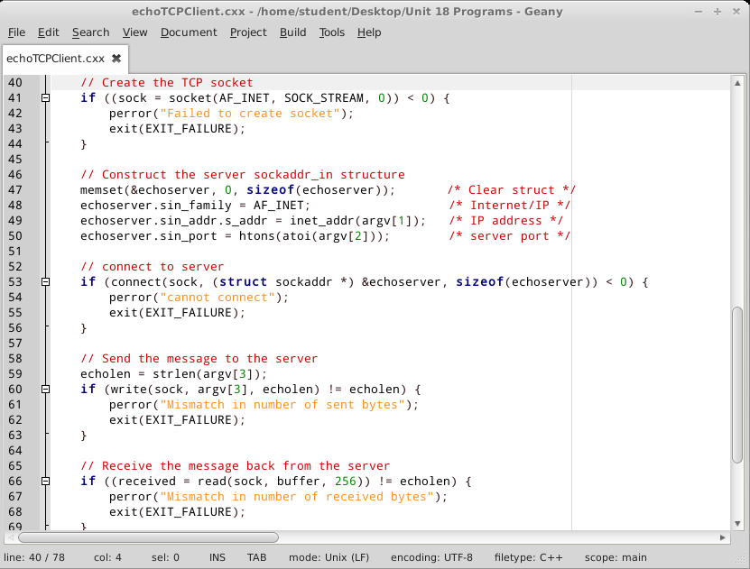
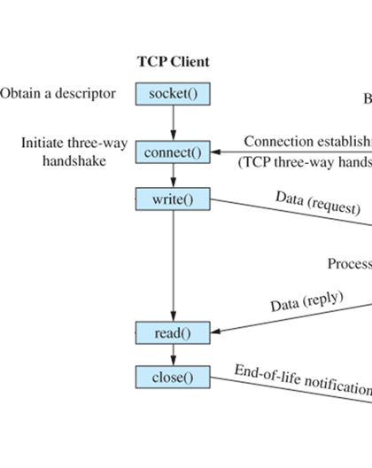
TCP client illustration

Slide 13
Client detail: create TCP socket
int sock;
// Create the TCP socket
if ((sock = socket(AF_INET, SOCK_STREAM, 0)) < 0) {
perror("Failed to create socket");
exit(EXIT_FAILURE);
}

Slide 14
Client detail: connect the socket
// Construct the server sockaddr_in structure
memset(&echoserver, 0, sizeof(echoserver)); /* Clear struct */
echoserver.sin_family = AF_INET; /* Internet/IP */
echoserver.sin_addr.s_addr = inet_addr(argv[1]); /* IP address */
echoserver.sin_port = htons(atoi(argv[2])); /* server port */
// connect to server
if (connect(sock,
(struct sockaddr *) &echoserver, sizeof(echoserver)) < 0) {
perror("cannot connect");
exit(EXIT_FAILURE);
}

Slide 15
Client detail: write to socket
// Send the message to the server
echolen = strlen(argv[3]);
if (write(sock, argv[3], echolen) != echolen) {
perror("Mismatch in number of sent bytes");
exit(EXIT_FAILURE);
}

Slide 16
Client detail: read from socket
// Receive the message back from the server
if ((received = read(sock, buffer, 256)) != echolen) {
perror("Mismatch in number of received bytes");
exit(EXIT_FAILURE);
}
/* Assure null-terminated string */
buffer[received] = '\0';
cout << "Server ("
<< inet_ntoa(echoserver.sin_addr)
<< ") echoed: " << buffer << endl;

Slide 17
Server system call: bind
int bind(int sockfd,
const struct sockaddr *addr,
socklen_t addrlen)
assigns address to socket: IP number and port
struct sockaddr holds address information
  will accept struct sockaddr_in pointer
addrlen specifies length of addr structure
returns 0 on success, -1 otherwise

Slide 18
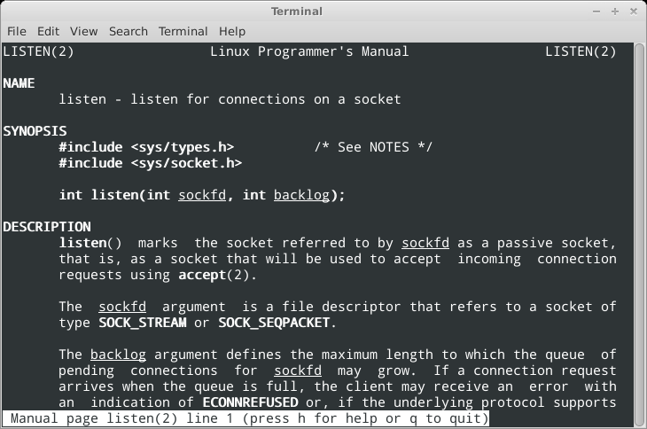
Server system call: listen

Slide 19
Server system call: listen
int listen(int sockfd, int backlog)
marks socket as passive socket
  it will be used to accept incoming requests via accept
backlog specifies length of incoming connection queue
returns 0 on success, -1 otherwise

Slide 20
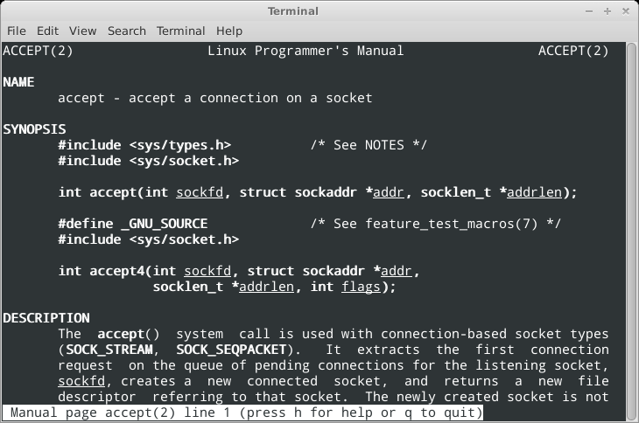
Server system call: accept

Slide 21
Server system call: accept
int accept(int sockfd,
struct sockaddr *addr,
socklen_t *addrlen)
extracts connection request from incoming queue
creates a new connected socket
  returns a new file descriptor for that socket, returns -1 on failure
struct sockaddr holds address information
  will accept struct sockaddr_in pointer
addrlen specifies length of addr structure

Slide 22
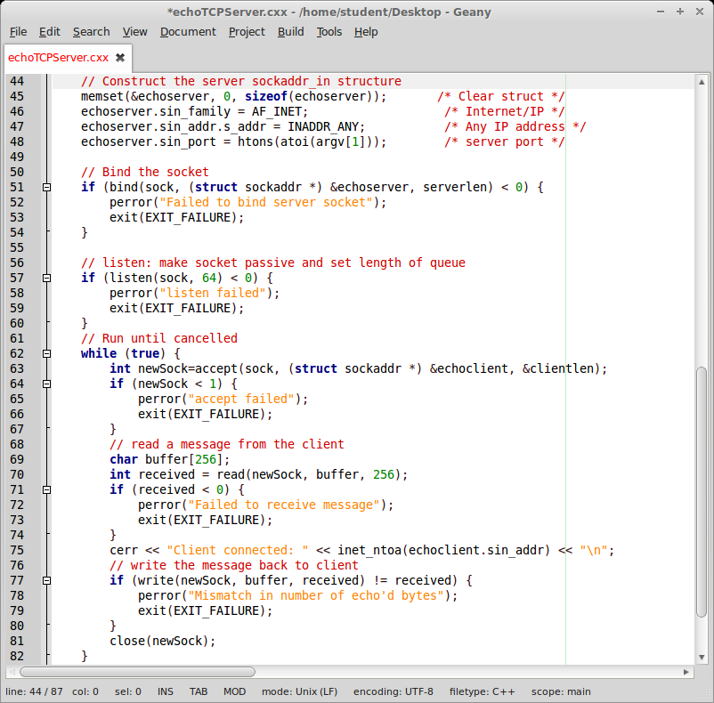
TCP server illustration

Slide 23
Server detail: create TCP socket
int sock;
// Create the TCP socket
if ((sock = socket(AF_INET, SOCK_STREAM, 0)) < 0) {
perror("Failed to create socket");
exit(EXIT_FAILURE);
}

Slide 24
Server detail: bind the socket
struct sockaddr_in echoserver; // structure for address of server
serverlen = sizeof(echoserver);
// Construct the server sockaddr_in structure
memset(&echoserver, 0, sizeof(echoserver)); /* Clear struct */
echoserver.sin_family = AF_INET; /* Internet/IP */
echoserver.sin_addr.s_addr = INADDR_ANY; /* Any IP address */
echoserver.sin_port = htons(atoi(argv[1])); /* server port */
// Bind the socket
if (bind(sock, (struct sockaddr *) &echoserver, serverlen) < 0) {
perror("Failed to bind server socket");
exit(EXIT_FAILURE);
}

Slide 25
Server detail: listen on the socket
// listen: make socket passive,
// set length of queue
if (listen(sock, 64) < 0) {
perror("listen failed");
exit(EXIT_FAILURE);
}

Slide 26
Server detail: accept new socket
// Run until cancelled
while (true)
int newSock=accept(sock,
(struct sockaddr *) &echoclient,
&clientlen)) {
// read & write from newSock
...
}

Slide 27
Server detail: read from socket
// read a message from the client
char buffer[256];
int received = read(newSock, buffer, 256);
if (received < 0) {
perror("Failed to receive message");
exit(EXIT_FAILURE);
}
cerr << "Client connected: "
<< inet_ntoa(echoclient.sin_addr) << "\n";

Slide 28
Server detail: write to socket
// write the message back to client
if (write(newSock, buffer, received)
!= received) {
perror("Mismatch in number of bytes");
exit(EXIT_FAILURE);
}

Slide 29
Summary
Transport layer
Transmission control protocol
TCP programming

