Slide 1
CSCI 330
UNIX and Network Programming
Unit XIV: User Datagram Protocol

Slide 2
Unit Overview
Transport layer
User datagram protocol
UDP programming
Example UDP client/server programs

Slide 3
Review: Network Layer
also called: Internet Protocol (IP) Layer
  provides host to host transmission service,
  where hosts are not necessarily adjacent
IP layer provides services:
  addressing
    hosts have global addresses: IPv4, IPv6
  routing and forwarding
    find path from host to host

Slide 4
Transport Layer
provides end-to-end communication services for applications
provides multiple endpoints on a single node: port
TCP: transmission control protocol
  connection oriented, guaranteed delivery
  stream oriented: basis for: http, ftp, smtp, ssh
UDP: user datagram protocol
  best effort
  datagram oriented: basis for: dns, rtp

Slide 5
UDP
simple message-based connection-less protocol
  transmits information in one direction from source to destination without verifying the readiness or state of the receiver
uses datagram as message
stateless and fast

Slide 6
UPD packet format
bits | 0 – 7 | 8 – 15 | 16 – 23 | 24 – 31
0 | Source IP address
32 | Destination IP address
64 | Zeros | Protocol | UDP length
96 | Source Port |  | Destination Port
128 | Length |  | Checksum
160+ | Data

Slide 7
UDP programming
common abstraction: socket
first introduced in BSD Unix in 1981
socket is end-point of communication link
  identified as IP address + port number
can receive data
can send data

Slide 8
Socket system calls
server
System call | Meaning
socket | Create a new communication endpoint
bind | Attach a local address to a socket
sendto | Send(write) some data over the connection
recvfrom | Receive(read) some data over the connection
close | Release the connection
client
optional

Slide 9
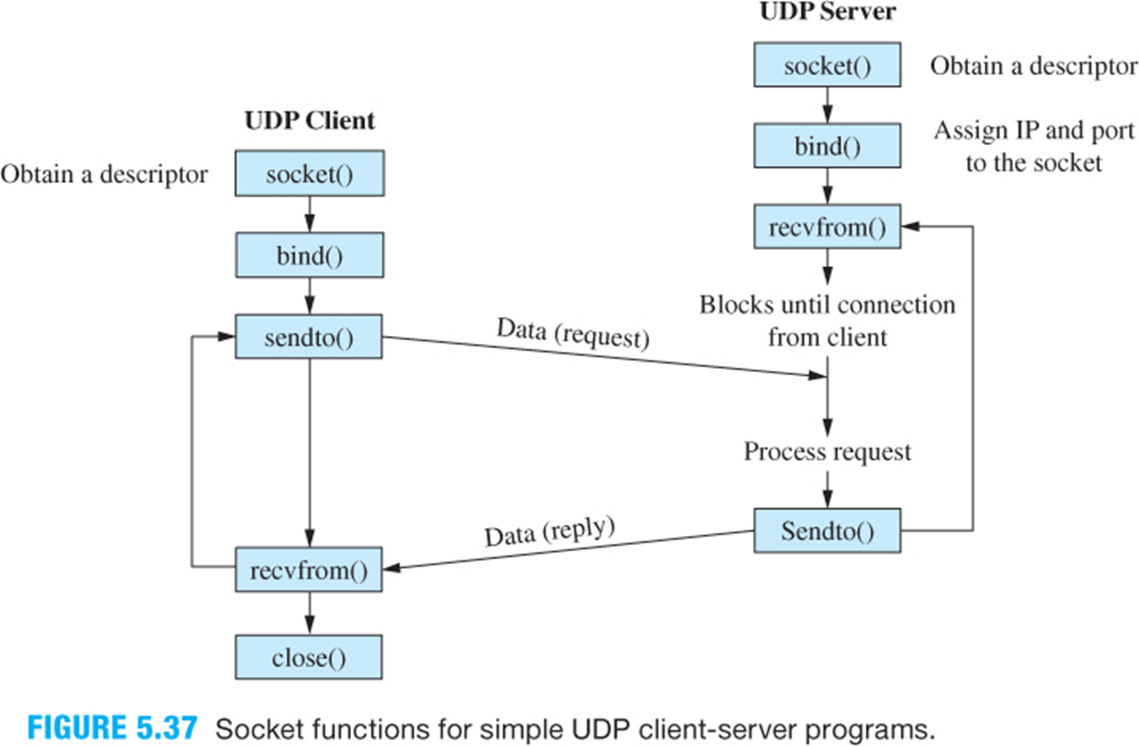
UDP communications pattern
optional

Slide 10
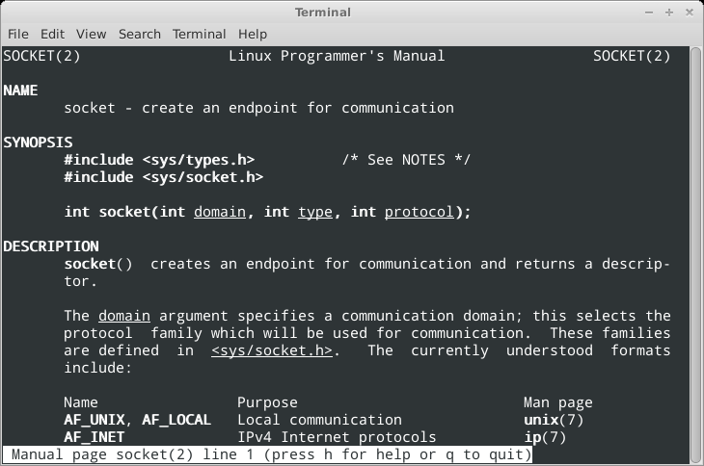
System call: socket

Slide 11
System call: socket
int socket(int domain, int type, int protocol)
creates a new socket, as end point to a communications link
domain is set to AF_INET
type is set to SOCK_DGRAM for datagrams
protocol is set to 0, i.e. default UDP
returns socket descriptor:
  used in bind, sendto, recvfrom, close

Slide 12
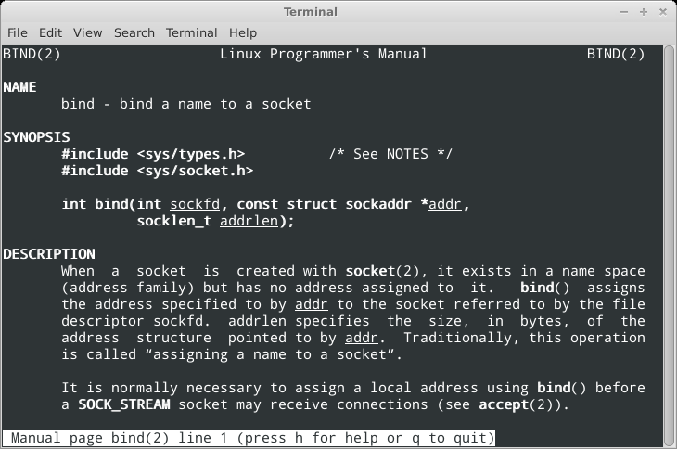
System call: bind

Slide 13
System call: bind
int bind(int sockfd,
const struct sockaddr *addr,
socklen_t addrlen)
assigns address to socket: IP number and port
struct sockaddr holds address information
  will accept struct sockaddr_in pointer
addrlen specifies length of addr structure
returns 0 on success, -1 otherwise

Slide 14
structure sockaddr: 16bytes
struct sockaddr {
short sa_family; /* address family */
char sa_data[14]; /* address data */
};
struct sockaddr_in {
short sin_family; /* address family */
unsigned short sin_port; /* port number:2 bytes */
struct in_addr sin_addr; /* IP address: 4 bytes */
/* pad to size of struct sockaddr */
char sin_zero[8];
};

Slide 15
structure sockaddr_in: members
sin_family /* address family */
always: AF_INET
sin_port /* port number: 2 bytes */
htons(4444) /* ensure network order */
sin_addr /* Internet address: 4 bytes */
s_addr = INADDR_ANY
s_addr = inet_addr("127.0.0.1")

Slide 16
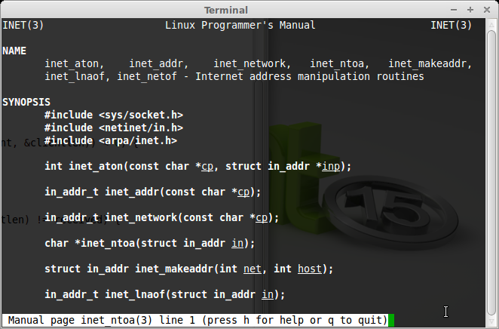
Inet Address Manipulation

Slide 17
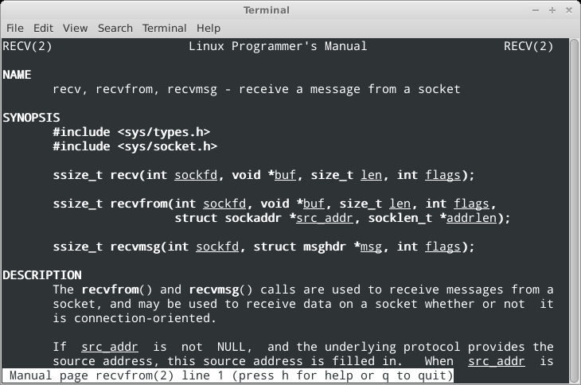
System call: recvfrom

Slide 18
System call: recvfrom
ssize_t recvfrom(int sockfd, void *buf, size_t len,
int flags, struct sockaddr *src_addr,
socklen_t *addrlen)
receives a datagram buf of size len from socket sockfd
  will wait until a datagram is available
  flags specifies wait behavior, e.g.: 0 for default
src_addr will hold address information of sender
  struct sockaddr defines address structure
  addrlen specifies length of src_addr structure
returns the number of bytes received, i.e. size of datagram

Slide 19
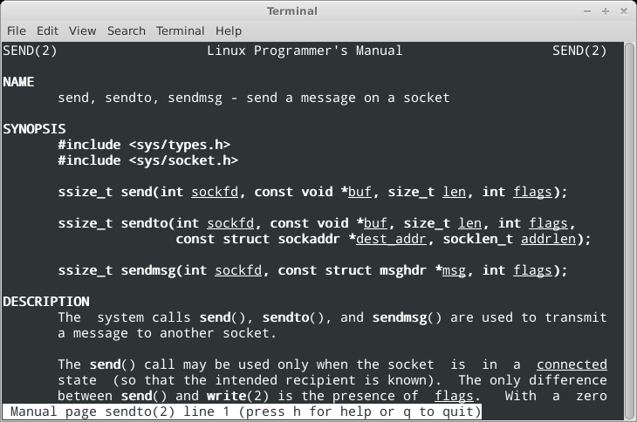
System call: sendto

Slide 20
System call: sendto
ssize_t sendto(int sockfd,
const void *buf, size_t len, int flags,
const struct sockaddr *dest_addr, socklen_t addrlen)
sends datagram buf of size len to socket sockfd
  will wait if there is no ready receiver
  flags specifies wait behavior, e.g.: 0 for default
dest_addr holds address information of receiver
  struct sockaddr defines address structure
  addrlen specifies length of dest_addr structure
returns the number of bytes sent, i.e. size of datagram

Slide 21
Example: UDP Programming
simple server: echo
  sends all received datagrams back to sender
simple client
  send datagram to server

Slide 22
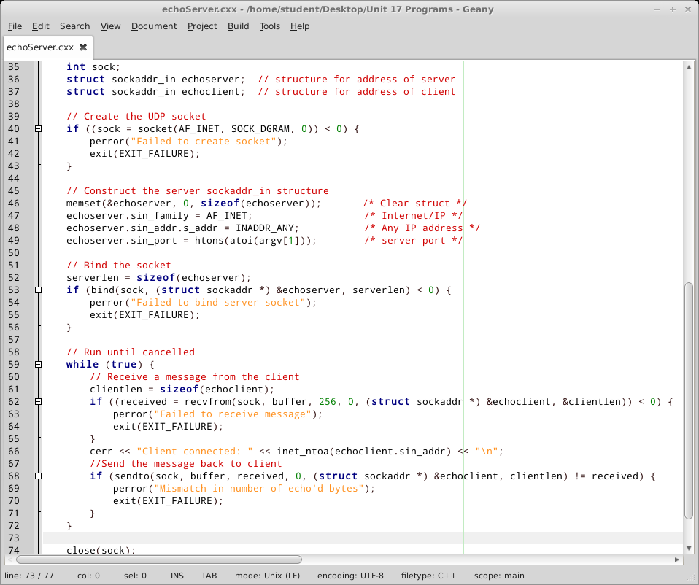
Illustration: echoServer.cxx

Slide 23
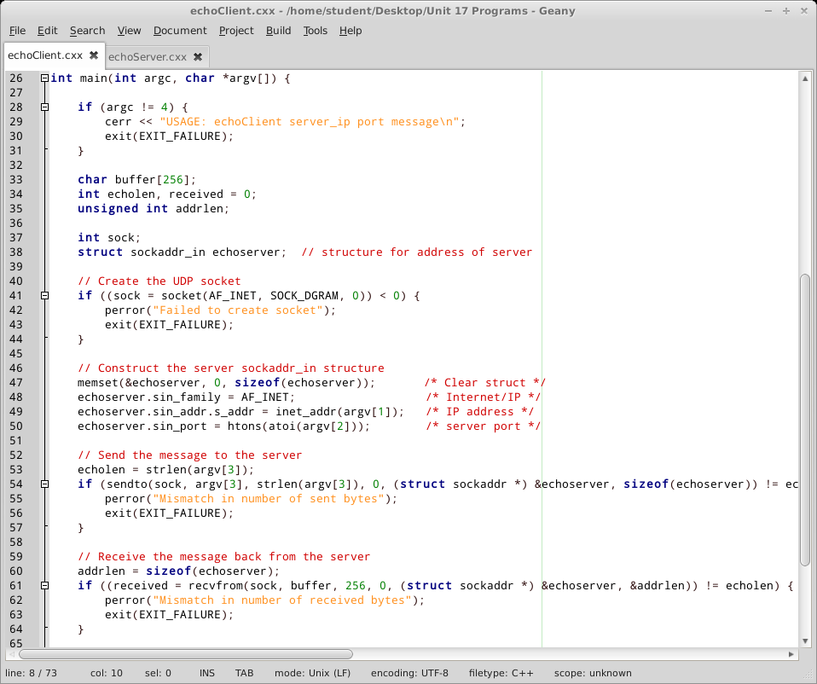
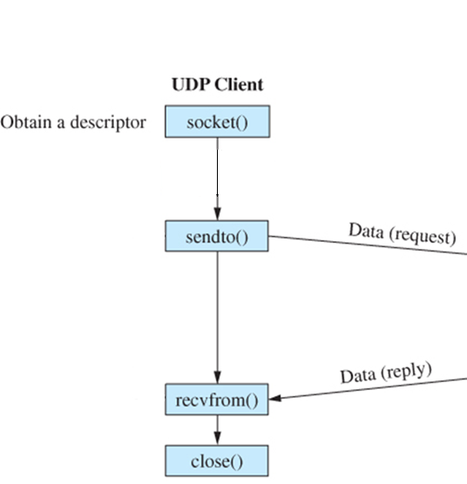
Illustration: echoClient.cxx

Slide 24
Detail: create UDP socket
int sock;
// Create the UDP socket
if ((sock = socket(AF_INET, SOCK_DGRAM, 0)) < 0) {
perror("Failed to create socket");
exit(EXIT_FAILURE);
}

Slide 25
Detail: bind the socket
struct sockaddr_in echoserver; // structure for address of server
// Construct the server sockaddr_in structure
memset(&echoserver, 0, sizeof(echoserver)); /* Clear struct */
echoserver.sin_family = AF_INET; /* Internet/IP */
echoserver.sin_addr.s_addr = INADDR_ANY; /* Any IP address */
echoserver.sin_port = htons(atoi(argv[1])); /* server port */
// Bind the socket
serverlen = sizeof(echoserver);
if (bind(sock, (struct sockaddr *) &echoserver, serverlen) < 0) {
perror("Failed to bind server socket");
exit(EXIT_FAILURE);
}

Slide 26
Detail: receive from socket
addrlen = sizeof(echoserver);
received = recvfrom(sock, buffer, 256, 0,
(struct sockaddr *) &echoserver, &addrlen);
cout << "Received: << received bytes\n";
buffer[received] = '\0'; /* Assure null-terminated string */
cout << "Server ("
<< inet_ntoa(echoserver.sin_addr)
<< ") echoed: " << buffer << endl;

Slide 27
Detail: send to socket
// Construct the server sockaddr_in structure
memset(&echoserver, 0, sizeof(echoserver)); /* Clear struct */
echoserver.sin_family = AF_INET; /* Internet/IP */
echoserver.sin_addr.s_addr = inet_addr(argv[1]); /* IP address */
echoserver.sin_port = htons(atoi(argv[2])); /* server port */
// Send the message to the server
echolen = strlen(argv[3]);
if (sendto(sock, argv[3], strlen(argv[3]), 0,
(struct sockaddr *) &echoserver, sizeof(echoserver))
!= echolen) {
perror("Mismatch in number of sent bytes");
exit(EXIT_FAILURE);
}

Slide 28
Summary
Transport layer
User datagram protocol
UDP programming
Example UDP client/server programs

