Slide 1
CSCI 330
UNIX and Network Programming
Unit XII: Process & Pipe
Part 2

Slide 2
Unit Overview
Process Management
  create new process
  change what a process is doing
Pipe concept
  Pipe for inter-process communication

Slide 3
System Calls
fork
  create a new process
wait
  wait for a process to terminate
exec
  execute a program
pipe
  establish communication channel
dup
  duplicate file descriptor

Slide 4
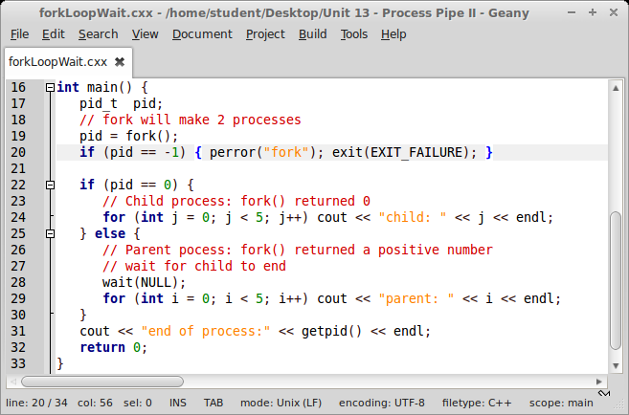
System Call: fork example

Slide 5
System Call: exec
family of functions that replace current process image with a new process image
    actual system call: execve
    library functions
      execl, execlp, execle
      execv, execvp
arguments specify new executable to run and its arguments and environment

Slide 6
C Library Function: execlp
int execlp(const char *cmd, const char *arg, ...)
starts executable for command specified in path
new executable runs in current process
cmd executable is found via path
arguments are specified as list, starting at argv[0],
terminated with (char *NULL)
return -1 on error

Slide 7
Together: fork and exec
UNIX does not have a system call to spawn a new
additional
process with a new executable
instead:
  fork to duplicate current process
  exec to morph child process into new executable

Slide 8
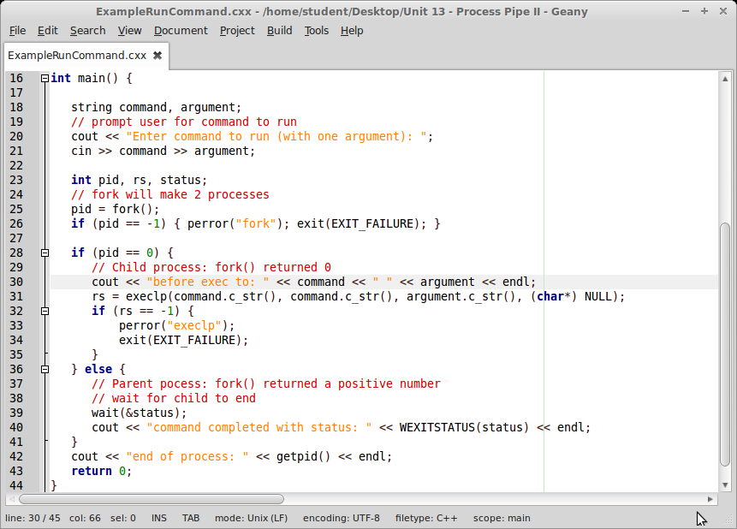
Together: fork and exec

Slide 9
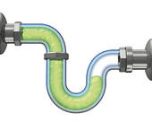
UNIX Pipe
can create a software pipeline:
set of processes chained by their standard streams
output of one process becomes input of second process
command line example:
ls | wc
implemented via pipe system call

Slide 10
System Call: pipe
int pipe(int pipefd[2])
creates a channel to transport data
has direction: one side to write, one side to read
  available via 2 file descriptors pipefd[2]
  read side pipefd[0]
  write side pipefd[1]
can be used synchronize producer and consumer of data

Slide 11
System Calls: pipe and fork
Idea: read and write end of pipe in different processes
  fork creates two processes
parent process:
  close read end of pipe
  write to write end of pipe
child process:
  close write end of pipe
  read from read end of pipe

Slide 12
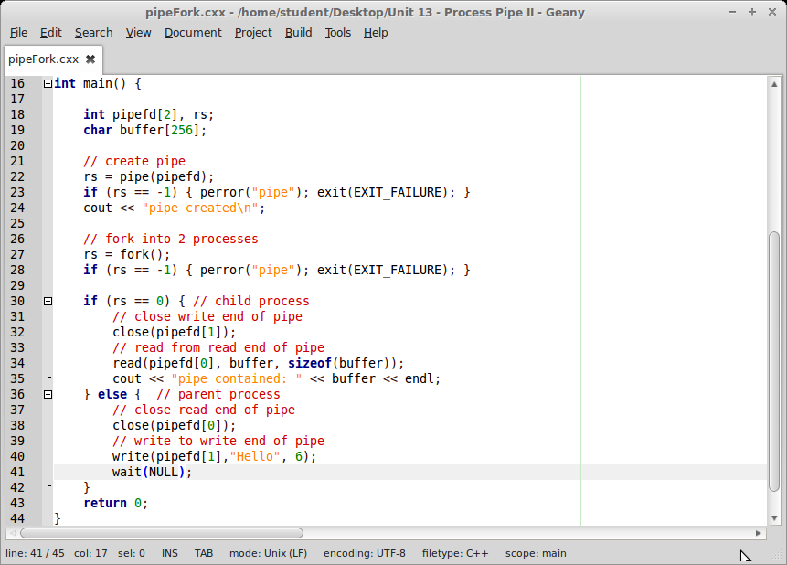
System Call: pipe & fork example

Slide 13
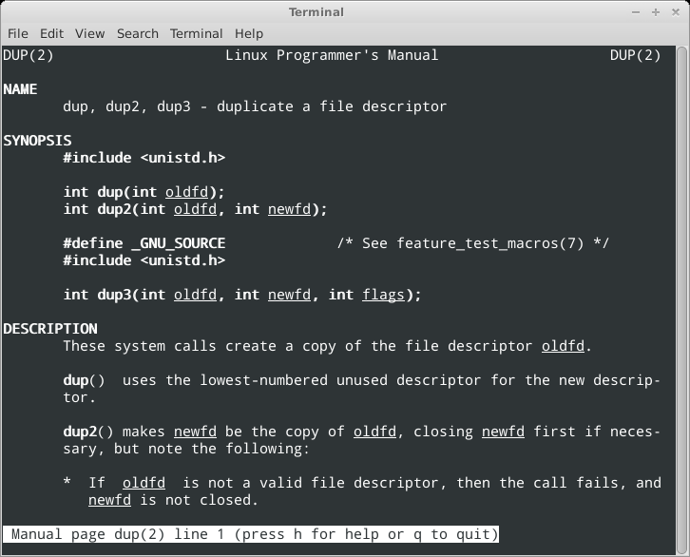
System Call: dup

Slide 14
System Call: dup
int dup(int oldfd)
creates copy of file descriptor oldfd
uses lowest-numbered unused descriptor
returns the new file descriptor, or -1 on error
used to claim standard I/O from inside program

Slide 15
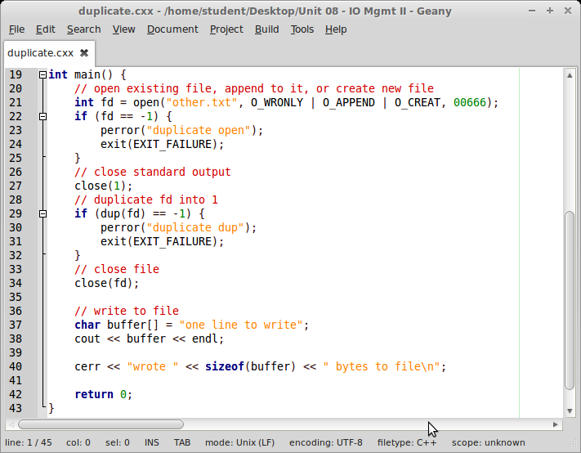
System Call: dup example

Slide 16
System Calls: pipe, fork and dup
parent process:
  close read end of pipe, keep write end of pipe open
  duplicate write end of pipe into standard output file descriptor
child process:
  close write end of pipe, read from read end of pipe
  duplicate read end of pipe into standard input file descriptor

Slide 17
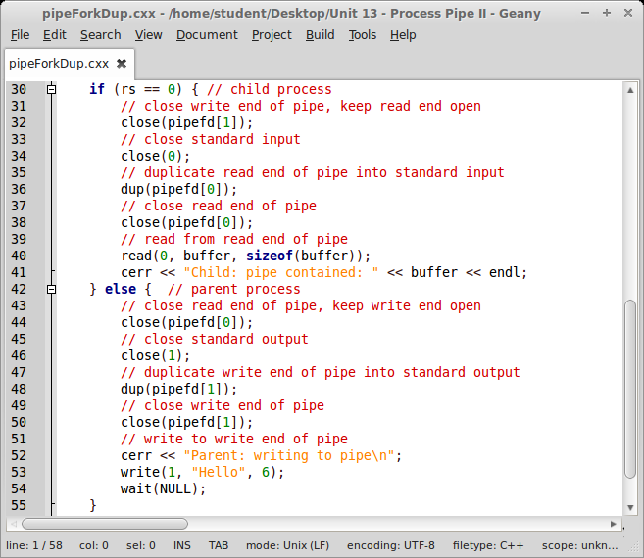
Example: pipe, fork & dup

Slide 18
System Calls: pipe,fork,dup and exec
Idea:
  2 processes communicate via pipe
  each process exec’s into new executable
Example: ls | wc
  parent: runs ls
  child: runs wc

Slide 19
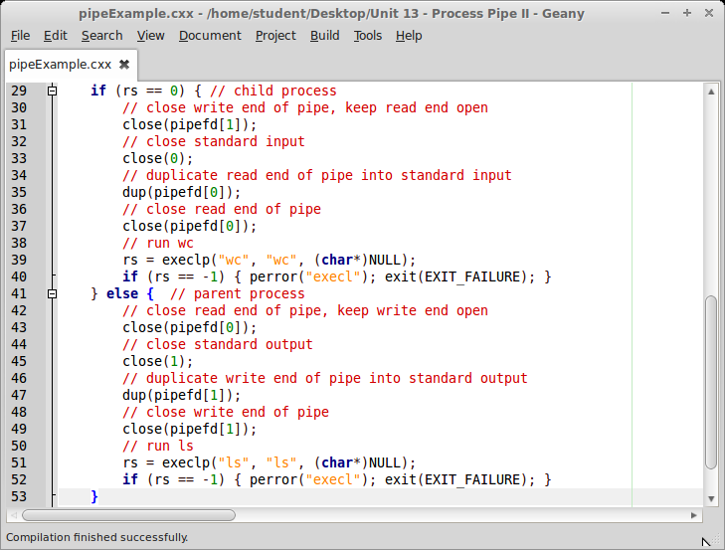
Example: pipe, fork, dup & exec

Slide 20
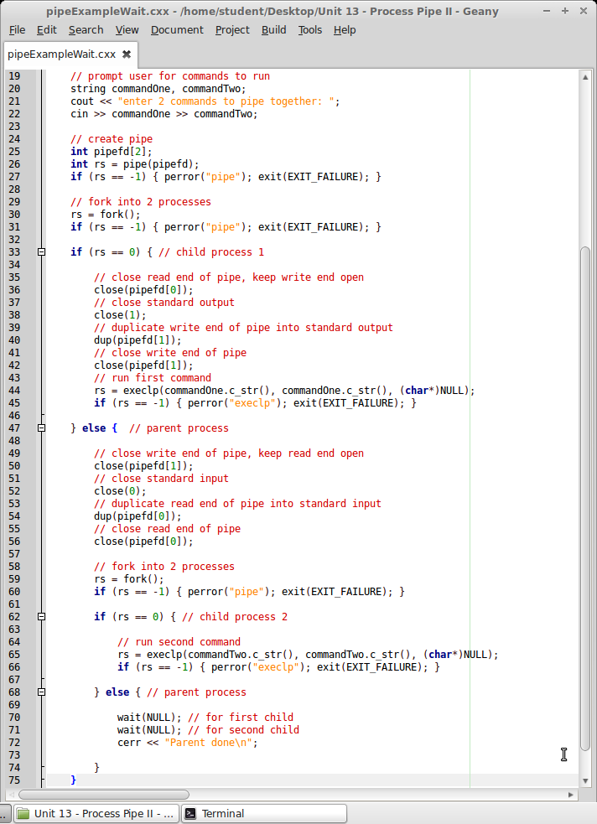
Example
prompt user for 2 commands
create pipe
run command 1 in child
  with pipefd[1] as output
run command 2 in child
  with pipefd[0] as input
wait for children

Slide 21
Summary
Process Management
  create new process
  change what a process is doing
Pipe concept
  Pipe for inter-process communication

