Slide 1
CSCI 330
UNIX and Network Programming
Unit XII: Process & Pipe
Part 1

Slide 2
Unit Overview
Process Management
  create new process
  change what process is doing
Pipe concept
  enables inter-process communication

Slide 3
Process Management System Calls
fork
  create a new process
wait
  wait for a process to terminate
exec
  execute a program

Slide 4
System Call: fork
creates new process that is duplicate of current process
new process is almost the same as current process
new process is child of current process
old process is parent of new process
after call to fork, both processes run concurrently

Slide 5
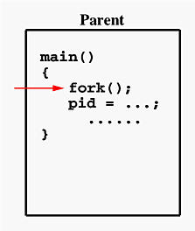
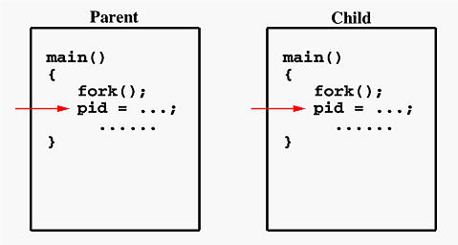
System Call: fork timeline
before
after

Slide 6
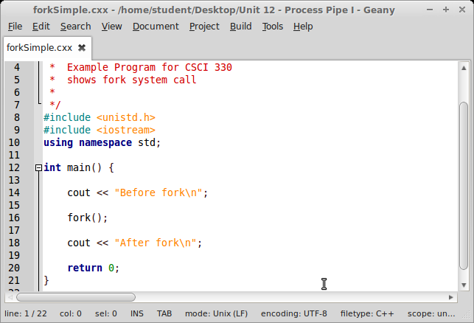
System Call: fork example

Slide 7
System Call: fork
new process is almost the same as current process
pid_t fork(void)
return value of fork is different:
parent: fork returns process id of child process
child: fork returns 0
fork returns -1 on failure

Slide 8
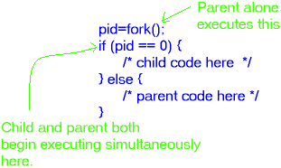
System Call: fork

Slide 9
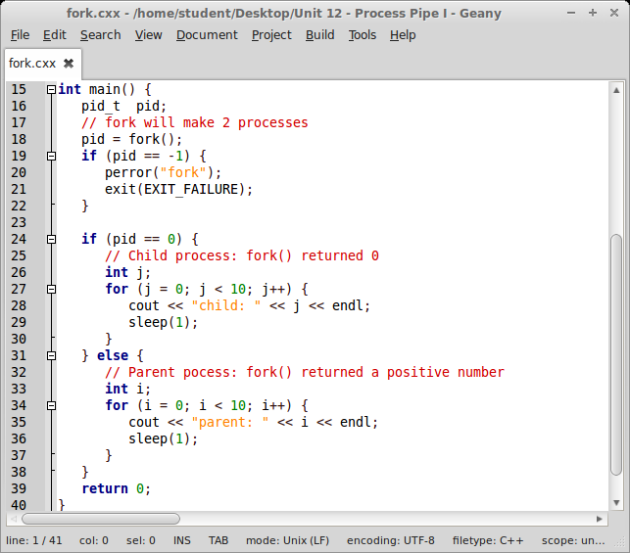
System Call: fork example

Slide 10
System Call: wait
pid_t wait(int *status)
lets parent process wait until a child process terminates
  parent is restarted once a child process terminates
returns process id of terminated child
  return -1 if there is no child to wait for
status holds exit status of child
  can be examined with WEXITSTATUS(status)

Slide 11
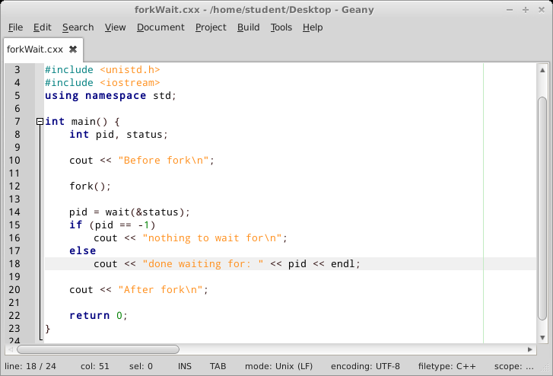
System Call: wait example

Slide 12
System Call: exec
family of functions that replace current process image with a new process image
    actual system call: execve
    library functions
      execl, execlp, execle
      execv, execvp
arguments specify new executable to run and its arguments and environment

Slide 13
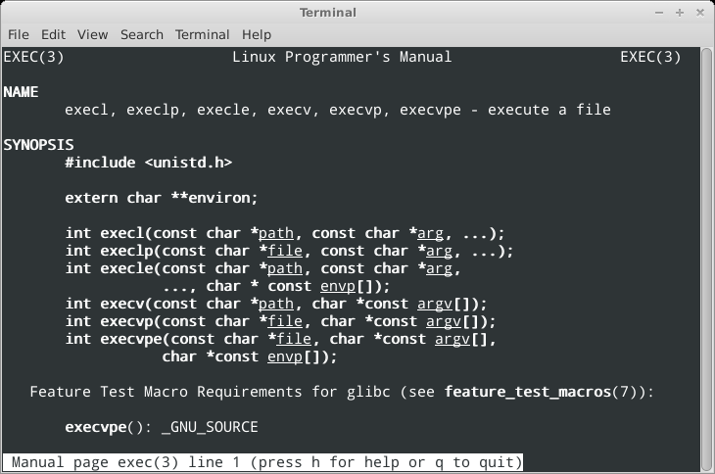
C Library Functions: exec

Slide 14
C Library Function: execl
int execl(const char *path, const char *arg, ...)
starts executable for command specified in path
new executable runs in current process
path is specified as absolute path
arguments are specified as list, starting at argv[0],
terminated with (char *NULL)
new executable keeps same environment
returns -1 on error

Slide 15
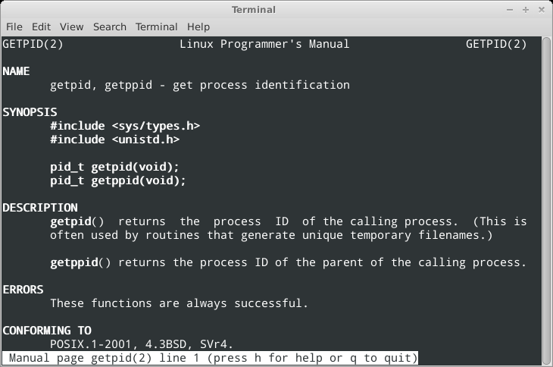
System Call: getpid

Slide 16
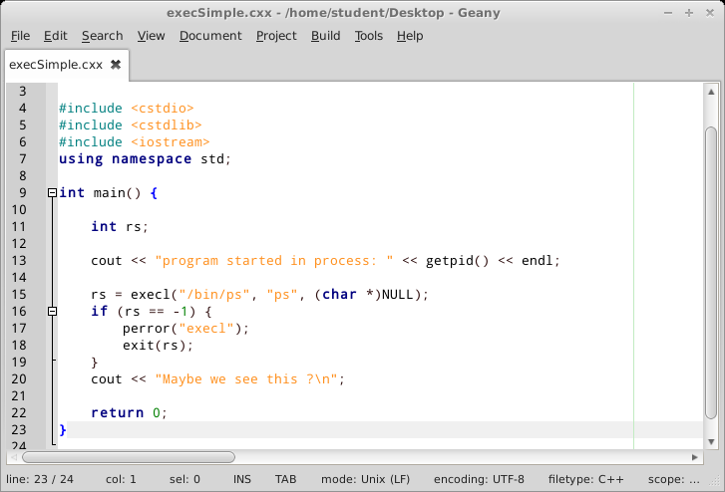
C Library Function: execl

Slide 17
C Library Functions: exec
execl, execlp, execle
  specify arguments and environment as list
execv, execvp
  specifiy arguments and environment as array of string values
execlp, execvp
  look for new executable via PATH

Slide 18
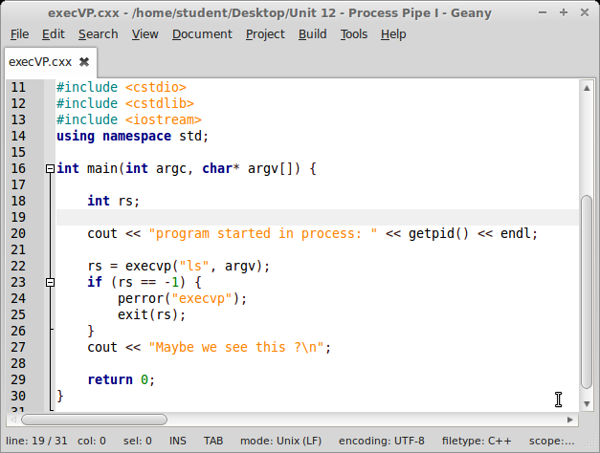
C Library Function: execv

Slide 19
Together: fork and exec
UNIX does not have a system call to spawn a new
additional
process with a new executable
instead:
  fork to duplicate current process
  exec to morph child process into new executable

Slide 20
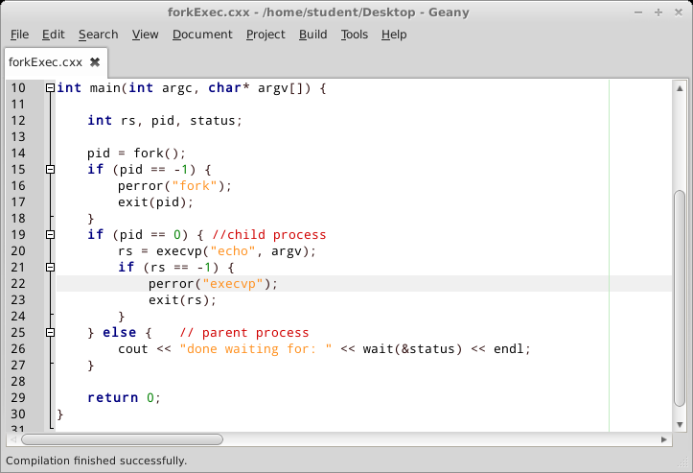
Together: fork and exec

Slide 21

UNIX Pipe
can create a software pipeline:
set of processes chained by their standard streams
output of one process becomes input of second process
command line example:
ls | wc
implemented via pipe system call

Slide 22
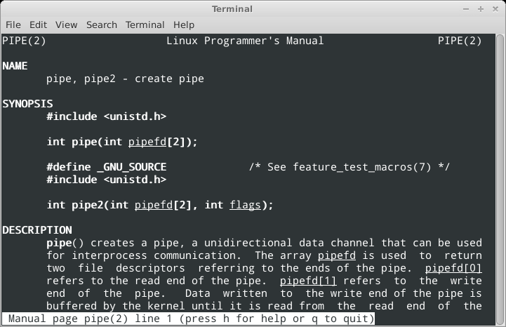
System Call: pipe

Slide 23
System Call: pipe
int pipe(int pipefd[2])
creates a channel to transport data
has direction: one side to write, one side to read
  available via 2 file descriptors pipefd[2]
  read side pipefd[0]
  write side pipefd[1]
can be used synchronize producer and consumer of data

Slide 24
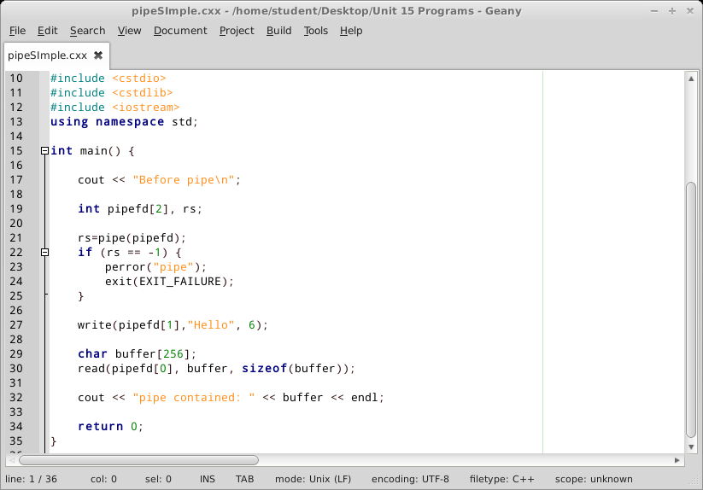
System Call: pipe example

Slide 25
System Calls: pipe and fork
Idea: read and write end of pipe in different processes
  fork creates two processes
parent process:
  close read end of pipe
  write to write end of pipe
child process:
  close write end of pipe
  read from read end of pipe

Slide 26
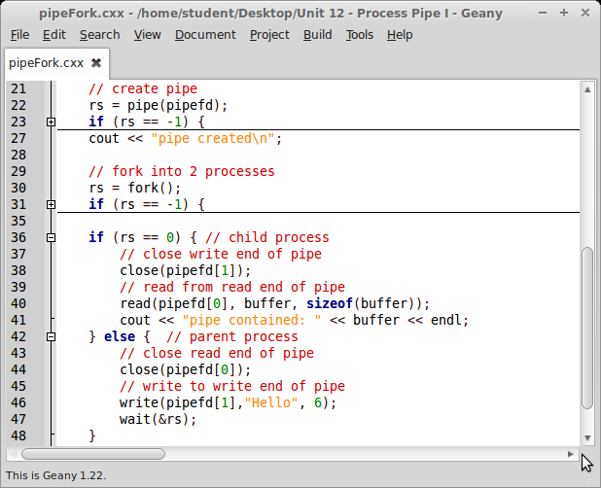
System Call: pipe & fork example

Slide 27
Summary
Process Management
  create new process (fork)
  wait for child process (wait)
  change what a process is doing (exec)
Pipe concept
  Pipe for inter-process communication

