Slide 1
CSCI 330
UNIX and Network Programming
Unit XI
sed - Stream Editor

Slide 2
What is sed?
A non-interactive stream editor
Use sed to:
  Automatically perform edits on file(s)
  Simplify doing the same edits on multiple files
  Write conversion programs
  Do editing operations from shell script

Slide 3
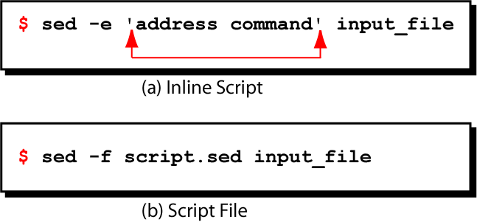
sed command syntax

Slide 4
How Does sed Work?
sed reads file line by line
  line of input is copied into a temporary buffer called pattern space
  editing instructions are applied to line in the pattern space
  line is sent to output (unless “-n” option was used)
  line is removed from pattern space
sed reads next line of input, until end of file
Note: input file is unchanged unless “-i” option is used

Slide 5
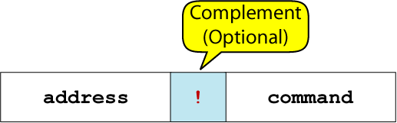
sed instruction format
address determines which lines in the input file are to be processed by the command(s)
  if no address is given, then the command is applied to each input line
address types:
  Single-Line address
  Set-of-Lines address
  Range address

Slide 6
Single-Line Address
Specifies only one line in the input file
  special: dollar sign ($) denotes last line of input file
Examples:
  show only line 3
  sed –n –e '3 p' input-file
  show only last line
  sed –n –e '$ p' input-file
  substitute “endif” with “fi” on line 10
  sed –e '10 s/endif/fi/' input-file

Slide 7
Set-of-Lines Address
use regular expression to match lines
  written between two slashes
  process only lines that match
  may match several lines
  lines don’t have to be consecutive
Examples:
  sed –e '/key/ s/more/other/' input-file
  sed –n –e '/r..t/ p' input-file

Slide 8
Range Address
Defines a set of consecutive lines
Format:
startAddr,endAddr (inclusive)
Examples:
  10,50 line-number,line-number
  10,/funny/ line-number,/RegExp/
  /funny/,10 /RegExp/,line-number
  /funny/,/sad/ /RegExp/,/RegExp/

Slide 9
Example: Range Address
% sed –n –e '/^BEGIN$/,/^END$/p' input-file
Print lines between BEGIN and END, inclusive
      BEGIN
      Line 1 of input
      Line 2 of input
      Line3 of input
      END
      Line 4 of input
      Line 5 of input
addr1
addr2
These lines are printed

Slide 10
Address with !
address with an exclamation point (!):
command applies to lines that do not match the address
Example:
print lines that do not contain “obsolete”
sed –n –e '/obsolete/!p' input-file

Slide 11
sed Commands
modify
  insert, append, change
  delete
  substitute
I/O
  next, print
  read, write
quit

Slide 12
Command: i, a, c
“i” adds line(s) before the address
“a” adds line(s) after the address
“c” replaces an entire matched line with new text
Syntax:
  [address] i\
  text

Slide 13
Example: Insert Command (i)
% cat tut.insert.sed
1 i\
Tuition List\
% cat tuition.data
Part-time 1003.99
Two-thirds-time 1506.49
Full-time 2012.29
% sed -f tut.insert.sed tuition.data
Tuition List
Part-time 1003.99
Two-thirds-time 1506.49
Full-time 2012.29
sed script to insert “Tuition List”
as report title before line 1
input data
output after applying
the insert command

Slide 14
Delete Command: d
deletes the entire pattern space
  commands following the delete command are ignored since the deleted text is no longer in the pattern space
Syntax:
  [address1[,address2]] d

Slide 15
Substitute Command (s)
Syntax:
[addr1][,addr2] s/search/replacement/[flag]
replaces text “search” string with “replacement” string
“search” & “replacement string” can be regular expression
flag:
  specific substitution count (integer), default “1”
  global (“g”), i.e. replace all occurrences

Slide 16
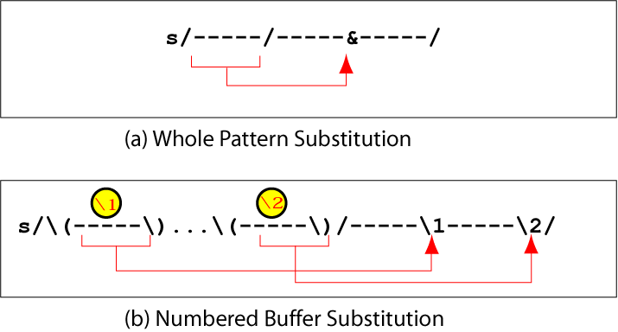
Substitution Back References

Slide 17
Example: Replacement String &
$ cat datafile
Charles Main 34
Patricia Jones 7
TB Savage 20
Margot Weber 9
Ann Stephens 13
$ sed -e 's/[0-9][0-9]$/&.5/g' datafile
Charles Main 34.5
Patricia Jones 7
TB Savage 20.5
Margot Weber 9
Ann Stephens 13.5

Slide 18
Example: Back Reference
$ cat name.data
John Doe
Susan Maloney
Harvey Keitel
Randy Newman
Ossie Weaver
$ sed -e 's/\(\<.*\>\) \(\<.*\>\)/\2, \1/g' name.data
Doe, John
Maloney, Susan
Keitel, Harvey
Newman, Randy
Weaver, Ossie

Slide 19
I/O Commands: n and p
n (lowercase)
  copies the contents of the pattern space to output
  deletes the current line in the pattern space
  refills it with the next input line
  continue processing
p (lowercase)
  copies the entire contents of the pattern space to output
  will print same line twice unless the option “-n” is used

Slide 20
File commands
allows to read and write from/to file while processing standard input
r read command
w write command

Slide 21
quit (q) Command
Syntax: [addr]q
  Quit (exit sed) when addr is encountered.
Example: Display the first 50 lines and quit
  % sed –e '50q' datafile

Slide 22
Summary: stream editor
can be called from shell script
allows systematic wholesale changes to files

