Slide 1
CSCI 330
UNIX and Network Programming
Unit VIII: I/O Management II

Slide 2
Unit Overview
System calls for I/O management
  so far: open, creat, read, write, close
today:
  unlink remove file
  stat get file information
  chmod change permissions
  dup duplicate file descriptor

Slide 3
UNIX System Call
a system call is how a program requests a service from the operating system, i.e. UNIX kernel
system call executes code in the kernel and makes direct use of facilities provided by the kernel
versus:
library function is linked to executable, becomes part of the executable

Slide 4
File Management
open open a file
creat make a new file
read read data from a file
write write data to a file
close close a file
also:
  unlink remove file
  stat get file information
  chmod change permissions
  dup duplicate file descriptor
all calls share file descriptor, i.e. number, to identify file

Slide 5
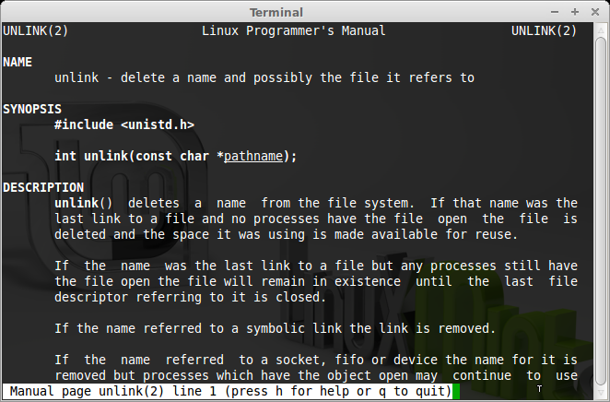
System Call: unlink

Slide 6
Remove a File: unlink
int unlink(const char *pathname)
removes a pathname from the file system
if pathname was the last link to a file, then it is deleted
if pathname refers to a symbolic link, then it is removed
returns zero, or -1 on error

Slide 7
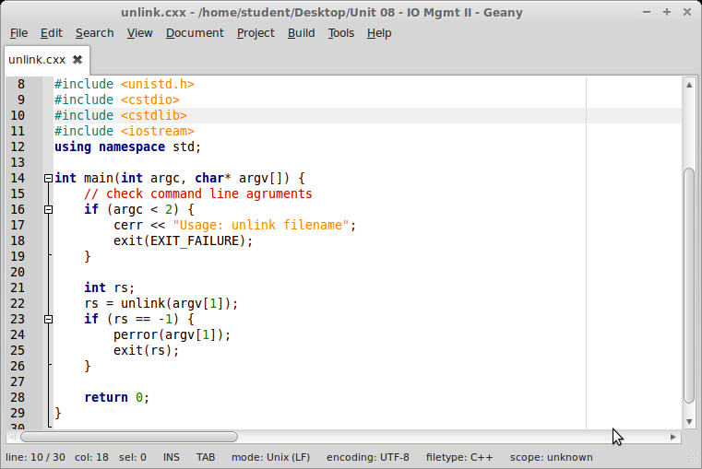
System Call: unlink example

Slide 8
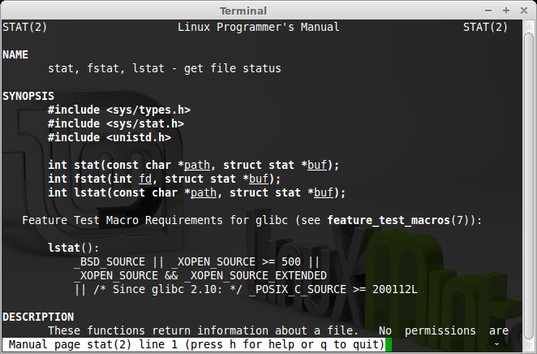
System Call: stat

Slide 9
File Status: stat
family of system calls to inquire about a file
int stat(const char *path, struct stat *buf)
path holds string file name
int fstat(int fd, struct stat *buf)
fd holds file descriptor of open file
int lstat(const char *path, struct stat *buf)
reports on symbolic link as is
buf is pointer to stat structure, which contains information on file

Slide 10
Structure stat
struct stat {
dev_t st_dev; /* ID of device containing file */
ino_t st_ino; /* inode number */
mode_t st_mode; /* file mode: contains permissions */
nlink_t st_nlink; /* number of hard links */
uid_t st_uid; /* user ID of owner */
gid_t st_gid; /* group ID of owner */
dev_t st_rdev; /* device ID (if special file) */
off_t st_size; /* total size, in bytes */
blksize_t st_blksize; /* blocksize for file system I/O */
blkcnt_t st_blocks; /* number of blocks allocated */
time_t st_atime; /* time of last access */
time_t st_mtime; /* time of last modification */
time_t st_ctime; /* time of last status change */
};

Slide 11
Structure stat st_mode field
contains file mode, including permissions
to check permissions
  st_mode & S_IRUSR owner has read permission
  st_mode & S_IWUSR owner has write permission
  st_mode & S_IXUSR owner has execute permission
to check file type
  S_ISREG(st_mode) is it a regular file
  S_ISDIR(st_mode) is it a directory
  S_IFLNK(st_mode) is it a symbolic link

Slide 12
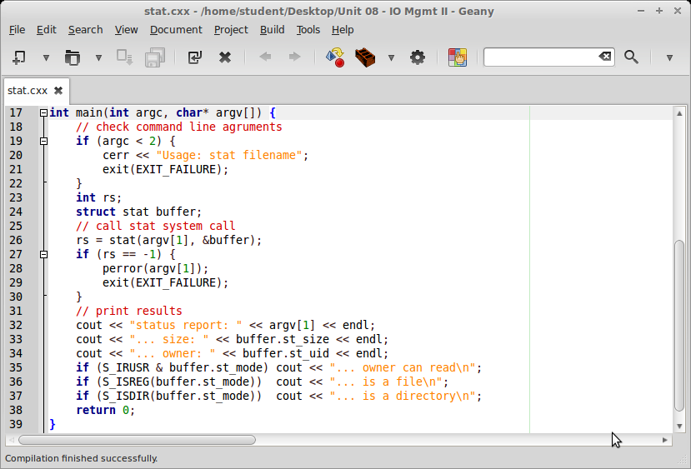
System Call: stat example

Slide 13
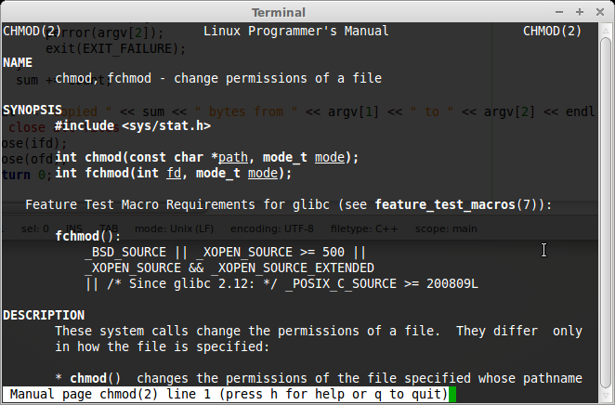
System Call: chmod

Slide 14
System Call: chmod
int chmod(const char *path, mode_t mode)
change permission settings for file given in path string
new file permissions are specified in mode
must be called by owner of file, or superuser
returns zero, or -1 on error

Slide 15
System Call: fchmod
int fchmod(int fd, mode_t mode)
change permission settings for open file fd
new file permissions are specified in mode
must be called by owner of file, or superuser
returns zero, or -1 on error

Slide 16
Permission mode
S_ISUID (04000) set-user-ID
S_ISGID (02000) set-group-ID
S_ISVTX (01000) sticky bit
S_IRUSR (00400) read by owner
S_IWUSR (00200) write by owner
S_IXUSR (00100) execute/search by owner
S_IRGRP (00040) read by group
S_IWGRP (00020) write by group
S_IXGRP (00010) execute/search by group
S_IROTH (00004) read by others
S_IWOTH (00002) write by others
S_IXOTH (00001) execute/search by others
mode bit mask is created by OR-ing together several of these constants:
ex.: S_IRUSR | S_IWUSR | S_IXUSR
S_IRUSR | S_IRGRP | S_IROTH
or:
0755
0644

Slide 17
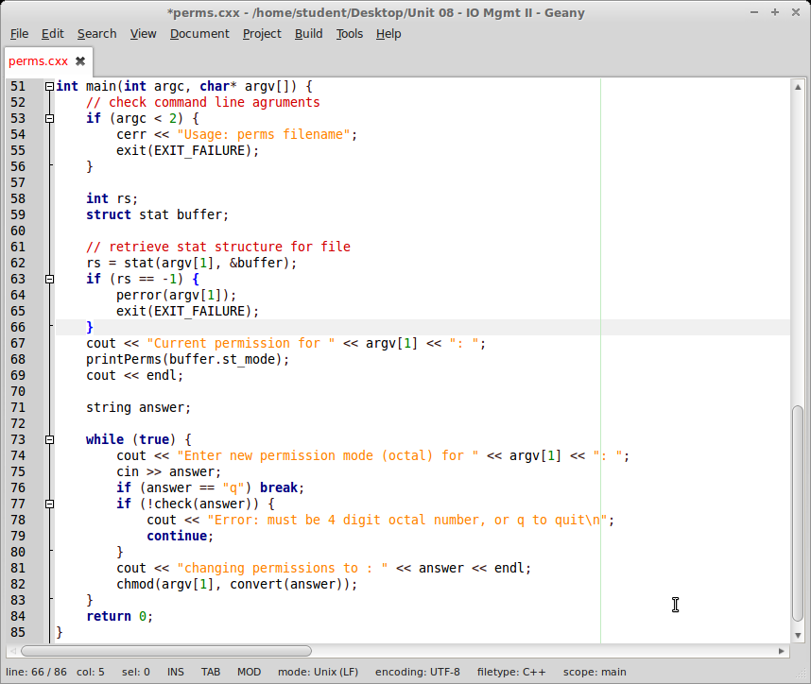
System Call: chmod example

Slide 18
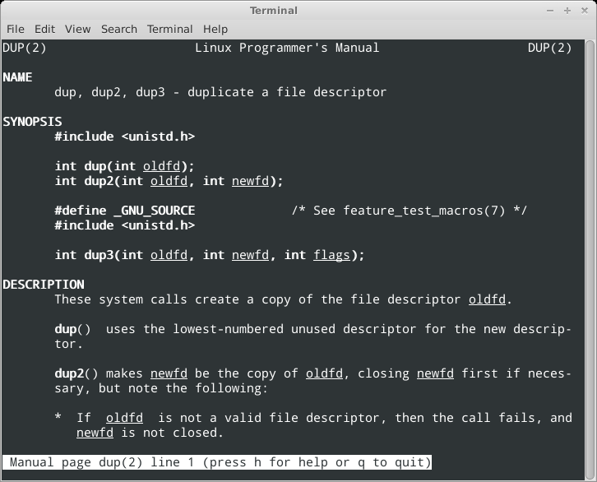
System Call: dup

Slide 19
System Call: dup
int dup(int oldfd)
creates copy of file descriptor oldfd
uses lowest-numbered unused descriptor
returns the new file descriptor, or -1 on error
used to claim standard I/O from inside program

Slide 20
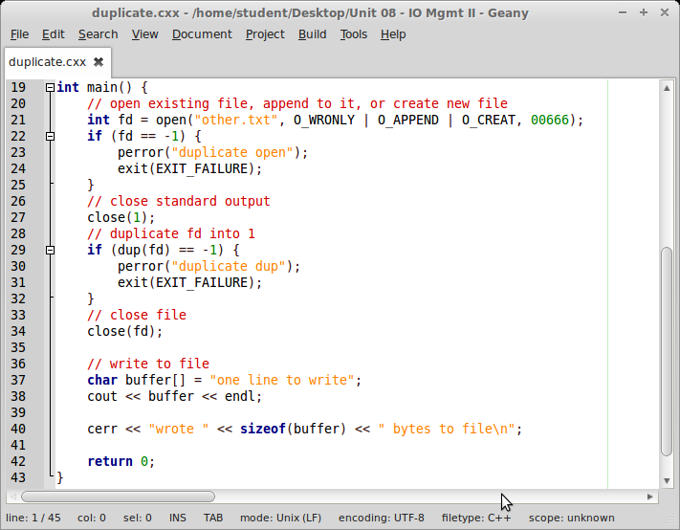
System Call: dup example

Slide 21
Summary: IO Management
open open a file
creat make a new file
read read data from a file
write write data to a file
close close a file
today:
  unlink remove file
  stat get file information
  chmod change permissions
  dup duplicate file descriptor

