Slide 1
CSCI 330
UNIX and Network Programming
Unit VII: I/O Management I

Slide 2
Unit Overview
System calls
File I/O
  open, creat
  read, write
  close
more later:
  unlink, stat, chmod, dup

Slide 3
UNIX System Call
a system call is how a program requests a service from the operating system, i.e. UNIX kernel
system call executes code in the kernel and makes direct use of facilities provided by the kernel
versus:
library function is linked to executable, becomes part of the executable

Slide 4
System Call Categories
process control
  create/terminate process, wait/signal event, allocate/free memory
file management
  create/delete file, open/close, read/write, get/set attributes
device management
  attach/request/release/detach device, read/write/position
information management
  get/set system data and attributes, e.g. time
communication
  create/delete connection, send/receive messages, remote devices

Slide 5
System Call Invocation
declare system call via appropriate C header file
  read man page carefully (section 2 of manual)
prepare parameters using basic C data types
  no C++ classes, i.e. string
prepare suitable return value variable
call like any other function

Slide 6
File Management
open open a file
read read data from a file
write write data to a file
close close a file
also:
  creat make a new file
  unlink remove file
  stat get file information
  chmod change permissions
  dup duplicate file descriptor
all calls share file descriptor, i.e. number, to identify file

Slide 7
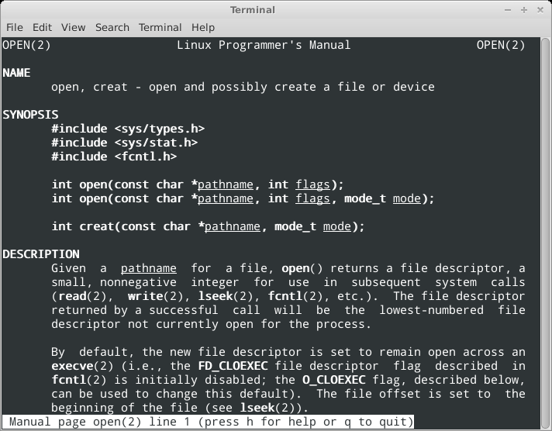
System Call: open

Slide 8
System Call: open
int open(const char* pathname, int flags)
opens file specified as pathname for access
flags determine access type
O_RDONLY read only
O_WRONLY write only
O_RDWR read and write
returns file descriptor, to be used in read/write/close
returns -1 on error

Slide 9
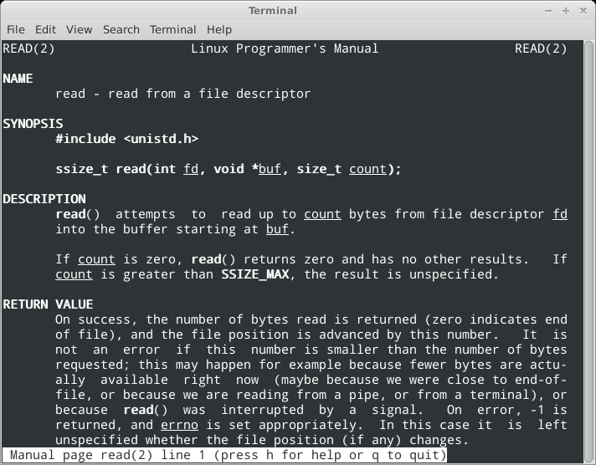
System Call: read

Slide 10
System Call: read
ssize_t read(int fd, void *buf, size_t count)
attempts to read count bytes from file descriptor fd into the buffer starting at buf
  ssize_t and size_t are system specific integer types
returns the number of bytes read
  maybe smaller than count, zero indicates end of file
  file position is advanced by this number
returns -1 on error

Slide 11
System Call: close
int close(int fd)
closes file specified by fd file descriptor
  makes file descriptor available
returns zero on success

Slide 12
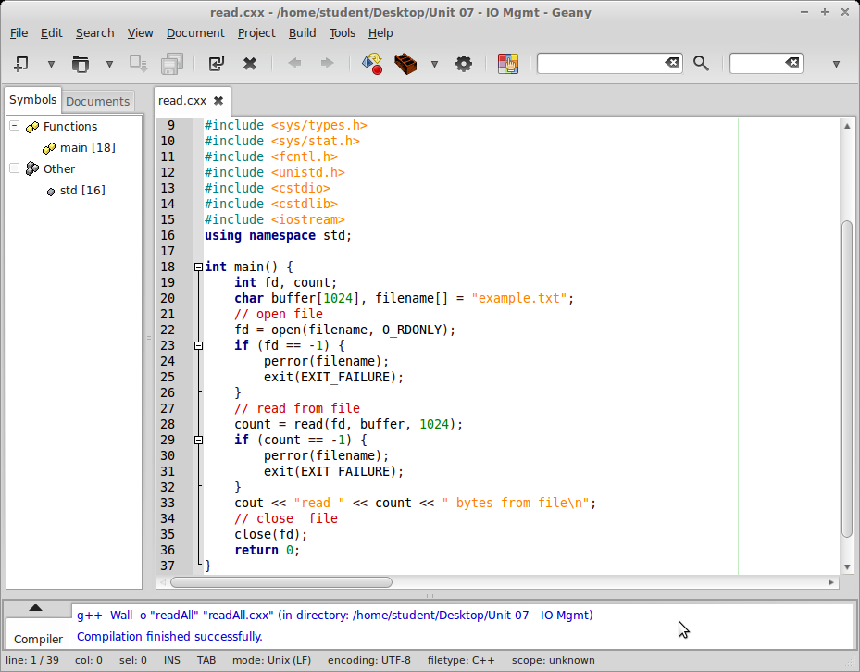
System Call: read example

Slide 13
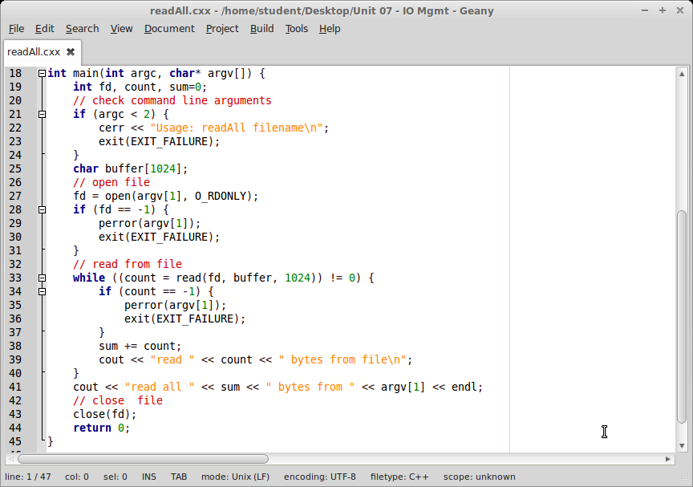
System Call: readAll example

Slide 14
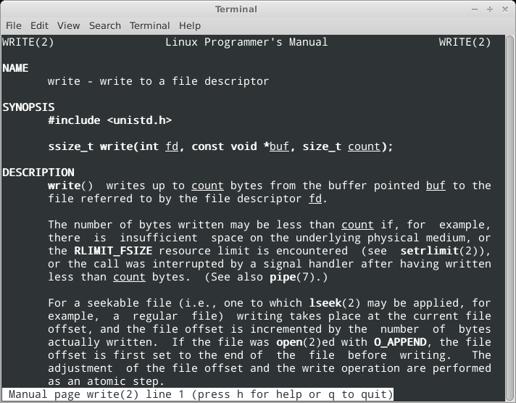
System Call: write

Slide 15
System Call: write
ssize_t write(int fd, const void *buf, size_t count)
writes up to count bytes from buffer starting at buf to the file referred to by file descriptor fd
  ssize_t and size_t are system specific integer types
returns the number of bytes written
  maybe smaller than count

Slide 16
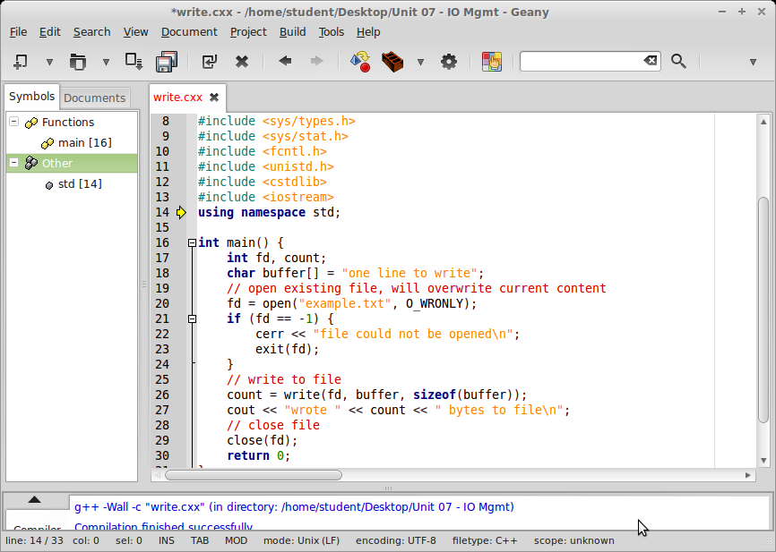
System Call: write example

Slide 17
revisit System Call: open

Slide 18
System Call: open
int open(const char* pathname, int flags)
opens file specified as pathname for access
flags determine access type
O_RDONLY read only
O_WRONLY write only
O_RDWR read and write
returns file descriptor, to be used in read/write/close
returns -1 on error

Slide 19
System Call: open
additional flags, used with O_WRONLY:
O_APPEND to append to an existing file
O_TRUNC existing file will overwritten (default)
Ex.:
O_WRONLY | O_TRUNC
O_WRONLY | O_APPEND
additional flag: O_CREAT
  creates file, if file does not exist

Slide 20
System Call: open with O_CREAT
int open(const char* pathname, int flags, mode_t mode)
must specify file mode, i.e. permissions, of type mode_t
S_IRWXU 00700 user has read, write and execute permission
S_IRUSR 00400 user has read permission
S_IWUSR 00200 user has write permission
S_IXUSR 00100 user has execute permission
S_IRWXG 00070 group has read, write and execute permission
S_IRWXO 00007 others have read, write and execute perm.
...
  C++ requires leading ‘0’ for octal numbers
  actual file mode is further modified by umask
Example:
open(“ex.txt”, O_WRONLY | O_APPEND | O_CREAT, 00666)

Slide 21
System Call: creat
int creat(const char *pathname, mode_t mode)
creates new file specified as pathname and opens file for write access
mode specifies permissions of type mode_t
returns file descriptor
returns -1 on error

Slide 22
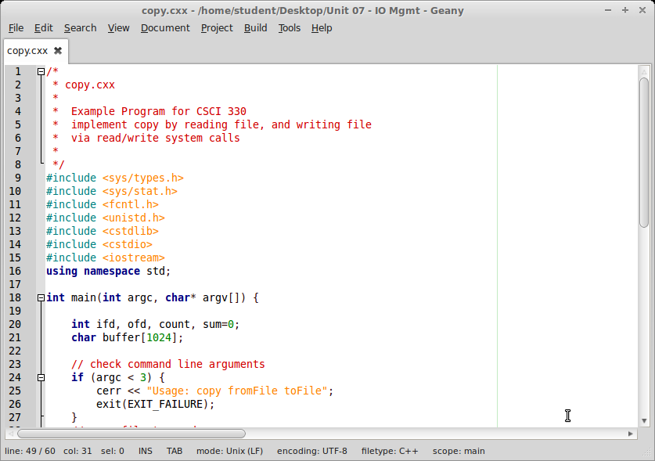
Example: copy file (1 of 2)

Slide 23
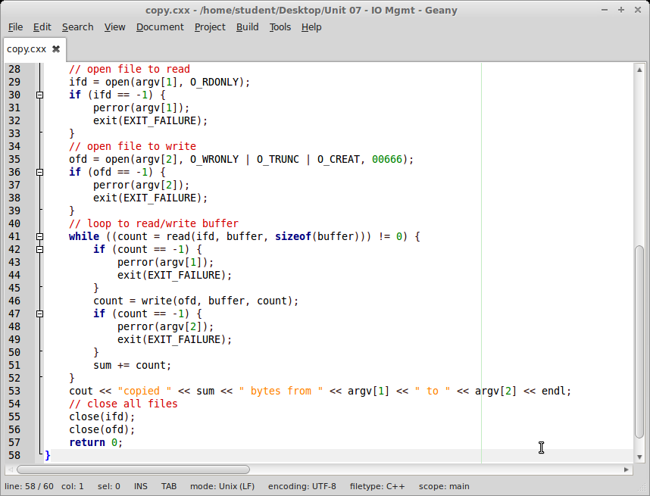
Example: copy file (2 of 2)

Slide 24
Summary
System calls: open, creat, read, write, close
next:
  unlink remove file
  stat get file information
  chmod change permissions
  dup duplicate file descriptor

