Slide 1
CSCI 330
UNIX and Network Programming
Unit VI: Systems Programming in C++

Slide 2
Unit Overview
C++ review
  programming with Geany
C Library functions
  C strings
  environment access
  regular expressions
  directory I/O

Slide 3
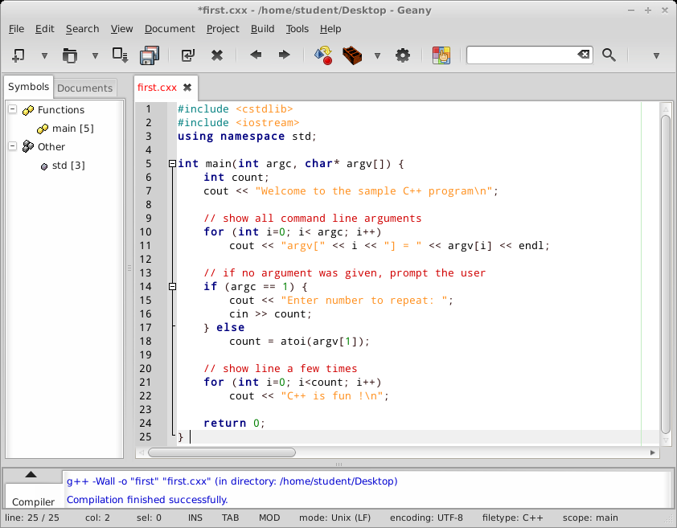
C++ Review

Slide 4
C Library Functions
C library is accessible to C++
I/O operations: #include <cstdio>
  functions: printf, scanf, putchar, getchar, ...
Strings: #include <cstring>
  functions: strlen, strcat, strcpy, strstr, memset, ...
Standard general utilities: #include <cstdlib>
  functions: atoi, rand, malloc, free, getenv, exit, system, ...
Reference: http://www.cplusplus.com/reference/clibrary

Slide 5
C Strings: strcpy
char* strcpy(char* dest, const char* source)
copies the C string pointed to by source into the array pointed to by dest, including the terminating null character
to avoid overflows, the size of the array pointed to by dest must be long enough to contain the same C string as source, including the terminating null character

Slide 6
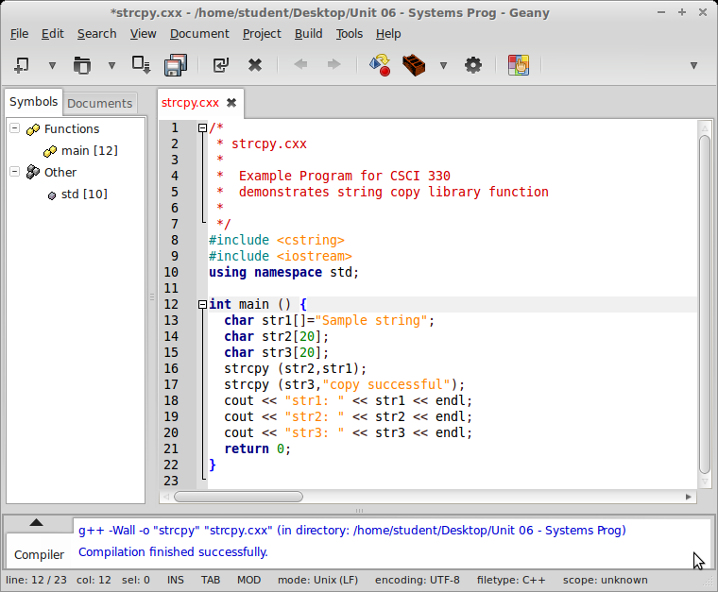
C Strings: strcpy

Slide 7
General Utility: getenv
char * getenv ( const char * name )
gets environment string
retrieves a C string containing the value of the environment variable whose name is specified as argument
if the requested variable is not part of the environment list, the function returns a null pointer

Slide 8
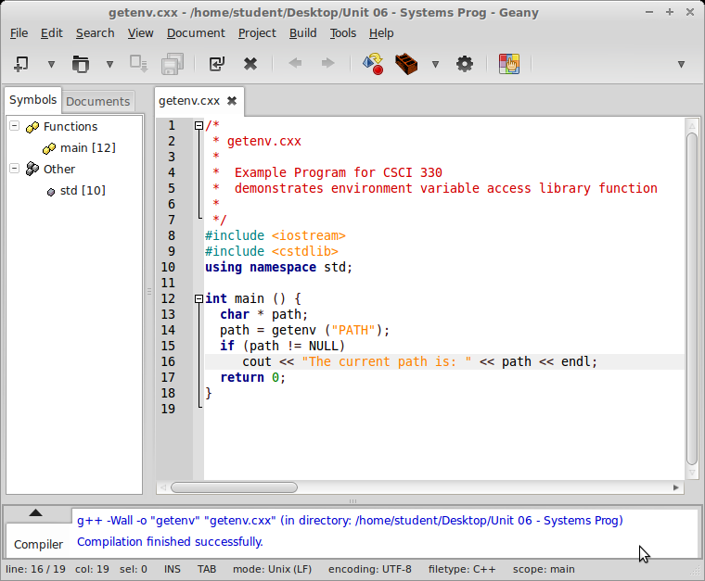
General Utility: getenv

Slide 9
General Utility: exit
void exit ( int status )
terminates calling process
if status is zero or EXIT_SUCCESS, a successful termination status is returned to the host environment
if status is EXIT_FAILURE, an unsuccessful termination status is returned to the host environment

Slide 10
General Utility: system
int system ( const char * command )
invokes the command processor to execute a command
returns exit status of command
if command is a null pointer, the function only checks whether a command processor is available

Slide 11
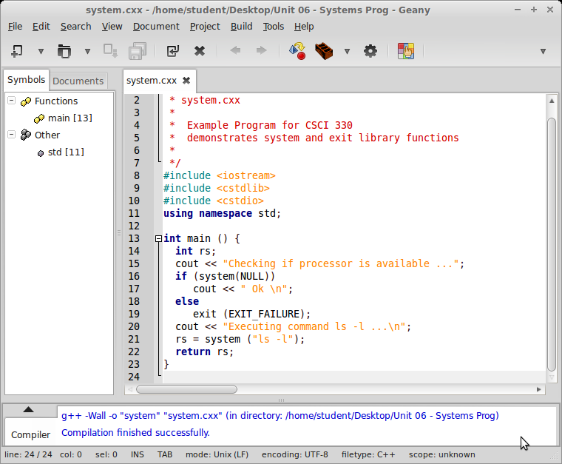
General Utility: system

Slide 12
Regular Expression Library Functions
allows to use regular expression to search strings
functions:
  regcomp to prepare, i.e. compile, a regular expression
  regexec to use prepared expression to search a string

Slide 13
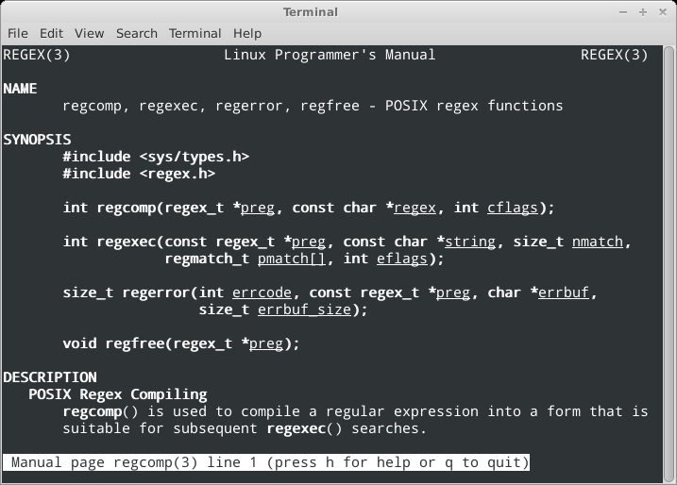
C Library: Regex

Slide 14
Library Function: regcomp
int regcomp(regex_t *preg, const char *regex, int cflags)
compiles the regular expression string regex into a regex_t structure preg for later use
cflags allows variations to regular expression styles
  0 selected basic regular expression syntax
  REG_EXTENDED uses extended regular expression syntax

Slide 15
Library Function: regexec
int regexec(const regex_t *preg, const char *string,
size_t nmatch, regmatch_t pmatch[], int eflags)
uses regular expression preg to analyze string
nmatch and pmatch[] return the location of matches
  can be set to 0 if not needed
eflags allows variations on end of line matching
  can be set to 0 if not needed
returns 0 for successful match

Slide 16
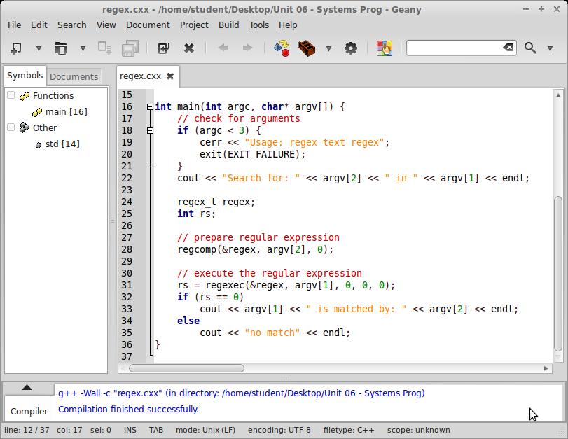
Library Function: regex example

Slide 17
Error Handling
convention on how to report errors
  return -1 in return status
  set global variable errno
  errno is index into table of error messages
C library function perror translates this error code and prints understandable error message

Slide 18
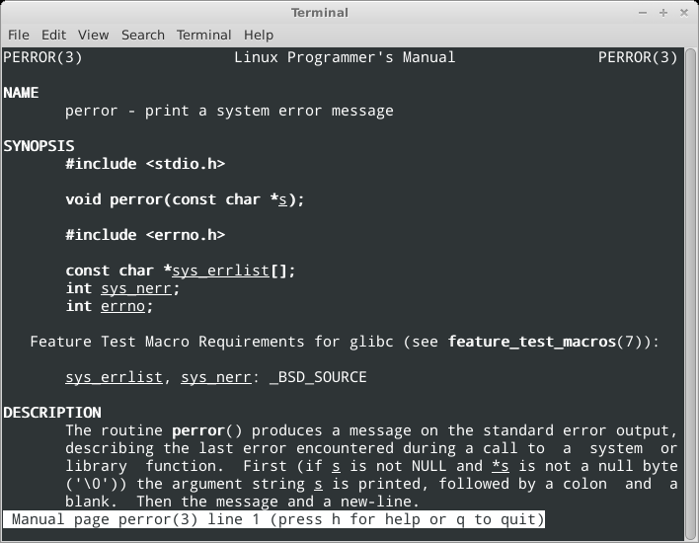
C Library Function: perror

Slide 19
Directory Input/Output
current directory: chdir, getcwd
directory I/O functions: opendir, readdir
directory I/O types: DIR, struct dirent

Slide 20
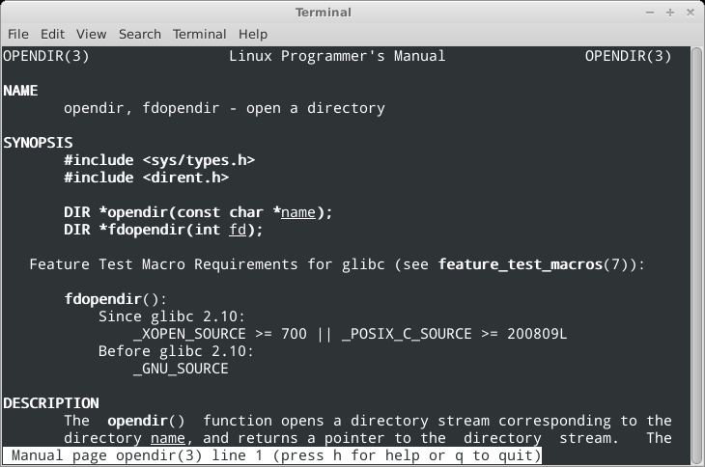
Directory I/O function: opendir

Slide 21
Directory I/O function: opendir
DIR *opendir(const char *name)
opens directory name as a stream
returns DIR pointer for readdir function
returns NULL on error, and errno is:
ENOENT directory does not exist
ENOTDIR name is not a directory

Slide 22
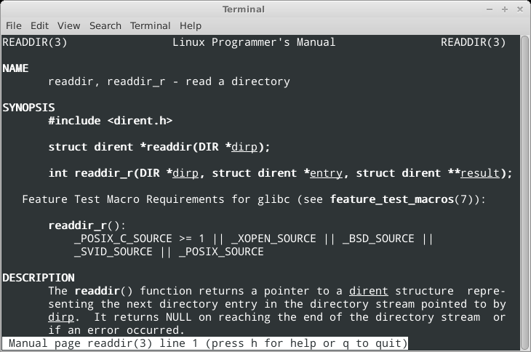
Directory I/O function: readdir

Slide 23
Directory I/O function: readdir
struct dirent *readdir(DIR *dirp)
returns a pointer to a dirent structure representing the next directory entry in directory dirp
returns NULL on reaching end of directory
or if an error occurred

Slide 24
dirent structure
struct dirent {
ino_t d_ino; /* inode number */
off_t d_off; /* offset to the next dirent */
unsigned short d_reclen; /* length of this record */
unsigned char d_type; /* type of file */
char d_name[256]; /* filename */
};

Slide 25
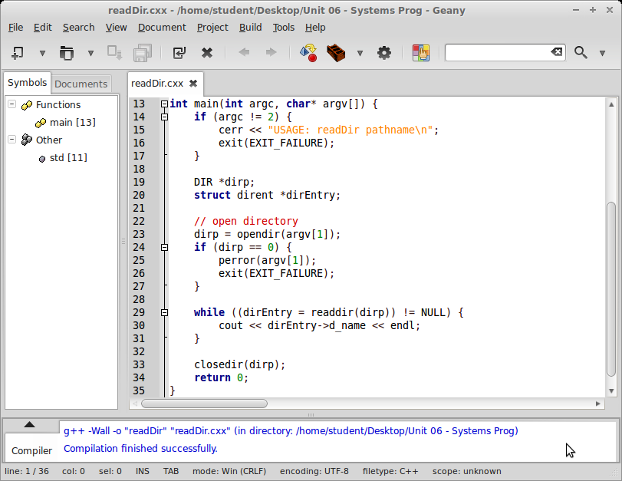
Illustration: readDir.cxx

Slide 26
Directory I/O detail
// open directory
dirp = opendir(argv[1]);
if (dirp == 0) {
perror(argv[1]);
exit(EXIT_FAILURE);
}
while ((dirEntry = readdir(dirp)) != NULL) {
cout << dirEntry->d_name << endl;
}
closedir(dirp);

Slide 27
Summary
C++ programming with C Library functions
Next:
  C++ programming with System Calls

