Slide 1
CSCI 330
The UNIX System
Unit V
Permissions

Slide 2
Permissions
all access to directories and files is controlled
UNIX uses discretionary access control (DAC) model
  each directory/file has owner
  owner has discretion over access control details
access control includes
  read, write: to protect information
  execute: to protect state of system
exception: super user

Slide 3
User Terminology
user
  any one who has account on the system, listed in /etc/passwd
  protected via password, listed in /etc/shadow
  internally recognized via a number called “user id”
group
  users are organized into groups, listed /etc/group
  user can belong to multiple groups
super user, root
  has user id “0”
  responsible for system administration

Slide 4
File/Directory access
file or directory has owner, i.e. the user who created it
owner sets access permissions
  access mode: read, write, execute
  accessor category: self, group, others
ownership change via: chown

Slide 5
Access Permission Modes
 | Meaning on File | Meaning on Directory
r (read) | View file contents (open, read) | List directory contents
w (write) | Change file contents | Change directory contents
x (execute) | Run executable file | Make it current directory, search for files in it

Slide 6
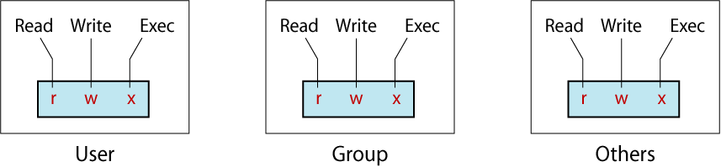
Categories of Users
3 categories of users want access

Slide 7
Checking Permissions
To check the permissions of an existing file or an existing directory, use the “ls -l” command:
Example:
% ls -l
drwx------ 1 z036473 student 86 Feb 7 19:22 scripts
-rw-rw-r-- 1 z036473 student 20 Feb 9 11:25 out.txt
-rwxr-xr-- 1 z036473 student 34 Feb 3 19:42 checkIt
-rw-r--r-- 1 z036473 student 34 Feb 5 9:05 a2.png

Slide 8
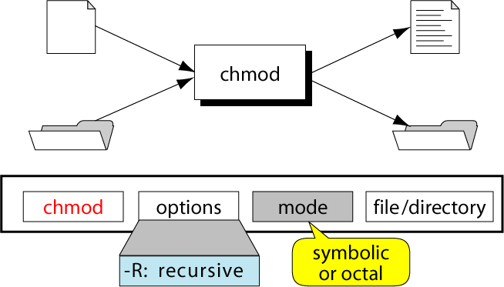
Change Permissions with chmod

Slide 9
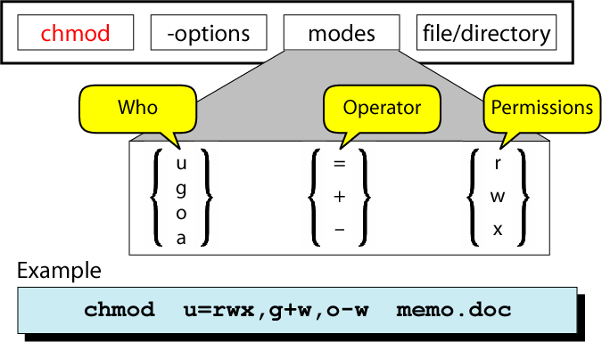
Changing Permissions: Symbolic Mode
u for user
g for group
o for others
a for all
+ for add
- for remove
= for assign
r for read
w for write
x for execute

Slide 10
Examples: Symbolic Mode
% chmod u-w file.txt
% chmod u+w file.txt
% chmod u+x script.sh
% chmod g-w file.txt
% chmod o-rw file.txt
% chmod ug=rwx play.cc
% chmod a+wx other.html
% chmod u+x,go=r script.sh

Slide 11
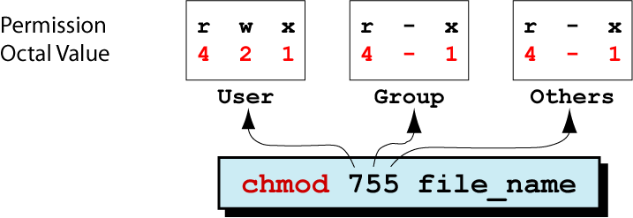
Changing Permissions: Octal Mode

Slide 12
Changing Permissions: Octal Mode
Step | Perform… | Settings
1 | List the desired setting
2 | Assign binary: 1 for access; 0 for no access
3 | List octal values for the corresponding binary 1’s
4 | Convert the octal values to a 3-digit number
5 | Write the command
% ls -l sort.c
-rwxr-xr-x 1 ege csci 80 Feb 27 12:23 sort.c
rwx|r-x|r-x
111|101|101
421|401|401
7 | 5 | 5
chmod 755 sort.c

Slide 13
Changing Permissions: example
Goal: set mode of file “myfile”
  Read, write, and execute permissions to self/owner
  Read and execute permissions to group
  Execute only permission to others
We want: rwx r-x --x
Symbolic Mode: chmod u=rwx,g=rx,o=x myfile
Octal Mode: chmod 751 myfile

Slide 14
Special Permissions
The regular file permissions (rwx) are used to assign security to files and directories
3 additional special permissions can be optionally used on files and directories
  Set User Id (SUID)
  Set Group ID (SGID)
  Sticky bit

Slide 15
Special Permissions: SUID
SUID used for executable files
  makes executable run with privileges of file owner, rather than invoker
Example:
  “passwd” command and file “/usr/bin/passwd”
-rwsr-xr-x 1 root root 41284 Apr 8 21:40 /usr/bin/passwd
allows regular user access to otherwise protected system files while changing password

Slide 16
Special Permissions: SGID
used for executable files
    logic is similar to SUID bit
runs program with group permission of file, rather than group of invoker
Example:
if a file is owned by the system group and also has the SGID bit set, then if file is executed it runs with system group privileges

Slide 17
SGID
Several file systems, including ext2/3/4, have the feature that when the SGID bit is set on a directory, then a file created in that directory will be owned by the group owner of the directory, not the group of the process that created the file.
This is invaluable for shared directories for group projects where users may belong to multiple working groups. The directory for the group is created with proper group ownership and the SGID bit set. From that point on files created in there will belong to the group.
Without the SGID bit set, what usually happens is that user A (who belongs to several groups) will place a file in the common directory. It will belong to their default group, which may or may not be the group of the project. User B comes along and can see the file in the directory, but can't modify it due to group ownership issues. Unless all users explicitly change the group ownership of files they create or change their default group association before working on the project, frustration ensues.
By itself, SGID on directories doesn't solve everything. (All users need a default umask of 002 instead of 022 as well.) But it goes a long way to making systems governed by projects with multiple users on multiple projects run a lot smoother.

Slide 18
Special Permissions: Sticky Bit
not clearly defined
for executable files:
  executable is kept in memory even after it ended
  (no longer used, since modern virtual memory
  methods are more advanced)
for directories:
  file can only be deleted by the user that created it

Slide 19
Special Permissions: display
“ls -l” command does not have a section for special permission bits
however, since special permissions required “execute”, they mask the execute permission when displayed using the “ls -l” command.
r w x r w x r w x
r w s r w s r w t
SUID
SGID
STICKY BIT

Slide 20
Setting Special Permissions
Use the “chmod” command with octal mode:
chmod 7777 filename
suid | sgid | stb | r | w | x | r | w | x | r | w | x
4 | 2 | 1 | 4 | 2 | 1 | 4 | 2 | 1 | 4 | 2 | 1
7 |  |  | 7 |  |  | 7 |  |  | 7
Special |  |  | user |  |  | group |  |  | others

Slide 21
Setting Special Permissions
chmod with symbolic notation:
u+s add SUID
u-s remove SUID
g+s add SGID
g-s remove SGID
+s add SUID and SGID
+t set sticky bit

Slide 22
File mode creation mask
umask (user mask)
  governs default permission for files and directories
  sequence of 9 bits: 3 times 3 bits of rwx
  default: 000 010 010 (022)
in octal form its bits are removed from:
  for a file: 110 110 110 (666)
  for a directory: 111 111 111 (777)
permission for new
  file: 110 100 100 (644)
  directory: 111 101 101 (755)

Slide 23
User Mask value examples
 | Directory Default: 777 | File Default: 666
000 | 777 (rwx rwx rwx) | 666 (rw- rw- rw-)
111 | 666 (rw- rw- rw-) | 666 (rw- rw- rw-)
222 | 555 (r-x r-x r-x) | 444 (r-- r-- r--)
022 | 755 (rwx r-x r-x) | 644 (rw- r-- r--)
002 | 775 (rwx rwx r-x) | 664 (rw- rw- r--)
066 | 711 (rwx --x --x) | 600 (rw- --- ---)
666 | 111 (--x --x --x) | 000 (--- --- --- )
777 | 000 (--- --- --- ) | 000 (--- --- --- )
default

Slide 24
Change the permission default
command to display: umask
  uses a leading zero
  0022
umask -S
  u=rwx,g=rx,o=rx
command to change: umask
  tolerates leading zero
  ex:
  % umask 0077
  % umask a-r

Slide 25
Summary
r, w, x
  and extra bits (s,t)
user (self, owner), group, others
file mode creation mask: umask

