Slide 1
CSCI 330
UNIX and Network Programming
Unit IV
Shell, Part 2

Slide 2
more bash shell basics
Wildcards
Regular expressions
Quoting & escaping

Slide 3
Command Line Behavior
Special characters have special meaning:
  $ variable reference
  = assignment
  ! event number
  ; command sequence
  ` command substitution
  > < | i/o redirect
  & background
* ? [ ] { }
  wildcards
  regular expressions
‘ “ \
  quoting & escaping

Slide 4
Wildcards: * ? [ ] { }
? exactly one character
% ls assign?.cc
% wc assign?.??
% rm junk.???
A pattern of special characters used to match file names on the command line
* zero or more characters
Ex: % rm *
% ls *.txt
% wc -l assign1.*
% cp a*.txt docs

Slide 5
Wildcards: [ ] { }
[...] matches any of the enclosed characters
[a-z] matches any character in the range a to z
  if the first character after the [ is a ! or ^
  then any character that is not enclosed is matched
  within [], [:class:] matches any character from a specific class:
alnum, alpha, blank, digit, lower, upper, punct
{ word1,word2,word3,...} matches any entire word

Slide 6
Wildcards: [ ] { } examples
% wc –l assign[123].cc
% ls csci[2-6]30
% cp [A-Z]* dir2
% rm *[!cehg]
% echo [[:upper:]]*
% cp {*.doc,*.pdf} ~

Slide 7
Regular Expression
A pattern of special characters to match strings in a search
Typically made up from special characters called meta-characters: . * + ? [ ] { } ( )
Regular expressions are used throughout UNIX:
  utilities: grep, awk, sed, ...
2 types of regular expressions: basic vs. extended

Slide 8
Metacharacters
. | Any one character, except new line
[a-z] | Any one of the enclosed characters (e.g. a-z)
* | Zero or more of preceding character
? also: \? | Zero or one of the preceding characters
+ also: \+ | One or more of the preceding characters
^ or $ | Beginning or end of line
\< or \> | Beginning or end of word
( ) also: \( \) | Groups matched characters to be used later (max = 9)
| also: \| | Alternate
x\{m,n\} | Repetition of character x between m and m times

Slide 9
Basic vs. Extended
Extended regular expressions use these meta-characters:
? + { } | ( )
Basic regular expressions use these meta-characters:
\? \+ \{ \} \| \( \)

Slide 10
The grep Utility
searches for text in file(s)
Syntax:
grep "search-text" file(s)
  search-text is a basic regular expression
egrep "search-text" file(s)
  search-text is an extended regular expression

Slide 11
The grep Utility
Examples:
% grep "root" /var/log/auth.log
% grep "r..t" /var/log/syslog
% grep "bo*t" /var/log/boot.log
% grep "error" /var/log/*.log
Caveat:
watch out for shell wild cards if not using “”

Slide 12
Regular Expression
consists of atoms and operators
an atom specifies what text is to be matched and
where it is to be found
an operator combines regular expression atoms

Slide 13
Atoms
any character (not a meta-character) matches itself
. matches any single character
[...] matches any of the enclosed characters
^ $ \< \> anchor: beginning or end of line or word
\1 \2 \3 ... back reference

Slide 14
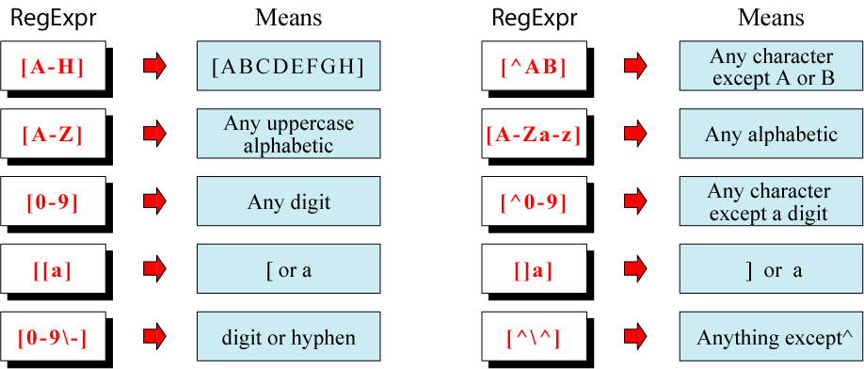
Example: [...]

Slide 15
short-hand classes
[:alpha:]
  letters of the alphabet
[:alnum:]
  letters and digits
[:upper:] [:lower:]
  upper/lower case letters
[:digit:]
  digits
[:space:]
  white space
[:punct:]
  punctuation marks

Slide 16
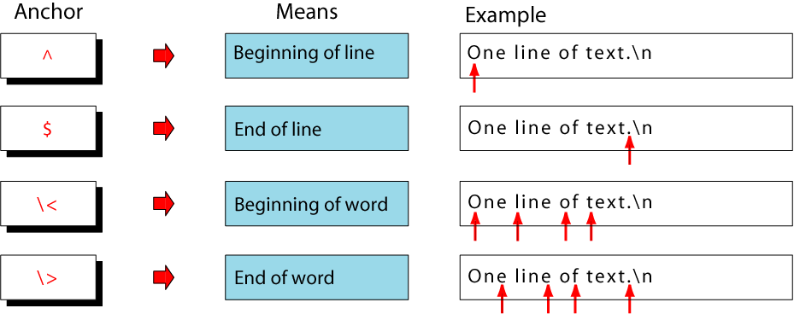
Anchors
Anchors tell where the next character in the pattern must be located in the text data

Slide 17
Back References: \n
used to retrieve saved text in one of nine buffers
ex.: \1 \2 \3 ...\9
buffer defined via group operator ( )

Slide 18
Operators
sequence
| alternate
{n,m} repetition
( ) group & save

Slide 19
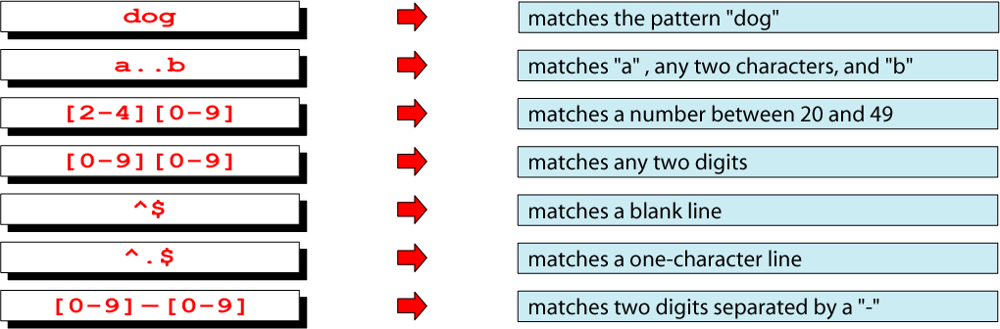
Sequence Operator
In a sequence operator, if a series of atoms are shown in a regular expression, there is no operator between them

Slide 20
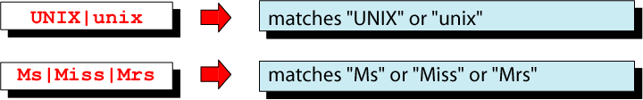
Alternation Operator: | or \|
searches for one or more alternatives
Note: grep uses | with backslash

Slide 21
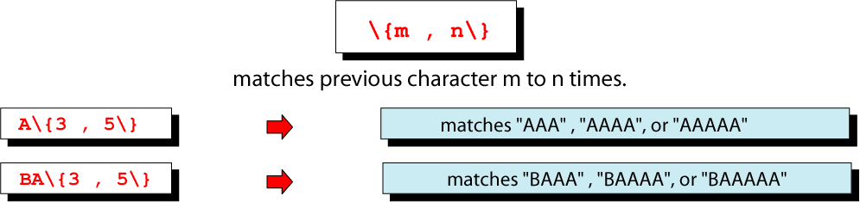
Repetition Operator: \{…\}
The repetition operator specifies that the atom or expression immediately before the repetition may be repeated

Slide 22
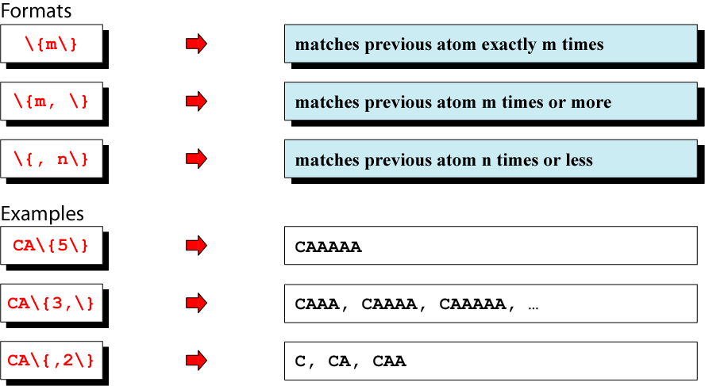
Basic Repetition Forms

Slide 23
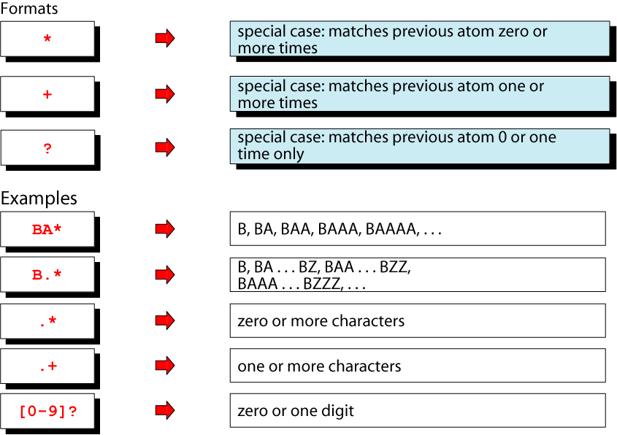
Short Form Repetition Operators

Slide 24
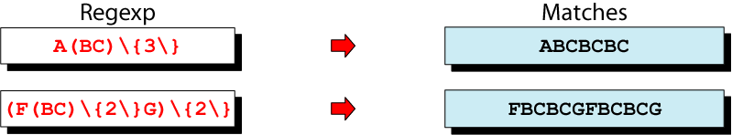
Group Operator: ( ) or \( \)
when a sequence of atoms is enclosed in parentheses, the next operator applies to the whole group, not only the previous characters
groups define numbered buffers, can be recalled via back reference: \1, \2, \3, ...

Slide 25
Summary: Regular Expressions
. | Any one character, except new line
[a-z] | Any one of the enclosed characters (e.g. a-z)
* | Zero or more of preceding character
? also: \? | Zero or one of the preceding characters
+ also: \+ | One or more of the preceding characters
^ or $ | Beginning or end of line
\< or \> | Beginning or end of word
( ) also: \( \) | Groups matched characters to be used later (max = 9)
| also: \| | Alternate
x\{m,n\} | Repetition of character x between m and m times

Slide 26
Quoting & Escaping
allows to distinguish between the literal value of a symbol and the symbols used as meta-characters
done via the following symbols:
  Backslash (\)
  Single quote (‘)
  Double quote (“)

Slide 27
Backslash (\)
also called the escape character
preserve the character immediately following it
For example:
to create a file named “tools>”, enter:
% touch tools\>

Slide 28
Single Quote (')
protects the literal meaning of meta-characters
  protects all characters within the single quotes
exception: it cannot protect itself
Examples:
  % echo 'Joe said "Have fun *@!"'
  Joe said "Have fun *@!"
  % echo 'Joe said 'Have fun''
  Joe said Have fun

Slide 29
Double Quote (")
protects all symbols and characters within the double quotes, expect for:
  $ (dollar sign) ! (event number)
  ` (back quote) \ (backslash)
Examples:
  % echo "I've gone fishing"
  I've gone fishing
  % echo "your home directory is $HOME"
  your home directory is /home/student

Slide 30
Quoting
Examples:
  % echo "Hello Ray []^?+*{}<>"
  Hello Ray []^?+*{}<>
  % echo "Hello $USER"
  Hello student
  % echo "It is now `date`"
  It is now Mon Feb 25 10:24:08 CST 2012
  % echo "you owe me \$500"
  you owe me $500

Slide 31
Summary
wildcards
regular expressions
  grep
quoting

