Slide 1
CSCI 330
UNIX and Network Programming
Unit II
Basic UNIX Usage: File System

Slide 2
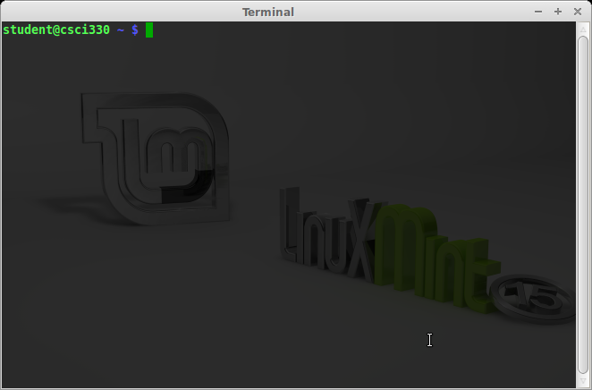
UNIX Shell: traditional user interface
“in the terminal at the command line”
  via “Terminal Emulator”
  via “putty”
Features:
  interprets and executes commands
  remembers command history and allows editing
  allows command submission as background jobs

Slide 3
Command Line Structure
% command [-options] [arguments]
UNIX is case sensitive
Must be a space between command, options and arguments
No space between the plus or minus sign and option letter
Fields enclosed in [ ] are optional
Command prompt
Command name
Command modifier: usually one character preceded by + or - sign
Arguments can be:
names of files
more information

Slide 4
Command Line Example
  % sort list
  % sort -r list
  % sort -o sorted list
Command
argument
Command name
Command option
Option argument

Slide 5
Some Basic Commands
passwd - change password
ls - list files
more - show content of file, page by page
logout - logout from system
date - display date and time
who - display who is on the system
clear - clear terminal screen
man - find and display system manual pages

Slide 6
RTFM: The man Command
show pages from system manual
Syntax: man [options] [-S section] command-name
  % man date
  % man -k date
  % man crontab
  % man -S 5 crontab
Caveats:
Some commands are aliases
Some commands are part of shell
Section | Description
1 | User commands
2 | System calls
3 | C library functions
4 | Special system files
5 | File formats
6 | Games
7 | Miscellaneous features
8 | System administration utilities

Slide 7
The Unix file system
hierarchical organization of files
  contains directories and files
  always single tree
basic commands to list and manipulate files
  independent of physical file system organization
typical Unix file system types
  ext4 (formerly ext2, ext3)
  Reiser4, UFS (… HFS+), JFS, …
  also: vfat, ntfs

Slide 8
Directory terminology
Root Directory: /
  top-most directory in any UNIX file structure
Home Directory: ~
  directory owned by a user
  default location when user logs in
Current Directory: .
  default location for working with files
Parent Directory: ..
  directory immediately above the current directory

Slide 9
Path
path: list of names separated by “/”
Absolute Path
  Traces a path from root to a file or a directory
  Always begins with the root (/) directory
  Example: /home/student/Desktop/assign1.txt
Relative Path
  Traces a path from the current directory
  No initial forward slash (/)
    dot (.) refers to current directory
    two dots (..) refers to one level up in directory hierarchy
  Example: Desktop/assign1.txt

Slide 10
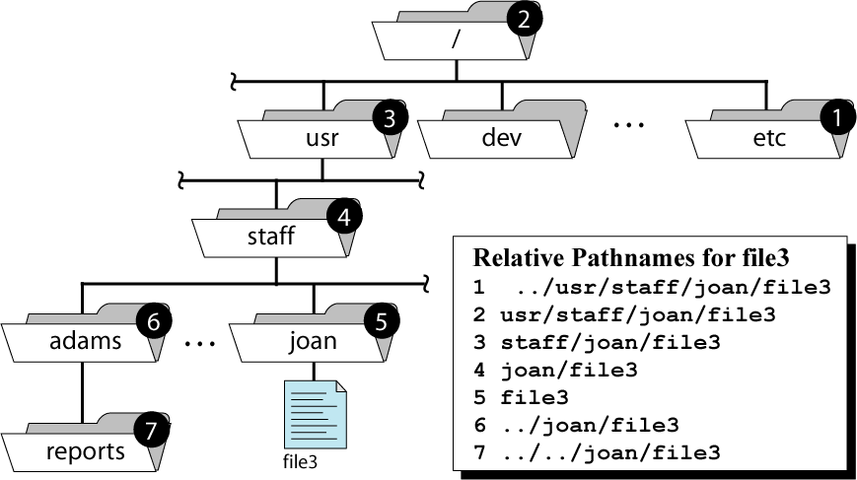
Path to file3
Absolute Path: /usr/staff/joan/file3

Slide 11
Directory commands
pwd to show path of current working directory
cd to change the current working directory
mkdir to create a new directory
rmdir to delete an empty directory
  use “rm -r” to remove non-empty directory

Slide 12
List directory content
most frequently used file system command:
Syntax:
  ls [options] [path]
common options:
-a show all files
-l show long version of listing
-t show files sorted by time stamp
-S show files sorted by file size
-r show files in reverse sorted order

Slide 13
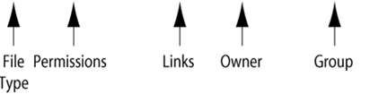
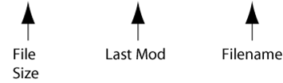
Long List Option
List contents of the current directory in long format
% ls -al
total 126
drwxr-xr-x 13 ege csci 1024 Apr 26 15:49 .
drwxr-xr-x 15 root root 512 Apr 24 15:18 ..
-rwxr--r-- 1 ege csci 885 Dec 2 13:07 .login
-rwx------ 1 ege csci 436 Apr 12 11:59 .profile
drwx------ 7 ege csci 512 May 17 14:11 330
drwx------ 3 ege csci 512 Mar 19 13:31 467
drwx------ 2 ege csci 512 Mar 31 10:16 Data
-rw-r--r-- 1 ege csci 80 Feb 27 12:23 quiz.txt
. is current directory
.. is parent directory
dot (.) names are hidden files
directories
plain file

Slide 14
File System Commands
Copying files or directories
Syntax: cp source(s) target
  source(s) is one or more items to copy
  target is either name of copied item, or directory
  commonly used options:
  -i if “target” exists, then prompts for confirmation before overwriting
  -r recursively copy entire directories
  -p preserve access times and permission modes
Moving files or directories
  Syntax: mv source(s) target

Slide 15
Renaming files or directories
use “mv”
Example: rename file “unix” to “csci330”
  % mv unix csci330
Caveat:
what happens if “csci330” exists and is a directory ?

Slide 16
Deleting files or directories
Syntax: rm path-list
Commonly used options:
  -f force remove regardless of permissions
  -i prompt for confirmation before removing
  -r removes everything under the indicated directory
Example: remove file “old-assign”
  % rm unix/assign/old-assign

Slide 17
Linking Files
Allows one file to be known by different names
Link is a reference to a file stored elsewhere
2 types:
  Hard link (default)
  Symbolic link (a.k.a. “soft link”)
Syntax: ln [-s] target local

Slide 18
Link illustration
create entry “bb” in “dir3” as link to file “aa” in “dir1”
% cd /home/student/dir2/dir3
% ln /home/student/dir1/aa bb
home
student
dir1
dir2
aa
dir3
bb
-s

Slide 19
File System Layout
file consists of:
  data blocks: identified by block numbers
  file meta information: inode
    contains which blocks make up file, owner, permissions, etc.
    stored in inode table
    index into table is inode number
directory is table of:
  file name -> inode number

Slide 20
Hard Link example: ln
Contents of dir1
inode table
.
. | 1076
.. | 2083
aa | 2407
home
2406
2407
student
2408
.
dir1
dir2
disk blocks
.
Contents of dir3
aa
dir3
. | 1070
.. | 2050
bb | 2407
file data
bb

Slide 21
Symbolic Link example: ln -s
Contents of dir1
inode table
.
. | 1076
.. | 2083
aa | 2407
home
2598
2599
student
2600
.
dir1
dir2
disk blocks
.
Contents of dir3
aa
dir3
. | 1070
.. | 2050
bb | 2599
/home/student/
dir1/aa
bb

Slide 22
Link type comparison
Hard Link | Symbolic Link
Checks for the existence of the original file The original file continues to exist as long as at least one directory contains it Cannot link to a file in a different file system | Created without checking the existence of the original file Cannot access the original file if its path has restricted permissions Can cross physical file systems Can be circular linked to another symbolic linked file

Slide 23
Locating Files: find
Syntax: find path-list expression(s)
“find” recursively descends through directories in path-list and applies expression to every file
Examples:
find . -name “*.txt”
find /tmp -empty -delete

Slide 24
Many more commands …
touch
updates time stamp on file or directory
can be used to create new, empty file
cat
displays content of file(s)
more, less or pg
display the contents of file(s) one page at a time
  Space bar – to advance to next page
  b – to go back a page
  Enter Key – to advance to next line

Slide 25
… more commands …
head
displays the beginning portion of indicated file(s);
the default head size is 10 lines.
tail
displays the ending portion of indicated file(s)
wc
display the size of files
common options:
  -l display the number of lines
  -w display the number of words
  -c display the number of characters

Slide 26
Comparing Files: diff
compare two files line by line
Syntax: diff [options] file-1 file-2
reports a series of commands that can be used to convert the first file to the second file via the “patch” command

Slide 27
Compress File Contents
utilities to compress and uncompress files
common on Linux:
  gzip, gunzip, zcat
  file extension: .gz
Example:
  % gzip assign1.txt
  % zcat assign1.txt.gz
  % gunzip assign1.txt.gz
Also:
  bzip2 better compression
  Windows compatible: zip/unzip

Slide 28
Sorting Files
Syntax: sort [options] file-name
Commonly used options:
  -r sort in reverse order
  -n numeric sort
  -t field delimiter (default: blank)
  -k field1[,field2]
  -f ignore case

Slide 29
User’s Disk Quota
quota is upper limit of
  amount disk space
  number of files
for each user account
command: quota -v
  displays the user’s disk usage and limits
2 kinds of limits:
  Soft limit: ex. 100MB
    Maybe exceeded for one week
    System will nag
  Hard limit: ex. 120MB
    Cannot be exceeded

Slide 30
Sending Files to the Printer
Syntax: lpr [options] file
option –P to specify printer: lpcsl (others: lpfrl)
Example:
% lpr –P lpcsl assign1.cc
other commands:
  lpq show print job queue
  lprm remove job from queue

Slide 31
Summary
shell is traditional command line user interface
hierarchical organization of files
basic commands to list and manipulate files

