Slide 1
CSCI 330
UNIX and Network Programming
Unit I
Introduction

Slide 2
Overview of Today’s class
Syllabus
Access to a UNIX system
History of UNIX
Modern UNIX/Linux

Slide 3
CSCI 330 – UNIX and Network Programming
Catalog Description:
UNIX system usage and commands. Shell script programming. Network programming concepts and protocols. System call level and basic network programming in C++. Extensive laboratory work.
Prerequisites:
CSCI 240 - Computer Programming in C++

Slide 4
Course Content
Basic UNIX system usage: file system, editors, commands
C++ programming: file access, permissions
Shell programming
System level C++ programming
Networking, TCP/UDP concepts: sockets
C++ network programming: TCP/UDP
Awk & sed programming
UNIX Administration

Slide 5
How to reach us
Instructor: John Berezinski
  Office: PM 354
  Hours: Mo/We 1pm to 2pm, or by appointment
  Email: berezin@cs.niu.edu
TAs:

Slide 6
Course Materials
8GB USB memory stick (required):
  formatted for NTFS (not FAT32) file system
  to hold the virtual disk image for Linux
Textbook (optional):
A Practical Guide to Linux, Mark Sobell, Prentice Hall
Online notes
faculty.cs.niu.edu/~berezin

Slide 7
Grading
The course website resides within the NIU Blackboard systems.
Students are responsible for checking announcements regularly.
The course features quizzes (online via Blackboard), assignments (no late assignments will be accepted), one midterm and one final exam (no make-up exams allowed, unless arranged with instructor in advance).
The final exam will be held December 9 according to the official NIU final exam schedule.
The following weights will be used in determining your final grade:
10% quizzes, 40% assignments, 20% midterm exam, 30% final exam.
The following thresholds will be used in computing your course grade:
A 93%, A- 90%, B+ 86%, B 83%, B- 80%, C+ 76%, C 70%, D 60%,
F less than 60%

Slide 8
Access to UNIX System
we will run individual
Linux system
via virtualization software
VMware Player
  installed on Lab computers
  download your own: vmware.com/player
stored on 8GB USB memory stick
  formatted with NTFS

Slide 9
More ways to get to a UNIX System
use CSCI servers
  turing.cs.niu.edu or hopper.cs.niu.edu
  login via remote secure shell, e.g. putty
install your own Linux system
  on spare machine
  as dual boot
Apple MacOS X

Slide 10
History of UNIX
Invented by Ken Thompson at Bell Labs in 1969
  first version written in assembly language
  single user system, no network capability
Thompson, Dennis Ritchie, Brian Kernighan
  rewrote Unix in C
Unix evolution:
  Bell Labs, USL, Novell, SCO
    BSD, FreeBSD, Mach, OS X
    AIX, Ultrix, Irix, Solaris, …
  Linux: Linus Torvalds
Newest:
  Linux on portables: Android

Slide 11
What Can UNIX Do for You ?
User Tools
  text processing (vi, sed, awk)
  productivity applications (web, mail, chat)
  entertainment (music, video)
Programmer Tools
  scripting: sh, awk, sed, perl
  compilers (C, C++, Java)
  programming tools: geany, eclipse
  source code control systems
E-commerce server
  mail server
  web server
  application server
  database server

Slide 12
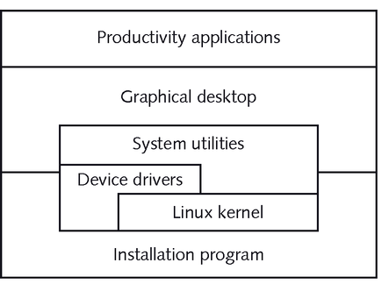
Components of UNIX
Distribution ?

Slide 13
Linux Distributions
Redhat
  Fedora
Debian
  Ubuntu
    Mint
Suse
  OpenSuse
…
www.distrowatch.com

Slide 14
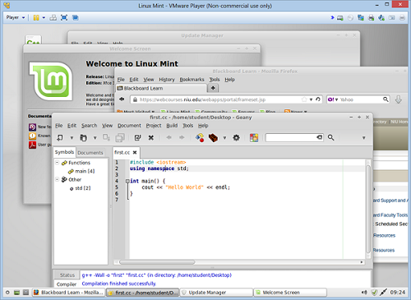
Linux Mint Tour

Slide 15
Summary
Syllabus
Access to a UNIX system
History of UNIX
Modern UNIX/Linux

